Slide 1
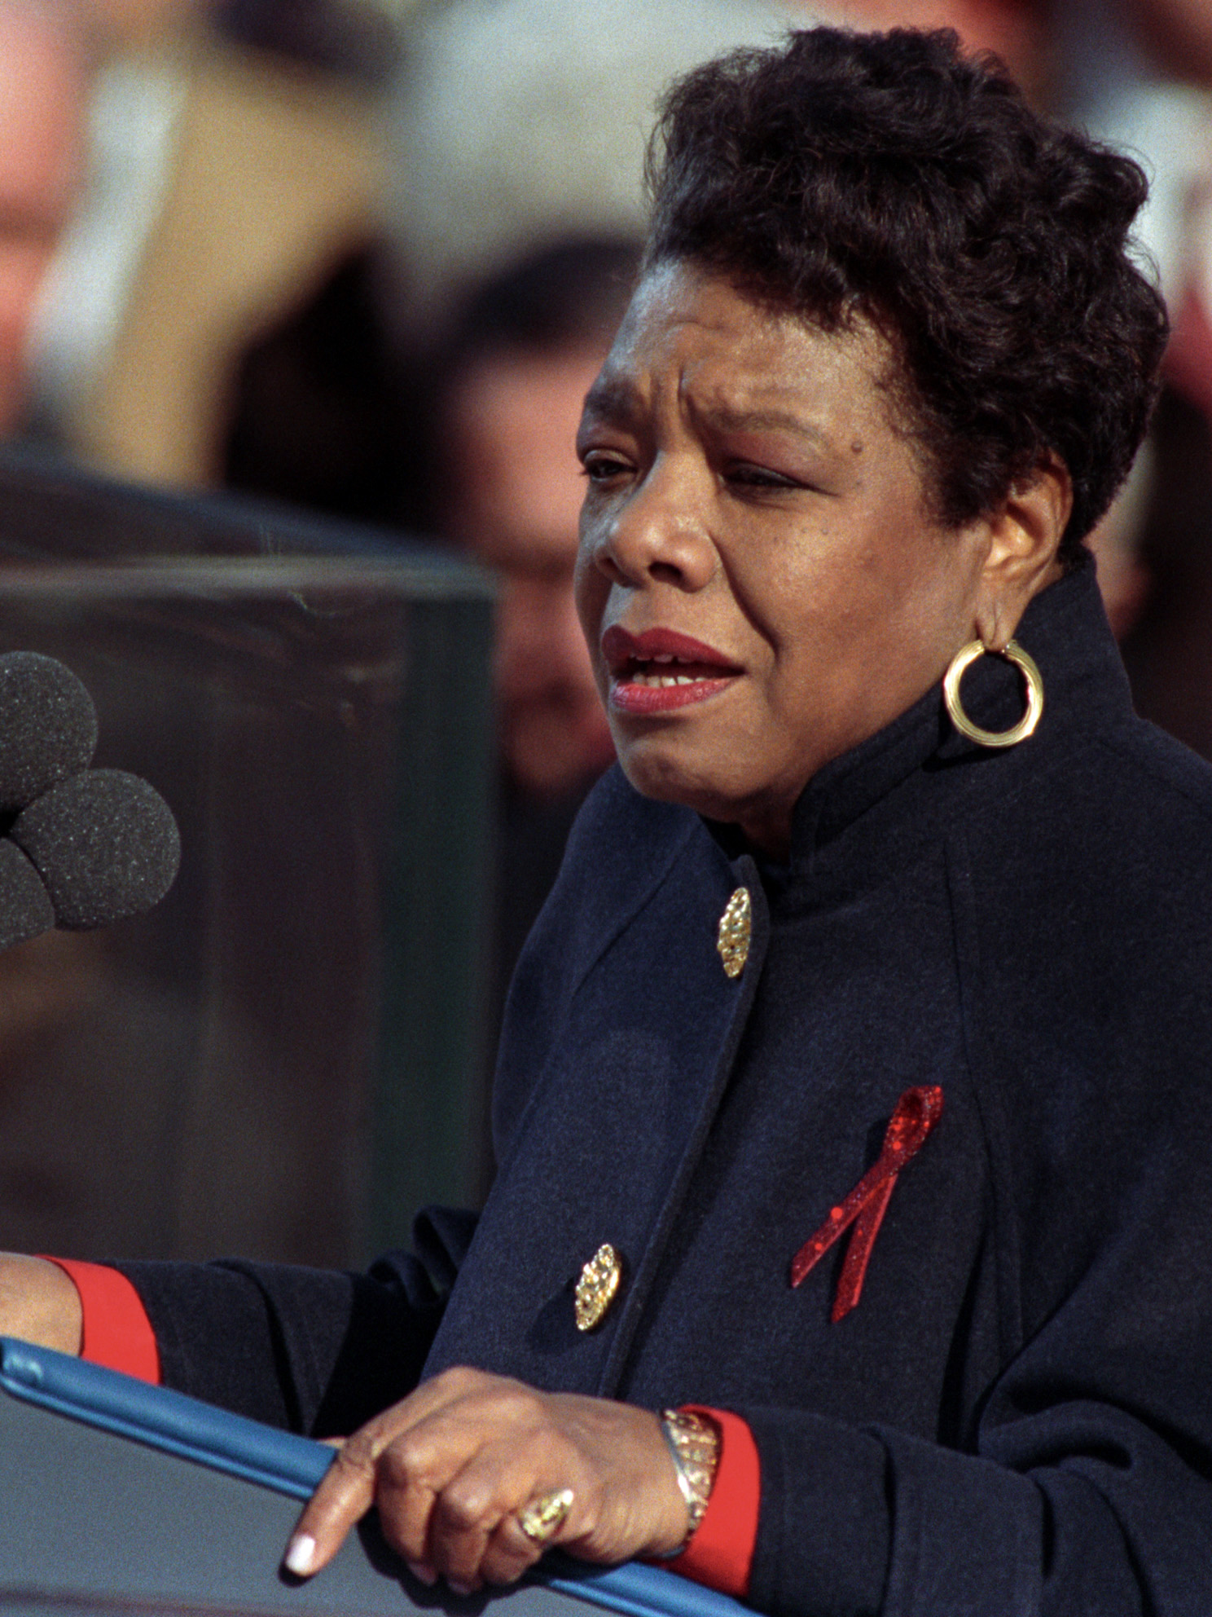
Maya Angelou
“Do the best you can until you know better. Then when you know better, do better.”

Slide 2
Dignity Model – Donna Hicks (2013)
Human desire to be treated with dignity is “primal”
When violated, it can feel like a threat to our survival
Treating people with dignity leads to more fruitful interaction
Notes:
Ralph

Slide 3

Hicks has defined dignity as “the glue that holds all of our relationships together” and “the mutual recognition of the desire to be seen, heard, listened to, and treated fairly; to be recognized, understood, and to feel safe in the world.”
Notes:
The principle of human dignity -
Hicks has defined dignity as “the glue that holds all of our relationships together” and “the mutual recognition of the desire to be seen, heard, listened to, and treated fairly; to be recognized, understood, and to feel safe in the world.”
“The emotional volatility associated with having our dignity honored or violated cannot be overstated. When people feel that their value and worth are recognized in relationships, they experience a sense of well-being that enables them to grow and flourish. If, in contrast, their dignity is routinely injured, relationships are experienced as a source of pain and suffering…. Why is this knowledge important for leadership? If we are going to lead people, we better understand them.”

Slide 4
“The emotional volatility associated with having our dignity honored or violated cannot be overstated. When people feel that their value and worth are recognized in relationships, they experience a sense of well-being that enables them to grow and flourish. If, in contrast, their dignity is routinely injured, relationships are experienced as a source of pain and suffering…. Why is this knowledge important for leadership?
If we are going to lead people, we better understand them.”
Notes:
Promotes healing, support and care
The principle of human dignity -
Hicks has defined dignity as “the glue that holds all of our relationships together” and “the mutual recognition of the desire to be seen, heard, listened to, and treated fairly; to be recognized, understood, and to feel safe in the world.”
“The emotional volatility associated with having our dignity honored or violated cannot be overstated. When people feel that their value and worth are recognized in relationships, they experience a sense of well-being that enables them to grow and flourish. If, in contrast, their dignity is routinely injured, relationships are experienced as a source of pain and suffering…. Why is this knowledge important for leadership? If we are going to lead people, we better understand them.”

Slide 5
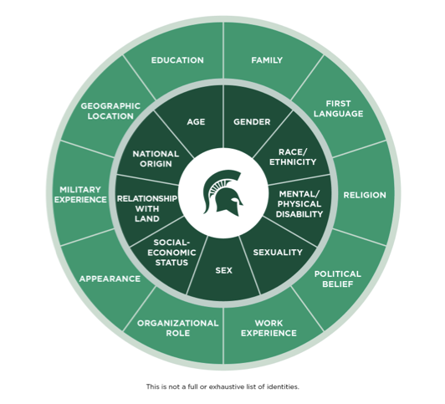
Social Identities
Notes:
As you review this chart from the upcoming DEI foundations program, think about your own social identities. Within the center ring are some identities that are more fixed and in the outer ring are identities that ten to be fluid or less fixed. Imagine having to take one or several identities and having to leave it behind. There may be some people that you work with now who have to leave a part of themselves or a portion of their identity hidden for their own safety or wellbeing.
Psychological safety-
May not feel as connected with you.

Slide 6
Bias
We all have biases
They impact our interactions and communication:
Level of service
Length of time you spend with a person
Interactions (face to face, telephone, email)
It does not make one a “good” or “bad” person
It means we have something to learn or unlearn

Slide 7

Bias
Explicit Bias
Attitude and beliefs that we have about a person or group on a conscious level. We are fully aware of these, so they can be self-reported.
LINE OF CONSCIOUSNESS
Unconscious Bias
Unconscious attitude that lie below the surface, but may influence our behaviors.
Notes:
Explicit Bias
Attitude and beliefs that we have about a person or group on a conscious level. We are fully aware of these, so they can be self-reported.
Implicit Bias
Unconscious attitude that lie below the surface, but may influence our behaviors.
Implicit Bias could also refer to bias living in policies and practices. This could be the result of policies created by those with overt bias, who have passed on those policies to others to carry out.
[Also, you could draw a line to one of those chunks under the surface to identify implicit bias living in policy]

Slide 8
Reducing Bias
Neuroplasticity
The brain is continuously reorganizing itself, creating new connections between neurons throughout the life span
Awareness and intentionality
Moves from automatic process to controlled process until it becomes automatic again
Notes:
You do not get to the full picture with one piece of the puzzle
Exposure to narratives that are different from your own will help you to interrupt your own biases. We cannot get rid of bias, but we can interrupt them.

Slide 9
The Impact of Inclusion
Increased (academic) achievement
Higher self-esteem and greater confidence in creative problem-solving
Improved critical thinking and openness to intellectual challenges
Increased awareness of social problems, civic engagement, and empathy
Increased sense of belonging
Reduced prejudice across difference and increased meaningful relationships across difference
These effects are long-term and consistent across age groups
Notes:
Inclusion benefits us all. From toddlers to elders inclusion is an important part of wellbeing. As humans, we need social interaction, support, love, and to belong. Our brains crave this interaction. We know that isolation can be detrimental to our physical and mental health, with long lasting effects and impacts. We experience social isolation in the same part of the brain as we do physical pain. There are costs when we do not have inclusive spaces, in our workforce, talent, ideas and more. We may lose out on valuable team members with great ideas to share if they do not feel safe to share in the space their in.
Inclusion invites diversity of thought, perspectives, people and ways of being. When people can feel safe to show up as themselves,

Slide 10
What is Oppression?
"Oppression" refers to a combination of prejudice and institutional power that creates a system that regularly and severely discriminates against some groups and benefits other groups
Oppression: a situation in which people are governed in an unfair and cruel way and prevented from having opportunities and freedom
https://nmaahc.si.edu/
https://dictionary.cambridge.org/
Notes:
Share out slide:
A person of the non-dominant group can experience oppression in the form of limitations, disadvantages, or disapproval. They may even suffer abuse from individuals, institutions, or cultural practices. "Oppression" refers to a combination of prejudice and institutional power that creates a system that regularly and severely discriminates against some groups and benefits other groups.
Oppression: a situation in which people are governed in an unfair and cruel way and prevented from having opportunities and freedom
https://nmaahc.si.edu/learn/talking-about-race/topics/social-identities-and-systems-oppression
https://dictionary.cambridge.org/us/dictionary/english/oppression

Slide 11

Oppression is an Umbrella Term
Oppression
-isms
Phobias
an extreme or irrational fear of or aversion to something
Some examples:
Fatphobia
Islamophobia
Transphobia
Xenophobia
an oppressive and discriminatory action or belief
Some Examples:
Ableism
Ageism
Anti-Semitism
Colorism
Elitism
Heterosexism
Racism

Slide 12
Power/Positionality
Social group(s)
People who share a range of physical, cultural or social characteristics within one of the social identity categories (Social class, Race, Gender, Religion, Education)
We have may have a variety of social identities
These identities may hold power and privilege in a variety of ways
Intersectionality (Crenshaw, 1989)
Our various identities work at different levels that can bring advantages, disadvantages, barriers, opportunities, we cannot be reduced to one part of our identity, multiple levels of oppression may combine or overlap

Slide 13
Intent Vs. Impact
Intent
What you think or feel
What you thought you were doing
What you aimed to achieve through an action
Impact
How your actions make other people feel
How your action was perceived by others
How a person/people/community receive your action
Notes:
Examples

Slide 14
A Scenario...
https://mediaspace.msu.edu/media/Toxic+Workplace/1_957mkywe
Notes:
https://mediaspace.msu.edu/media/Toxic+Workplace/1_957mkywe

