Slide 1
Management of cases Reported TO the Office for Civil Rights & Title IX
Process & Responsibilities

Slide 2
Strategic Partners
Nicole Schmidtke, Faculty and Academic Staff Affairs, messin41@msu.edu
Amanda Moses, Employee and Labor Relations, mosesa@hr.msu.edu​
Rob Kent, Interim Executive Director and Senior Deputy Title IX Coordinator, isr.robkent@msu.edu
​
​
​

Slide 3
WARNING
This presentation refers to an example of sexual misconduct.
If you believe that you will find the discussion to be traumatizing, you may choose to not participate in the meeting or step away from the discussion.
Resources and assistance are available through the Center for
Survivors and the Employee Assistance Program.

Slide 4
ACRONYMS
ADP (Anti-Discrimination Policy)
FASA (Office for Faculty and Academic Staff Affairs)
OCR (Office for Civil Rights and Title IX Education and Compliance)
ISR (Investigation, Support and Resolution – the division in OCR that used to be referred to as OIE)
ELR (Employee and Labor Relations)
OGC (Office of General Counsel)
OHS (Office of Health Sciences)
RVSM (Relationship Violence and Sexual Misconduct and Title IX Policy)

Slide 5
Objectives
Increase understanding of the OCR process and your role as an administrator
Establish the importance of working closely with FASA, ELR and OHS throughout this process, so that you have the support needed
Identify possible action steps to assess and address misconduct related to reports made to OCR

Slide 6
Office for Civil Rights, & title IX education & Compliance
Prevention, Outreach, and Education Department (POE)
Investigation, Support and Resolution
  Support and Intake Team (SIT)
  Director, RVSM Response & Investigations
  Director, ADP Response & Investigations
  Resolution Office (RO)
Office of the ADA Coordinator
Office of the Vice President
  PACE (Projects, Analytics, Compliance and Envisioning)
  Equity Review Officer
  Advisors

Slide 7

OCR Overview

Slide 8
Human resources STRUCTURE @ MSU
FASA Bucket
ELR Bucket
Provost
Associate Provost and Associate VP
for Faculty and Academic Staff Affairs
5,600 faculty, academic staff and executive managers
Executive Dean, Health Sciences
EVP Administration
Vice President and CHRO
7,000+
support staff

Slide 9
What is misconduct?
Wrongful conduct, by the University or a University community member that is illegal under applicable federal, state, or local laws, is fraudulent, or is in violation of any of the University’s policies or procedures. Misconduct includes, but is not limited to, violations of University policy and the law including academic misconduct, fraud, unauthorized use of the University’s property or resources, fraudulent or dishonest financial reporting, bribery, or kickbacks.
Notes:
Poll

Slide 10
Policy Overview
Faculty & Academic Staff
Faculty Rights and Responsibilities** (Recently Updated)
Code of Teaching Responsibility
Consensual Amorous or Sexual
Relationships with Students
Outside Work for Pay
Research Misconduct
University-Wide
Relationship Violence and Sexual Misconduct & Title IX Policy
Anti-Discrimination Policy
Mandatory reporting of RVSM
Acceptable Use Policy for MSU Information Technology
Occupational Health and Safety Rules & Regulations
Interim Protection from Retaliation* (New)
Support Staff
Support Staff Rules Governing Personal
Conduct of Employees

Slide 11
Who to call?
You hear that an Academic Specialist in your unit may have sexually harassed a support staff employee in your unit?
You heard that a support staff manager in your area was bullying their direct report employees and yelling at them?
A faculty member comes to you to report that students in their class engaging in a group assignment are experiencing conflict and one of the students has reported that the other student may have engaged in plagiarism?
A faculty member comes to you to report that after they reported their senior faculty last month for misconduct, the senior faculty is retaliating against them?
OCR
ELR
Chair/Grad Program Director
FASA

Slide 12

Questions?

Slide 13

OCR's Initial Response and Notification Process

Slide 14

Report Submitted to OCR: Initial Assessment
Notifications to Other Units
Referrals
Outreach
Closure Considerations

Slide 15

OCR Notification of Reported Behavior
Consult with FASA, ELR, OHS to review
Consider whether interim action may be needed
Do not investigate
Do not retaliate
OCR Notification to Senior Admins, FASA or ELR*
  *FASA: If the respondent is FAS or EM
  ELR: If the respondent is Support Staff

Slide 16
Hello,
​​​​​​​
My name is [[SENDER_FULL_NAME]] with the Office for Civil Rights and Title IX Education and Compliance (OCR) at MSU. OCR is responsible for responding to possible violations of the Relationship Violence & Sexual Misconduct and Title IX Policy (RVSM) and the Anti-Discrimination Policy (ADP). You are receiving this notification based on your current listed role on campus.
OCR received a report about concerns involving Respondent Employee RESPONDENT FULL NAME, RESPONDENT TITLE, AND RESPONDENT ID NUMBER
Claimant impacted by the conduct is CLAIMANT FULL NAME, CLAIMANT TITLE, AND CLAIMANT ID NUMBER.
At the present time, OCR is aware of the following information:
INSERT BULLET DESCRIPTION OF ALLEGATIONS AND OTHER RELEVANT INFORMATION AND INCLUDE ATTACHMENTS IF NECESSARY
OCR is also aware of the following reports or complaints previously made about Respondent:
INSERT BULLET POINTS LISTING OF CASE NUMBERS AND BRIEF SYNOPSIS, INCLUDING HOW THE MATTER WAS RESOLVED

Slide 17
OCR has the reviewed the submitted report and based on the information available at this time, OCR will be closing this matter for the following reason:
The information available does not demonstrate coverage under OCR polices.
The information provided is insufficient for an investigation into this matter without claimant participation.
The information provided is insufficient for an investigation into the matter because the respondent has not been identified.
The facts provided, taken as true would not demonstrate an OCR policy violation.
We are referring the matter to you for review to take potential action as deemed necessary to address conduct that may implicate policies, protocols, or standards of conduct other than the ADP/RVSM policy. Please consult with Human Resources for further guidance on the available options and implementation of employment actions and notify OCR if action is taken. In the event you have additional information that may change OCR's review, please do not hesitate to contact us immediately.
Prohibition on Retaliation...
Privacy notice...

Slide 18
Questions?

Slide 19

Interim Actions- FASA/ELR and the Unit Leaders Response

Slide 20
Protocol for Coordinated Response
OCR, FASA, ELR and OHS created shared protocol for coordinated response and information sharing between these units
The Protocol addresses each unit's role in the response and info sharing process from initial notification, interim and supportive measures to sanctioning or other follow up
https://civilrights.msu.edu/policies/Protocol-for-Coordinated-Response-11.1.24_.pdf

Slide 21
INTERIM Actions
Interim Employment Measures = Non-disciplinary, safety measures or measures to deter conduct during an investigation under RVSM Policy or ADP.
  Examples include: Verbal coaching, change of supervision, no contact directives, delaying performance reviews, paid administrative leave, etc.
Must talk to FASA, ELR, OHS (and Title IX Coordinator or Designee) prior to any action.
  Exception: Imminent Safety Concerns
Promptly notify FASA, ELR, OHS (and Title IX Coordinator or Designee) if measures implemented under other policy.

Slide 22

No interim actions
If no interim actions taken, you will wait for the findings concerning the ISR investigation and/or RO finding.
Remain observant of the situation and reach out to FASA, ELR, OHS if you have concerns.
You will get regular status updates from ISR and/or RO. If you have questions, reach out to ISR or RO.
You may address other workplace issues such as performance or policy violations. You should consult with ELR/FASA/OHS as appropriate.

Slide 23
Situational considerations
Health and safety concerns
How often the parties interact and how they interact
Power dynamics
Life experiences
  Awareness of multiple people within the unit potentially being involved in a case, witnesses resulting in divisions and residual conflict
  Reducing the ability for any retaliation
  Pattern of behavior

Slide 24
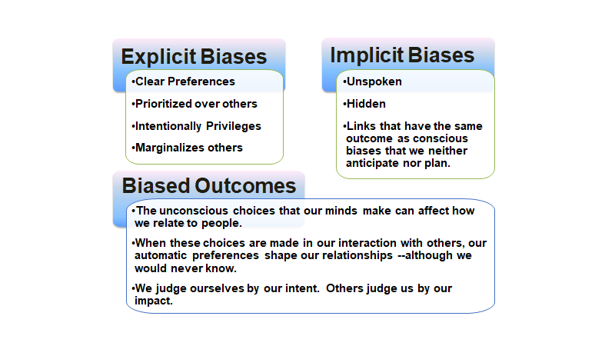
Individual Leadership Considerations

Slide 25

Case Scenarios and Application- Initial Notification and Interim Measures

Slide 26
Introduction of Peers
Carl Davidson, Assocaite Dean of Faculty Affairs, College of Social Science
Kelly High McCord, Chief of Staff, Student Life & Engagement

Slide 27

Case Scenario – Part 1-- Notification from OCR (FAS)
FAS/EM- You receive an initial notification from OCR regarding a tenured Professor in your College:
  The unidentified Claimant anonymous individual identifying themselves as a student, reports that they are in Full Professor's ABC 123 class this semester and they are experiencing unwanted attention from Full Professor and it is making them uncomfortable
  ant reports that Full Professor has invited them (and other students) to their office for a "drink" on multiple occasions, and so far, Claimant has found excuses to not go.
  Claimant stated they have heard from other students who took Full Professor's classes in the past, that he is "touchy" and "creepy"
  The anonymous reporter states that they are relying on this grade to boost their GPA, and thus, are afraid of retaliation. The reporter states they may feel more comfortable coming forward after the end of semester grades are submitted, which is 6 weeks away.

Slide 28

Your FASA liaison promptly schedules an interim measures meeting with the College leadership, FASA and OCR.
  At the meeting, the College tells the group that Full Professor is the expert in his area (ABC's) and is currently the PI on several NSF and NIH grants.
What questions do you have for FASA and/or OCR?
What potential interim measures are you considering based on this information?
  What information is missing that would be helpful to aid this decision?

Slide 29

Case Scenario – Part 1-- Notification from OCR (Support staff)
Support Staff - You receive an initial notification from OCR regarding Building Sanitation Worker in your Department:
  Claimant, a full time Office Coordinator I alleges “harassment” from Respondent, a full time Building Sanitation Worker.
  It is reported that the Respondent may have put their butt in Claimant's face and back into Claimant when Claimant would drop something on the floor or file items into the bottom drawer of the file cabinets.
  The Building Sanitation Worker may have also performed a sexual act on banana in front of Claimant.
  Claimant may believe that Respondent believes that the Claimant is a "white nationalist" which may have led to Respondent’s threats.

Slide 30

Case Scenario – Part 1-- Notification from OCR (Support staff)
Your ELR liaison promptly schedules an interim measures meeting with the you, your HR team, ELR and OCR.
What questions do you have for ELR and/or OCR?
What potential interim measures are you considering based on this information?
  What information is missing that would be helpful to aid this decision?

Slide 31
Claimant DOes not Participate- What happens now?
OCR will still evaluate the information and determine whether the Title IX Coordinator will sign a complaint
  If no TIX signed complaint, then the matter will close and will be referred to the Unit/HR
OCR closure DOES NOT mean that the Unit/HR's work is done
The information should still be evaluated for potential follow up

Slide 32
Questions?

Slide 33

OCR – Investigation and Resolution Process

Slide 34
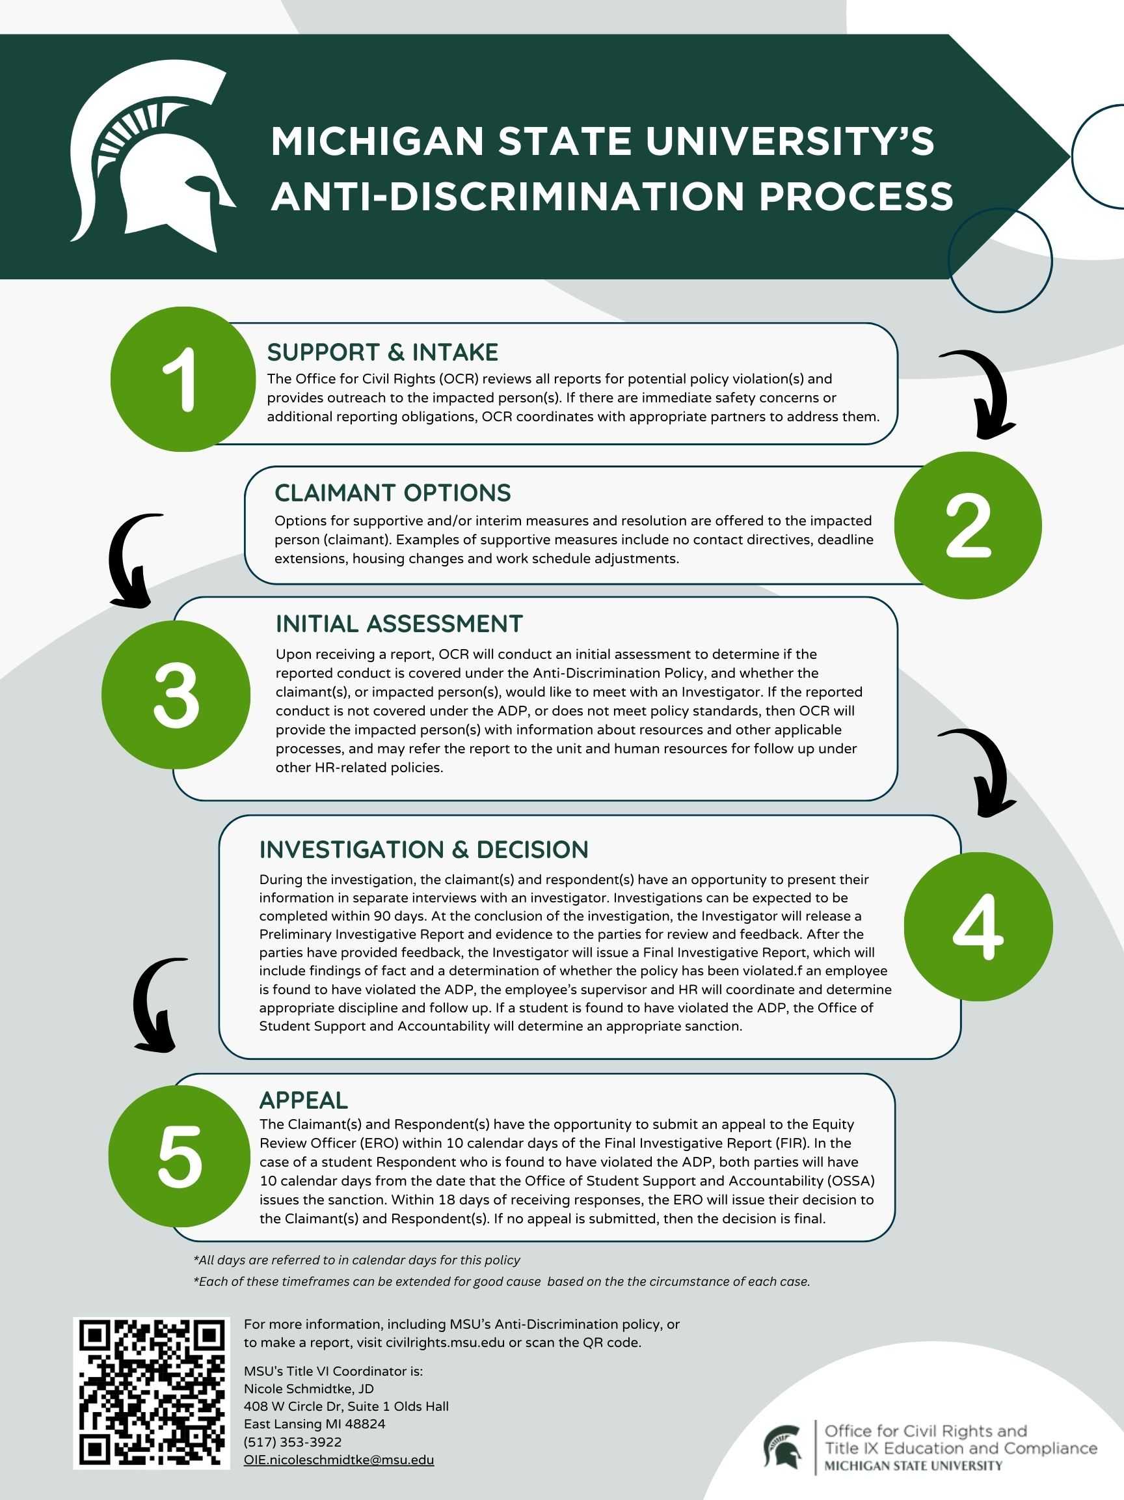

Slide 35
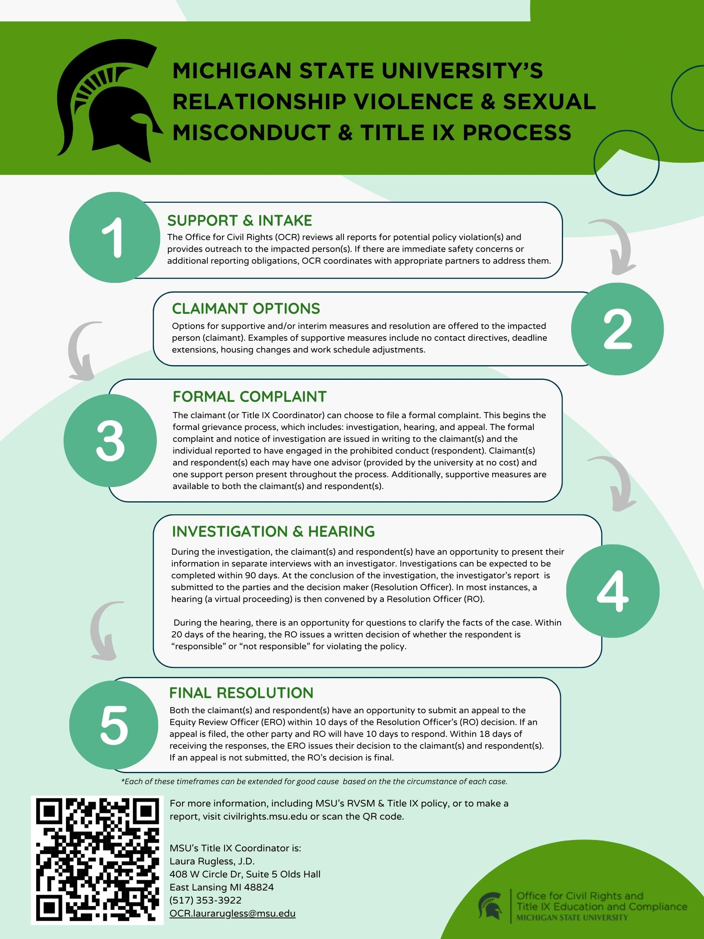

Slide 36
What is considered in an appeal
Procedural Irregularity
New Evidence
Conflict of Interest or Bias
Arbitrary and Capricious

Slide 37
Case Scenario Part 2- New Information During the Investigation (FAS)
A few weeks after the initial report, OCR informs you that they have identified the student Claimant, and that they are participating in the investigation. Now that they have met with the Claimant, they shared additional information:
  Claimant went to Full Professors office hours a few weeks ago because they were stuck on an assignment. Claimant said Full Professor leaned over to view Claimant's computer screen and placed their hand on Claimant's thigh. The Claimant shared that this touch did not feel accidental and Full Professor's hand remained there for at least 5 seconds.
  Claimant also identified three additional students who have reported similar behavior to Claimant. OCR has reached out to these students.
Your FASA liaison schedules another meeting to discuss interim measures.
  What interim measures are you considering based on this information?

Slide 38
Case Scenario Part 2- New Information During the Investigation (Support Staff)
Two months after the initial report, you have been informed that the Claimant has voluntarily quit due to being uncomfortable in the workplace. You have notified your ELR liaison and OCR.
Your ELR liaison schedules another meeting to discuss interim measures.
  What interim measures are you considering based on this information?
  Are there other considerations that you might have?

Slide 39
Questions?
Notes:
Amanda

Slide 40

FASA/ELR and the Unit- Post-Decision Response

Slide 41
FINDING: Violation of RVSM or ADP Policy
Schedule
Schedule a meeting with College/Department leadership, FASA/ELR, OGC, and OCR
Consider
Consider if other policies were violated and if further investigation of the issues is needed
Assess
Assess appropriate discipline or other interventions
Create
Create a plan to implement discipline and any necessary communications

Slide 42
Discipline Overview for Support STaff
Consult with ELR to ensure compliance with collective bargaining agreements and human resource policy.
Approval from the Director of Employee Relations is required for certain actions.
ELR can assist with required notifications/reporting

Slide 43
No finding
What does "No Finding" Really Mean?
Next Steps/Considerations:
Leadership meets with FASA, ELR or OHS to assess situation
Are there other behaviors or actions that are concerning?
Is further investigation needed (under other policies)?
Action steps to consider: professional development, re-entry, clarification of rules/policy, discipline, etc.
How do you rebuild the team?

Slide 44
Discipline overview for faculty & academic staff
Academic Specialist Handbook
Faculty Handbook
Fixed-Term
Tenure Stream Faculty
FRIB NCSL Handbook
Health Professional (HP) Handbook
Librarian Handbook
UNTF Contract

Slide 45
Case Scenario Part 3- Post Decision Response (FAS)
The Resolution Officer issues its final decision and the outcome is that Full Professor was found in violation of the University's RVSMTIX Policy for sexual harassment and non-consensual sexual contact.
Full Professor files an appeal. After the appeal process concludes, the Equity Review Officer finds that the Resolution Officer's decision stands.
The TIX Coordinator meets with the Claimants to discuss remedies and additional support.
Your FASA liaison schedules a meeting to discuss potential sanctions. The decision is made to terminate Full Professor through the dismissal for cause process.
  Apart from the disciplinary process, what other impacts could you foresee for this College/Department?

Slide 46
Case Scenario Part 3- Post Decision Response (Support Staff)
The Resolution Officer issues its final decision and the outcome is that Building Sanitation Worker was not found in violation of the University's RVSMTIX Policy or ADP.
There is no appeal filed by either party.
Your ELR liaison schedules a meeting to discuss next steps.
  What steps would you be taking next in relation to the respondent?
  What other impacts could you foresee for this Department?

Slide 47

Peer Leaders- Lessons learned?
Kelly & Carl

Slide 48
Questions?

Slide 49
Safe Environment ACTION Plan protocol
In 2022, a taskforce was empaneled by the Provost to review best practices around reintegrating employee respondents into the workforce post-OCR investigation
The taskforce's recommendations were published- Safe Environment Action Plans
The purpose of the Plan is to provide guidance to the unit on how to provide a safe and inclusive working environment post-OCR investigation, particularly in situations where respondents are re-integrated into the workplace
The Plan is then reviewed with the Review Team for consultation and feedback
After consultation with Review team, the Plan is finalized and implemented. FASA and the unit will review the Plan periodically and make adjustment as needed.
Review teams will be trained on the confidential nature of the process

Slide 50
Communication Review process for employee misconduct
Communications should reflect the University’s commitment to ensure a safe and respectful working and learning environment while adhering to employee privacy rights required by law.
The University endeavors to increase transparency, promote accountability, and build trust and awareness within the University community.
  Balance of transparency and confidentiality
  Stakeholder communication strategy
  Working with ELR/FASA, OCR, OGC, Presidential Advisors, and University Communications
  Considering communication in the context stage of the process and impact on stakeholders

Slide 51
Reporting
If interim actions or actions after a finding are taken, other oversight organizations may need to be notified
Clery Act – if the incident involved a Clery crime, the Clery Act Compliance Coordinator will be notified by FASA/ELR
Federal Agencies (NSF/NASA/NIH/DOD/DOE/USDA)
CGA website with requirements: https://www.cga.msu.edu/PL/Portal/2190/HarassmentReportingRequirementsbyAgencyEntityinBrief
OCR Resolution Office must be notified immediately of any disciplinary action taken
    Requirements under Title IX to notify claimant

Slide 52

Questions?

