Slide 1


Slide 2
MSU 2030 Plan...
Reframe, Refresh, Reimagine
What is It?
  It is not creating a new strategic plan
  It is an opportunity to survey the environment, reflect on lessons learned, and adjust our course to achieve our vision
Three Phases to Our Work
  Phase One – Reconsidering our Goals, Objectives, and Action Steps
  Phase Two – Reframing our Metrics and Benchmarks
  Phase Three – Implementation

Slide 3
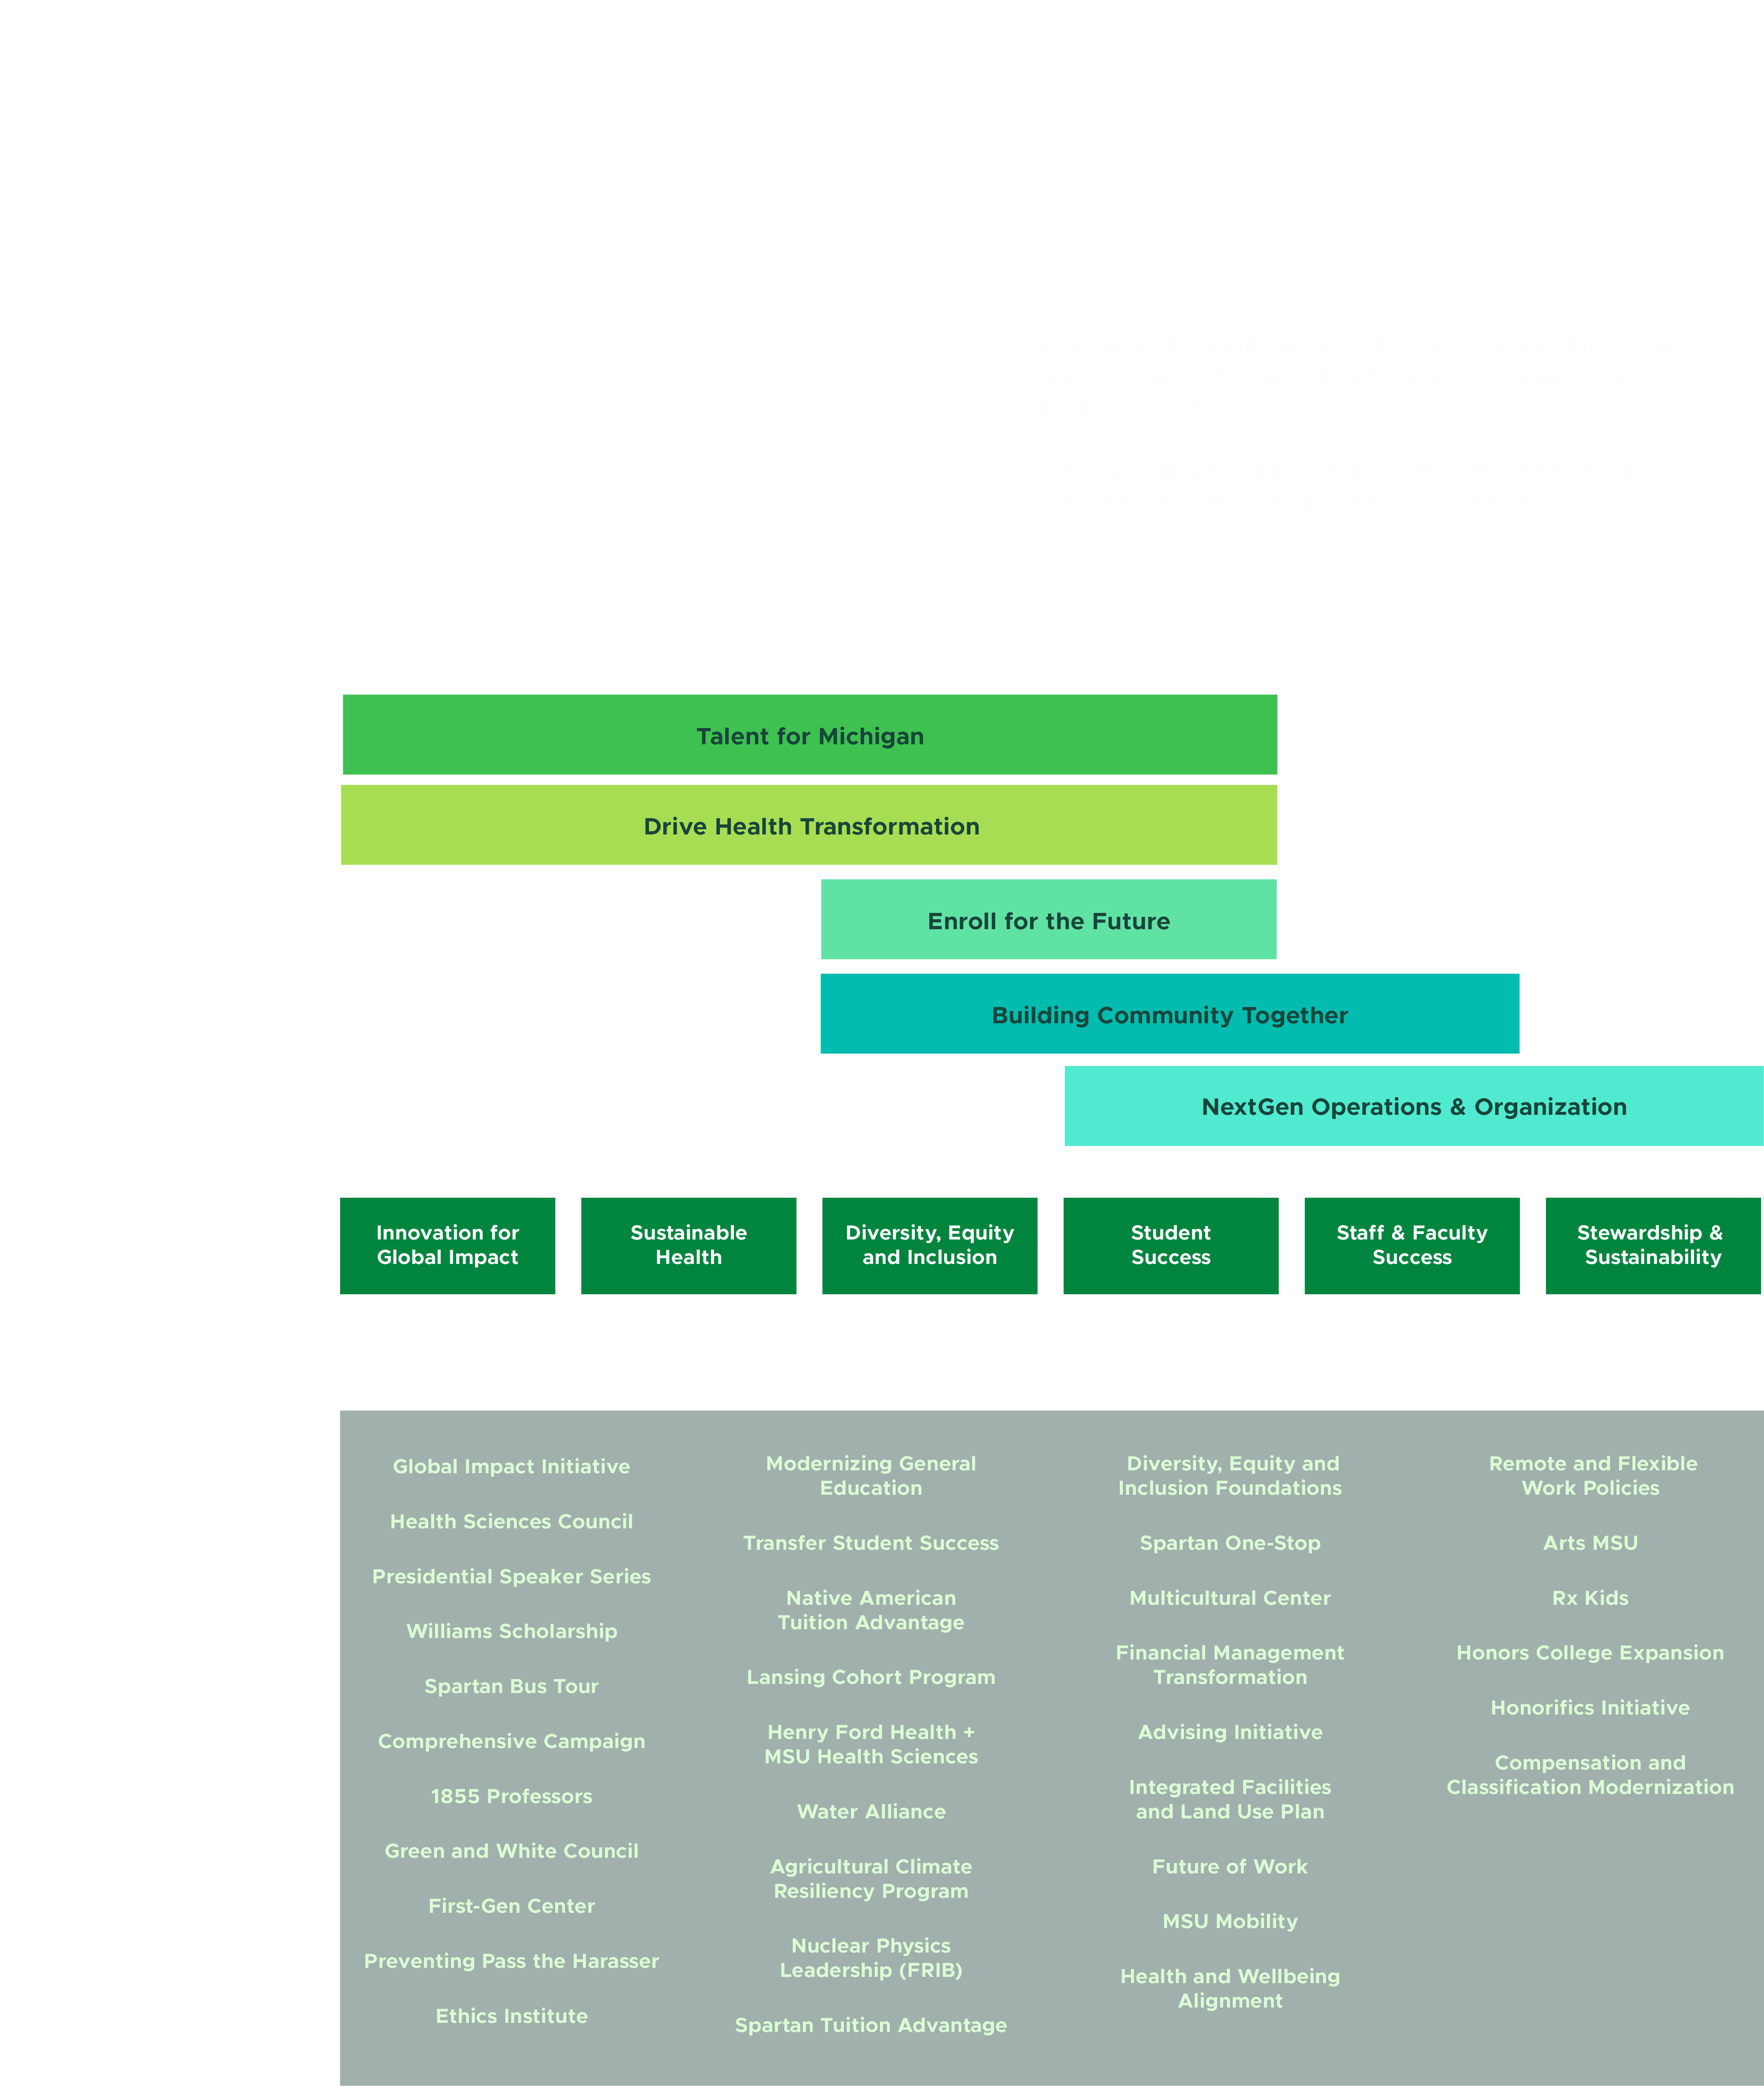
Notes:
Spartan Bus Tour visits

Slide 4

Notes:
Spartan Bus Tour visits

Slide 5
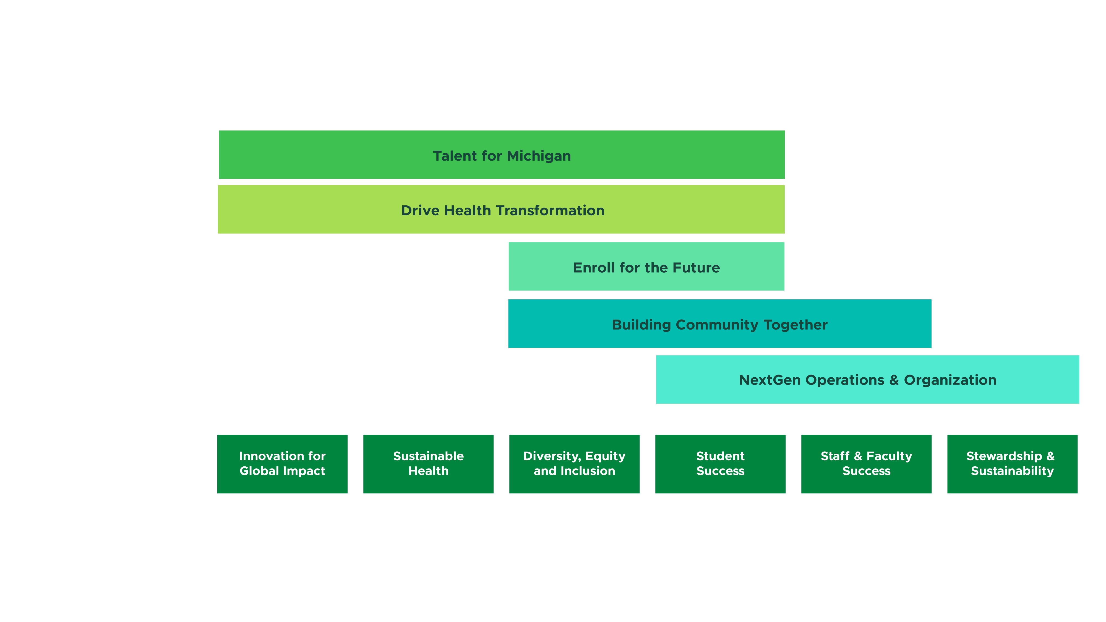
Notes:
Spartan Bus Tour visits

Slide 6
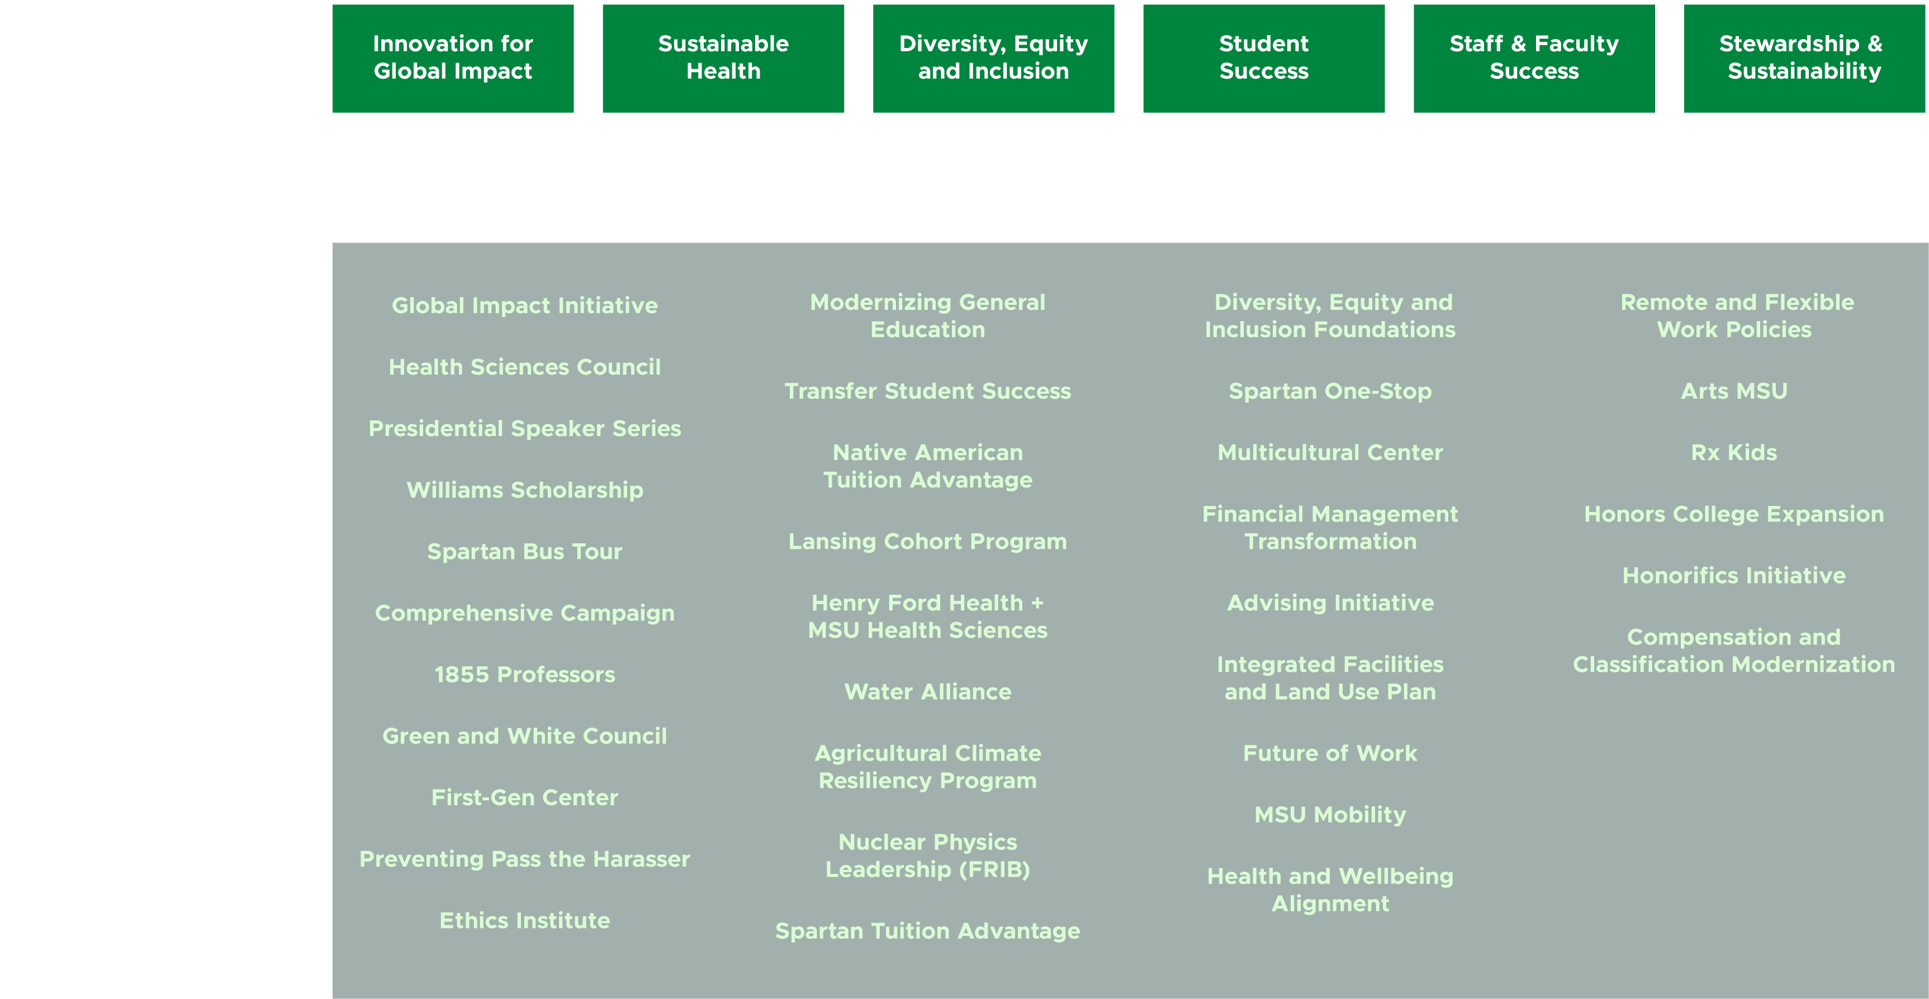
Notes:
Spartan Bus Tour visits

Slide 7
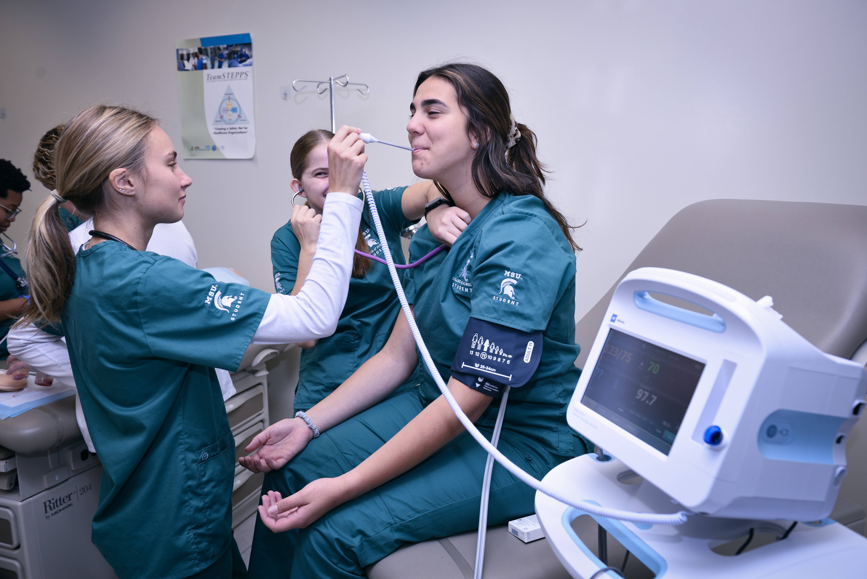
One Team, One Health
Michigan State is uniquely positioned to lead and shape the future of health sciences. We’re going to bring our strengths in human, animal and environmental health together to become a national powerhouse of healing. This new vision will benefit our students and the people of Michigan and beyond.

Slide 8
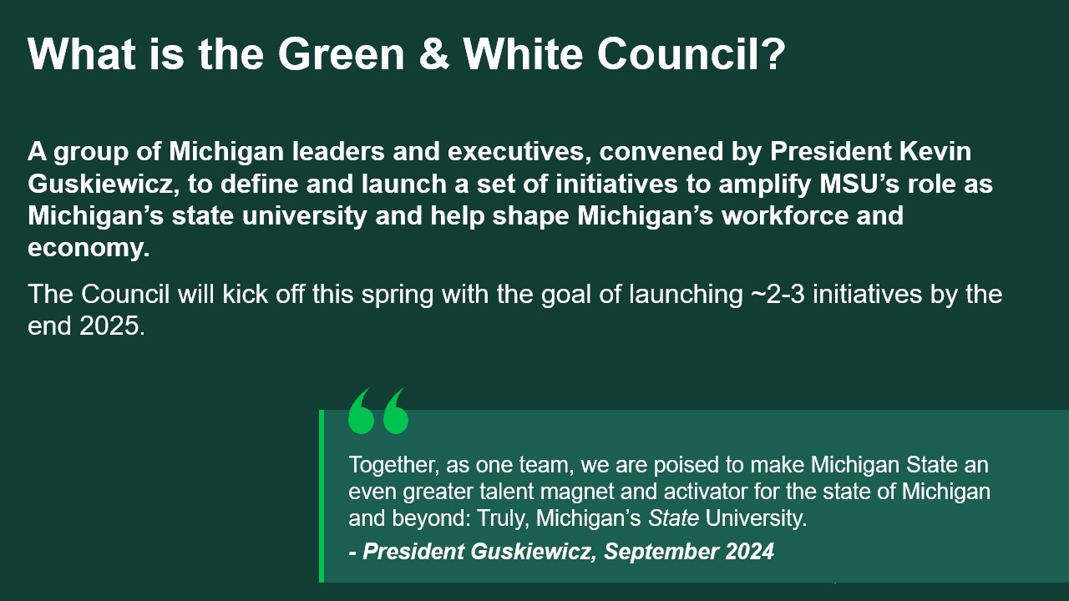

Slide 9
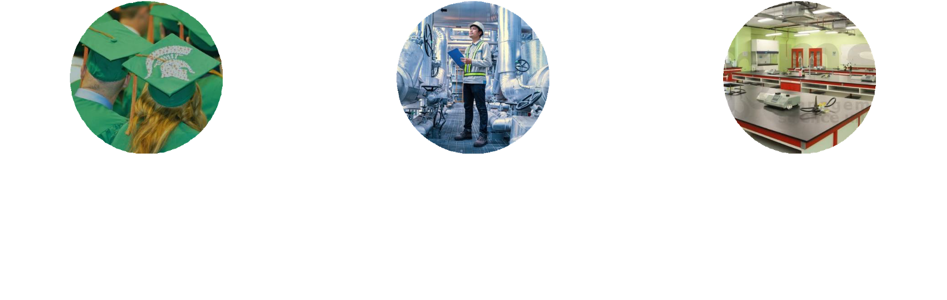
Three Goals of Green & White Council

Slide 10
MSU highlights: Michigan’s State University
1. National ranking has gone up 21 spots since 2020 and student interest in MSU has been accelerating. MSU has seen an 87% increase in applications over the last 10 years, which is 47pp higher than the average application growth rate for Michigan’s largest public universities.
2. MSU enrolls more in-state students than any other Michigan university and a higher share of in-state undergraduates than the Big 10 average (10pp higher). MSU enrolled ~38K total Michiganders in Fall 2024 compared to ~26K at the second-largest enroller of in-state students, UM.
3. There are 275K MSU alumni living in Michigan and 66% of recent Bachelor’s graduates stay in state to work after graduation.
4. MSU has a range of academic strengths:
      Seven #1 ranked programs in education and supply chain management and logistics
      Additional 20 programs ranked in the top 10 (e.g., nuclear physics, rehabilitation counseling, industrial/organizational psychology)
      Leading packaging program is the first of its kind and largest in the US
5. MSU’s research expenditures are in line with other Big 10 institutions that do not have their own hospital system, driven by:
      Physics (MSU is home to FRIB, the world’s most powerful rare isotope accelerator)
      Physical sciences (MSU is responsible for 60%+ of the state’s academic physical sciences R&D spend)
      Ranked #1 nationally in Department of Energy-funded expenditures ($156,742 in FY 2023)

Slide 11
MSU highlights: Michigan’s State University Cont.
6. MSU is launching an ambitious $4B capital campaign centering around topics including student success, doubling its most recent campaign in 2014.
7. MSU reaches every corner of the state through its programs and physical footprint. MSU Extension programs (agricultural, educational, and community programs) are present in every county in Michigan and 90K young people participate in MSU’s 4-H programs (the largest youth development organization in the state) each year. MSU’s physical footprint spans 25 Michigan counties, including Grand Rapids Innovation Park and the MSU Detroit Center.
8. MSU makes significant contributions to Michigan’s workforce for the most critical professions (select examples):
~500 physicians graduate annually from MSU’s MD and DO programs (compared to ~330 MD graduates at the Big 10 Public University with second-largest graduating class of physicians in 2024).
~300 certified teachers graduate annually from MSU’s education programs (#1 in the state).
#2 for engineering and physics graduates out of all Michigan public universities (>1000 engineering completions in 2023 across Bachelor’s and Master’s degree programs; 100+ physics completions).
MSU graduates 96% of all agriculture graduates from Michigan public universities (493 completions in 2023).

Slide 12
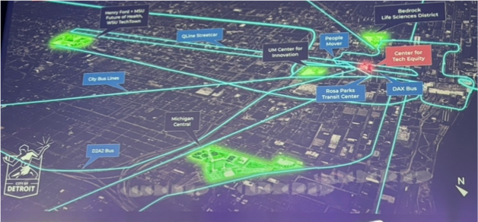
Apple Developer Academy & Apple Manufacturing Academy
MSU needs a strategic entry point into Detroit’s growing innovation ecosystem.
A centralized MSU Detroit Innovation Hub could operationalize these efforts.
Beyond Future of Health development, MSU in Detroit could become Apple’s preferred site for reimagining:
  Medical education & health innovation
  Spatial computing, simulation, wearables
  AI & manufacturing
Apple Academy connects key campus and corporate partners.
MSU in Detroit provides an opportunity to (re)imagine and design the future of higher education.
Feb 2025, Detroit Innovation Conference

Slide 13
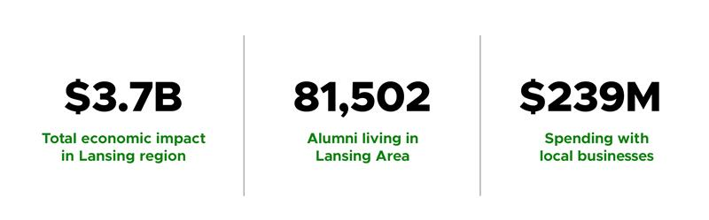
Lansing Region Impact
Feb 2025, Detroit Innovation Conference
Notes:
Primarily visual?

Slide 14


Slide 15


