Slide 1

Setting the Tone: Assessing the Climate
LaShondra Hemphill, Climate & Response Unit
Notes:
Introduce yourself & share a little about the Climate & Response Unit

Slide 2
Culture & Climate
CULTURE:
Sum of the values, traditions, beliefs, interactions, behaviors & attitudes
- Often deep and more stable
CLIMATE:
PERCEPTION ABOUT THE WORK/LEARNING ENVIRONMENT, HOW PEOPLE FEEL AT WORK/CLASS, RELATED TO MOTIVATION
- Often easier to assess and change
Resources:
- Coyle. D (2018) The Culture Code: The Secrets of Highly Successful Groups, Bantam.
- Agarwal, D. P. (2018, August 30). How To Create A Positive Workplace Culture. Forbes

Slide 3

CLIMATE CONDITIONS:
What's your mountain?

Slide 4
THE BUSINESS CASE
RESIDUAL IMPACTS
HEALTH IMPACTS
PRESENTEEISM
  Anxiety
  Depression
  Fear leading to presenteeism or departure
  Lost productivity
  $150 billion lost revenue in US each year
  Fear for safety
  Reduced innovation & creativity

Slide 5
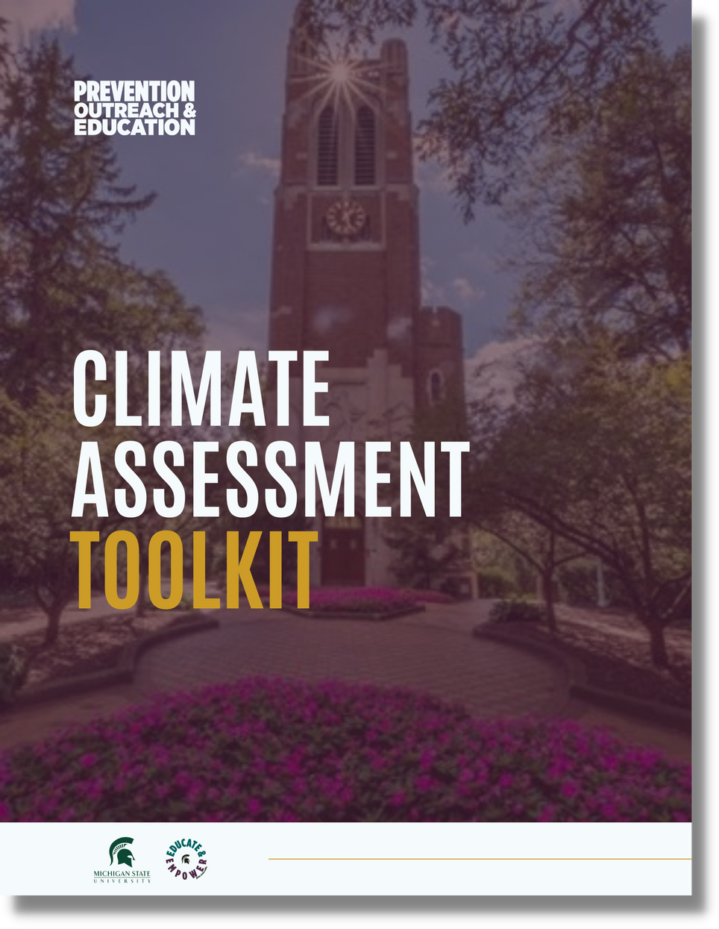
WHAT IS IT?
The Climate Assessment Toolkit is a self-guided resource that is designed for team leaders (i.e. deans, chairs, directors, executive managers, and supervisors).
The Climate Assessment Toolkit aids leaders in interpreting the atmosphere and culture within their teams. Offering practical skills and exercises, the Toolkit assists leaders in cultivating positive environments, recognizing issues and obstacles, mitigating risks, and fostering positive work and learning environments.
poe.msu.edu/climate-and-response/assessment-kit

Slide 6



Climate Assessment Toolkit
Understanding the Current Climate on Your Team
Understanding the Surrounding Climate
Self-Assessment
POE.MSU.EDU

Slide 7
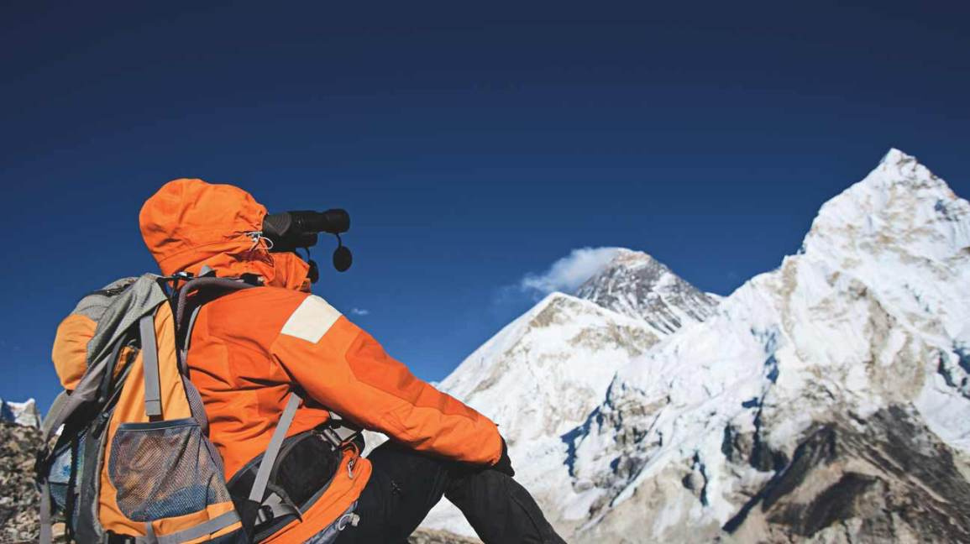
SELF-ASSESSMENT
What is my preparedness?

Slide 8
SELF-ASSESSMENT
Strengths as a Leader &
Areas for Improvement
Managing and Resolving Conflict
Values into Action

Slide 9



A foundation
Guide decisions
Inform beliefs
Don't change often,
but can differ based on role
Guide actions
VALUES

Slide 10
Select all that resonate with you
VALUES IDENTIFICATION
Notes:
WORKSHEET

Slide 11
Select all that resonate with you
VALUES IDENTIFICATION
Choose top THREE
Notes:
How did that go?

Slide 12
Select all that resonate with you
VALUES IDENTIFICATION
Choose top THREE
Star ONE

Slide 13

Communicate values through actions
Use values to make decisions
COMMUNICATING VALUES
Make them visible
Affirm/Support other's values
Unite as a team to explore values and actions via workshops/trainings

Slide 14
SUPPORT MAP
In each of the circles, write the names of people in your network who you can go to for particular areas of support. Write the areas of support on the arrow line (examples provided).
Workplace Conflict
Self-Accountability
ME
Exploring new ideas

Slide 15
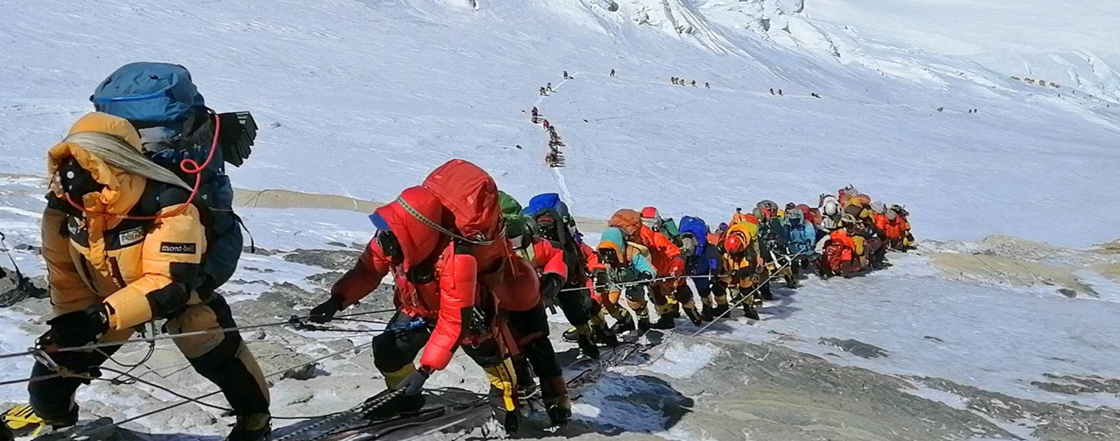
Understanding the Climate of Your Team
Where are we starting?

Slide 16
Stay Interviews
Structural
  Is there something you need to do your job more effectively?
CONNECTION TO THE WORK (ENGAGEMENT)
  WHAT DO YOU LOOK FORWARD TO EACH DAY WHEN YOU COME TO WORK?
  If you won the lottery, what would make you stay here?
Interpersonal Leadership
  What makes you feel appreciated?
  What is the best way for me to give you feedback?
CAREER
  What can I do to help you accomplish your goals?
  What attracted you to this job (why did you choose this job)? Does it still apply?

Slide 17
Assessing the Team Climate
S
Strengths
O
Opportunities
S
Strengths
W
Weaknesses
A
Aspirations
R
Results
O
Opportunities
T
Threats

Slide 18
Assessing the Team Climate
VALUES - Establishing team values & strong expectations
HISTORICAL AND CURRENT HARM?
  EX. OCR INVESTIGATIONS
  Power, privilege and identity
WARNING SIGNS
  Harassment, microaggressions, etc.
  Inequitable, hostile environments, interpersonal dynamics
WHAT ARE YOU ACCOUNTABILITY PRACTICES WITHIN THE UNIT?
  DEPENDENCE UPON FORMAL STRUCTURES
  Informal conflict resolution options

Slide 19

Supporting
the Team

Slide 20
1
Stay calm and objective
2
Immediate response
Knowing How to
Offer Support
3
Avoid blame and judgement
4
Empathetic listening and understanding
5
Set expectations
6
Collaborative problem solving

Slide 21


Be an Active Bystander
DELEGATE
DISTRACT
DIRECT
Asking for assistance from another person when intervening
De-escalating the situation by drawing attention away from the problem
Putting yourself into the situation and confronting the problem
Informal accountability practice - Request a training from POE

Slide 22
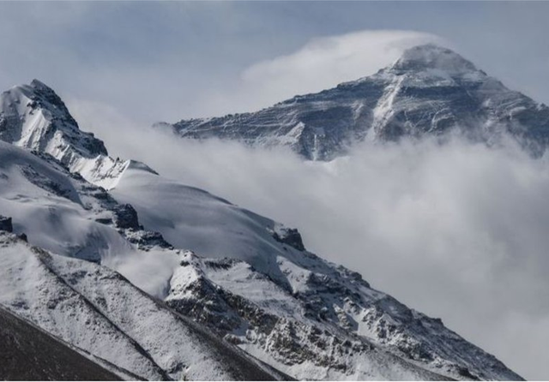
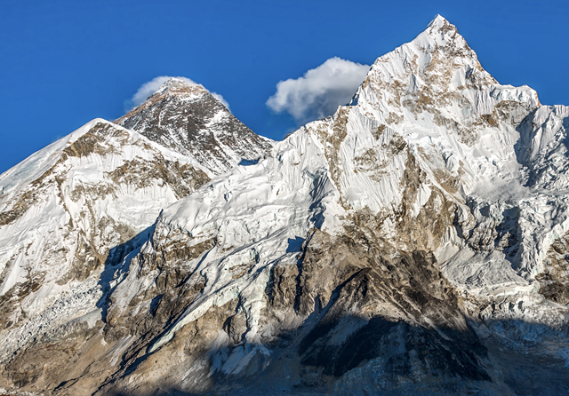
SURROUNDING CLIMATE
What are the conditions around me and my team?

Slide 23
CONDITIONS TO CONSIDER
COLLEGE VALUES & POLICIES/EXPECTATIONS
POWER DYNAMICS & HIERARCHY IN ACADEMIA
  Spheres of influence
  Unique aspects of academic administration roles
  Rethinking accountability
AREAS OUTSIDE OF OUR CONTROL
  COVID
  University priorities & mandates
  Changes in leadership

Slide 24
How intentional are they about climate & culture?
Do they model what you are striving for?
YOUR PEERS AND LEADERS
What impact does this have on you and your team?
What if there are warning signs at level above you?
What is your comfort level with having difficult conversations with peers and those above you in hierarchy?

Slide 25
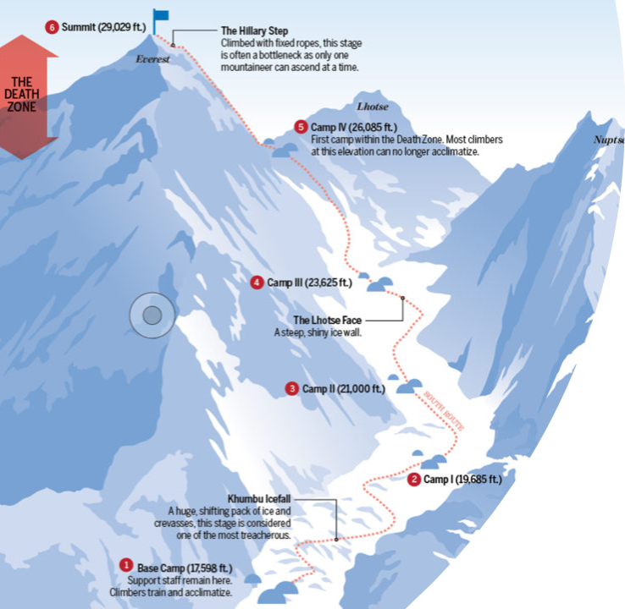

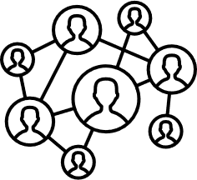


THE MAP
Utilize the Climate Assessment Toolkit
Find your support network
Keep learning & discovering new strengths
Model the behavior & keep reassessing the climate

Slide 26
Questions?

Slide 27


POE.MSU.EDU
POE.CLIMATE@MSU.EDU
LaShondra Hemphill
poe.LaShondraHemphill@msu.edu
@MSUPOE
@MSUPOE

