Slide 1
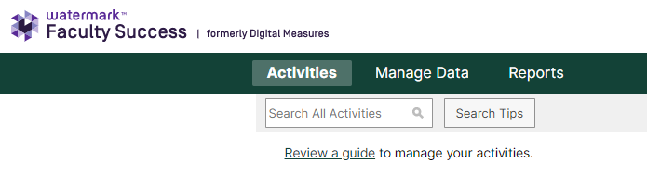
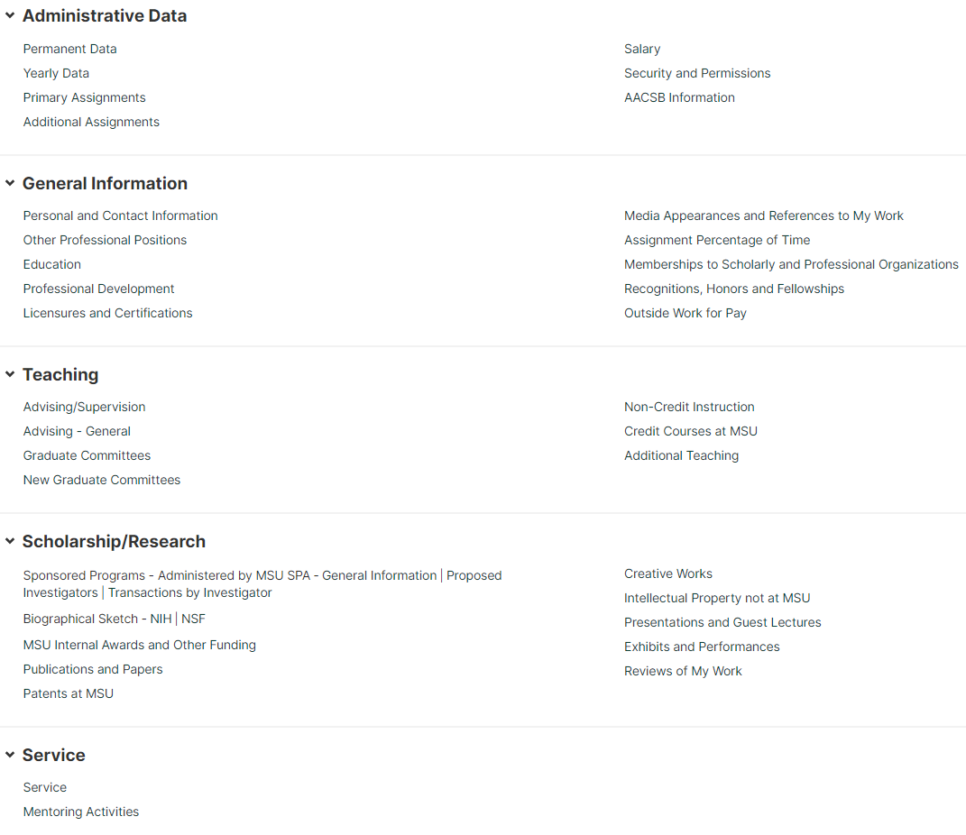
Academic Profile
Overview

Slide 2


Overview
  Academic Profile (AP) is a web-based application that allows faculty and academic staff to track their accomplishments easily and consistently.
  With AP, faculty and academic staff can easily view, edit, and report their accomplishments. AP supports annual review; institutional reporting; and reappointment, promotion, and tenure.
  AP blends institutional data with faculty CVs creating a single source repository for faculty work and productivity.

Slide 3
Information Available
Academic Profile integrates data from MSU’s systems of record including information related to:
Instruction
Graduate Committees
Sponsored Awards
Faculty Rank and Job Titles
Salary
Additional Assignment and Affiliated Units
All Degrees Earned
Institutional Data

Slide 4
Information Collected
AP team loads the initial CV for faculty and academic staff. Individuals then maintain their information relating to:
Publications and Creative Works
Presentations and Media Appearances
Service – Internal and External
Advising
External Funding not in KC
Professional Memberships
Honorifics
Individual Data Not Held in Central Systems
Notes:
Can import BibTex File or pull from WOS, Pub Med, and ORCiD

Slide 5
MSU Implementation
Fully Implemented or Accessible:
Broad College of Business
College of Arts and Letters
College of Communication Arts Sciences
Osteo Med Physician’s Assistant Program
College of Agriculture and Natural Resources
(Full access available, re-engagement forthcoming)
Implementation in progress:
College of Music
College of Vet Med
College of Human Med
Piloting with:
Lyman Briggs
Residential College in the Arts and Humanities
James Madison

Slide 6
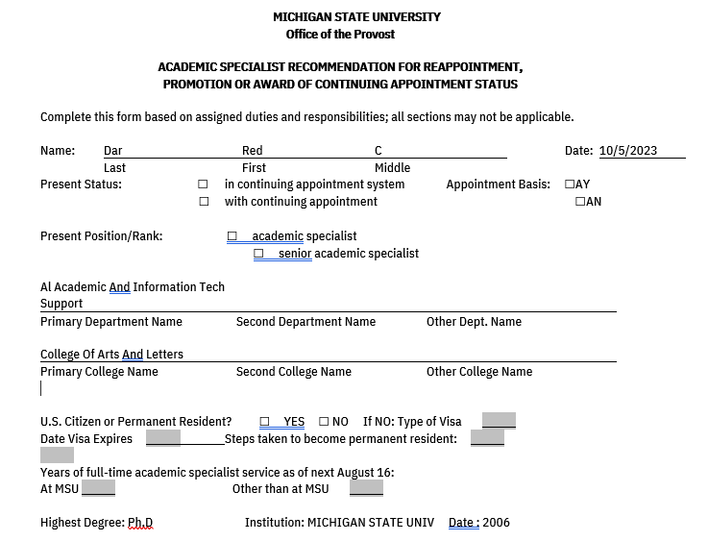
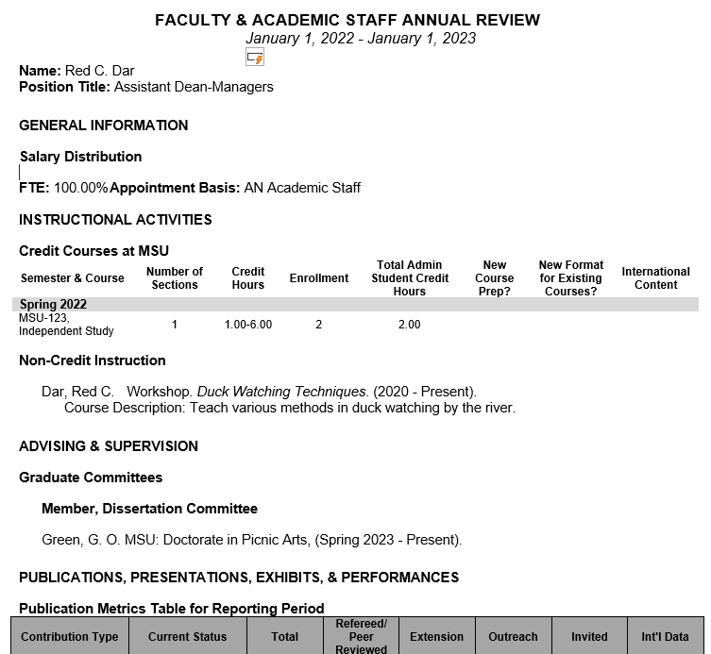
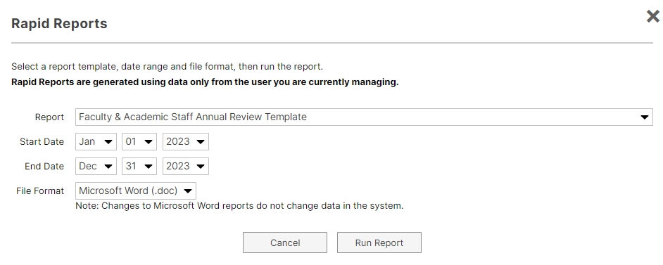
Export Reports
Annual Reviews &
Forms on Progress and Excellence

Slide 7
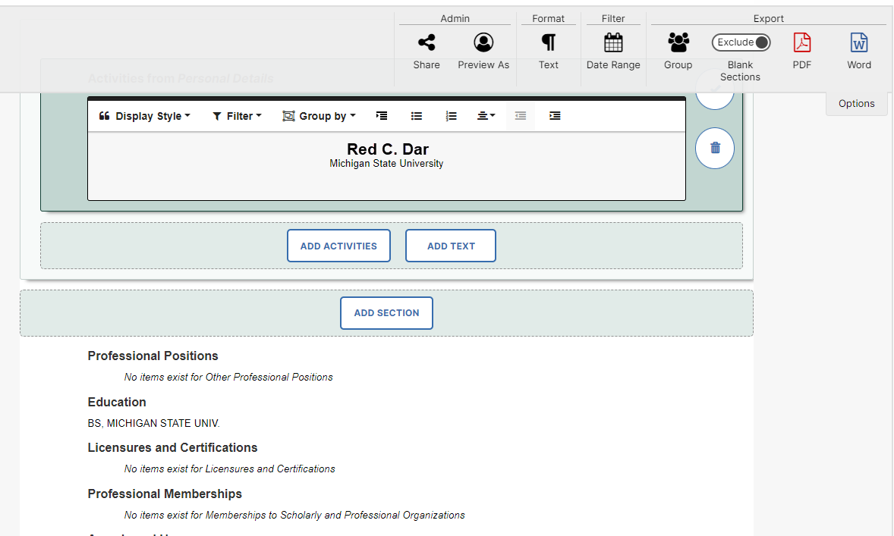
Export CV

Slide 8
Access & Onboarding
Process for entering CVs:
AP inputs CVs sent to AcadProf@MSU.EDU
AP needs updated CV with dates attached to each activity (need at least year)
Category headings are important (e.g., service, paid consulting etc.)
Attributes are important (e.g., peer reviewed, invited papers or presentations, etc.)
Training Sessions:
    Learn basic functionality of screens (manual and auto loaded data)
    Validate data
    How to run reports (Forms on Progress and Excellence, Annual Review)

