Slide 1
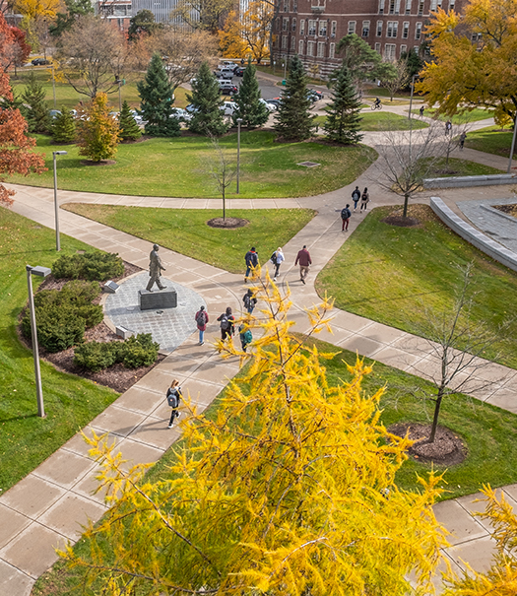
Thriving as an Academic Specialist at Michigan State University
February 8, 2023
Presented By:
Ann Austin, Ph.D - Interim Associate Provost and Associate Vice President Faculty and Academic Staff Affairs (FASA)
Kathy Charles, MHRLR – Director Faculty and Academic Staff Affairs (FASA)

Slide 2
Learning Objectives
Understand the various roles you play as Specialists and how your work fits into the university
Gain knowledge about the evaluation process towards achievement of Continuing status and Promotion to Senior Specialist
Learn from other Specialists who have developed distinguished careers in the Specialist system

Slide 3
Basis for Establishing Academic Specialist Positions
Functional Areas
Appointment Types
Ranks
Academic Advisor
Teaching
Curriculum Development
Research
Outreach
Fixed Term
Continuing System
Specialist
Senior Specialist

Slide 4
Academic Specialist at MSU

Slide 5
Academic Specialist By Functional Area (Data As of January 2023)

Slide 6




Initiatives to Provide Support for Academic Specialists
Comprehensive Review of Policies in the Handbook
Working Group developed to review Fixed Term and Continuing Review Process
Charged with recommending review processes that are Transparent and Equitable
Other policies/initiatives to include: Salary Minima, Retirement Eligibility Annual Review, Release Time for Scholarly Duties

Slide 7
Annual Evaluation
For all faculty and academic staff, MSU requires an annual evaluation.
Our policy is a minimalist policy, allowing for unit customization, i.e.
There is no standardized form
Units determine the timeline, e.g.: academic year, calendar year

Slide 8
Academic Specialists - Evaluation Policy
Annual reviews between specialist and their supervisor/administrator must occur at least once each fiscal year
The review must be a joint process between the specialist and the supervisor/administrator
The exact process may be determined by the unit, if the following conditions are met:
The annual review must include a conversation between specialist and supervisor/administrator that is based on documentation of accomplishments from the past year and goals/plans for the future
The specialist must be provided with a written summation of the review from the supervisor within 30 days and have the option to provide a written response for rebuttal and/or clarification if desired

Slide 9
Continuing System Reappointment
Reappointment, including the award of continuing appointment status and promotion to the rank of senior academic specialist, is predicated on the:
exemplary performance of assigned duties,
professional development,
excellence in scholarly activity,
leadership and contributions to the institution.

Slide 10
Continuing System Reappointment (Cont’d)
Establishment of Committee - The unit administrator shall establish a review committee to advise the unit administrator about the reappointment, or award of continuing appointment status, or promotion of the individual academic specialist.
Joint Appointment - Establishes the process of review and consultation when a specialist is jointly appointed
Unit Review Committee Composition
Goal of the Committee - Provides goal of committee and the documents that should be included as part of the review
Opportunity to Confer - Expectation for specialist to confer with review committee and timeline notification.
Summary for Specialist - The unit administrator must provide the individual with a summary of the recommendation to Provost and with feedback after the recommendation is forwarded. Also establish a timeline for when notification should take place.
Denial of Promotion - Denial of promotion requires a conversation between the administrator and specialist to detail rationale and next steps to be eligible.
Appeals & Grievance - Notification of appeal FGP and Administrative Review Process

Slide 11
Continuing System Timeline
Appointed as a Continuing System Specialist to a 3-year probationary appointment
During the 2nd year, reappointment review occurs
If unsuccessful, the appointment ends as originally scheduled
If successfully reappointed, the Specialist begins a second 3-year probationary appointment
During the 5th year, the continuing review occurs
If successful, one is reappointed with continuing status
If unsuccessful, the appointment ends as originally scheduled

Slide 12
Promotion to Senior Specialist (1 OF 2)
Basis for Promotion
As a fixed term Academic Specialist, promotion to senior status should be based on long-term, high-level performance, not merely time in rank (for a minimum of 60 FTE at the university).
This long-term, high performance in the position is demonstrated by assigned duties and recognition by peers and colleagues both within the University and regionally, nationally, or internationally based on what is appropriate for the specific position.
A promotion recommendation requires a robust review of the specialist’s ability to demonstrate (1) long-term, high performance in their position, (2) endorsement by the unit review committee, academic unit administrator, intermediate administrators/head of MAU, and the Provost that merits the award of promotion to the rank of Senior Specialist.

Slide 13
Promotion to Senior Specialist (2 OF 2)
Fixed Term - If an individual is hired as a senior specialist in the fixed term system, they will remain fixed term unless there is a later opportunity to move into the continuing system, which can be done in consultation with the Office of the Provost.
Continuing System - If an individual is hired as a senior specialist in the continuing system, upon approval by the Office of the Provost, they will also receive continuing status upon hire.
Process - An appointment as Senior Academic Specialist status upon hire must include a letter from the unit administrator(s) and dean(s) that summarizes the qualifications and verifies approval of the department/school/unit review committee regarding appointment with senior status.
Internal MSU hiring - If a specialist is promoted to senior specialist in a functional area and moves to another unit or college with the same functional area (i.e. research specialist position to another research specialist position), their senior specialist designation will remain with them.

Slide 14
Diversity Equity and Inclusion (DEI) in the Evaluative Process
DEI are core values of MSU, thus…
Academic Specialists should include evidence of their activities and accomplishments in DEI
High-quality, impactful work presents itself differently across fields, units and appointment situations
DEI contributions should be interwoven in reappointment and promotion materials
Determining specific instructions about how to address DEI in materials are at the unit level

Slide 15
Continuing and Promotion Timeline
Mid - JULY
Deans and Separately Reporting Directors send notices of actions by Provost to Chairs and Specialists
Mid- JULY
Reviewed by Provost with outcome notification back to unit
EARLY MAY
Dean forwards recommendation to Provost
APRIL 1st
Deadline to request an extension of Academic Specialist review to FASA
MARCH
Recommendation is reviewed and sent to major unit administrator (i.e., Dean)
February
Review committee makes recommendation to the appropriate academic unit administrator
December - February
Review committee is established
Early November
Academic Specialist notified of the review process

Slide 16
Continuing and Promotion Timeline (cont’d)
December 15th
Deadline for notification to Academic Specialist in the continuing System not reappointed.
Mid-October
Approved Extensions are Due. Outcomes effective January 1st of the following year.
October 1st
Award of Continuing and/or Promotion to Sr Specialist salary increases in effect.

Slide 17
Career Growth Considerations
Career Growth occurs through various paths:
Continuing Education
Professional and Scholarly Organizations
Academic Governance (department, college, campus)
Advising of Student Groups
Lilly Fellows and Adams Academy
Leadership Learning Communities
Mentoring

Slide 18
Questions?
Faculty and Academic Staff Affairs Team:
Ann Austin, Interim Associate Provost and Associate Vice President, FASA
Kathy Charles, Director
Melissa Sortman, Director
Jennie Yelvington, Director
Kara Yermak, Director

