Slide 1
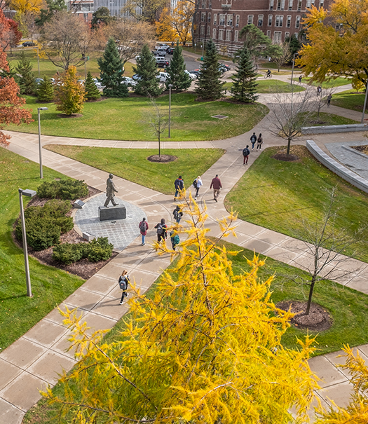
Thriving as an Academic Specialist at Michigan State University
October 15, 2025
Presented By:
Kathy Charles, MHRLR – Sr. Director Faculty and Academic Staff Affairs (FASA)

Slide 2
Basis for Establishing Academic Specialist Positions
Functional Areas
Academic Advisor
Teaching
Curriculum Development
Research
Outreach
Appointment Types
Fixed Term
Continuing System
Ranks
Specialist
Senior Specialist

Slide 3
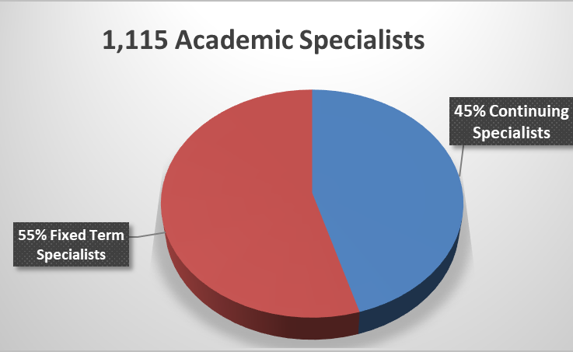
Academic Specialist at MSU (As of 10/01/2025)

Slide 4
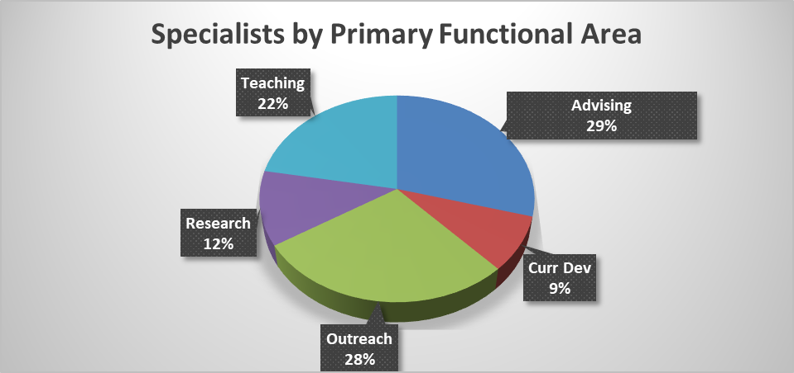
Academic Specialist By Functional Area (Data As of 10/01/2025)
Notes:
Kathy-Please update the numbers if necessary

Slide 5
Academic Specialists - Evaluation Policy
Annual reviews between specialist and their supervisor must occur at least once each fiscal year
The review must be a joint process between the specialist and the supervisor/administrator
The exact process may be determined by the unit, if the following conditions are met:
The annual review must include a conversation between specialist and supervisor/administrator that is based on documentation of accomplishments from the past year and goals/plans for the future
The specialist must be provided with a written summation of the review from the supervisor within 30 days and have the option to provide a written response for rebuttal and/or clarification if desired

Slide 6
Continuing System Reappointment
Reappointment, including the award of continuing appointment status and promotion to the rank of senior academic specialist, is predicated on the:
exemplary performance of assigned duties,
professional development,
excellence in scholarly activity,
leadership and contributions to the institution.

Slide 7
Continuing System Reappointment (Cont’d)
Establishment of Committee - The unit administrator shall establish a review committee to advise the unit administrator about the reappointment, or award of continuing appointment status, or promotion of the individual academic specialist.
Joint Appointment - Establishes the process of review and consultation when a specialist is jointly appointed
Unit Review Committee Composition
Opportunity to Confer - Expectation for specialist to confer with review committee and timeline notification.
Summary for Specialist - The unit administrator must provide the individual with a summary of the recommendation to Provost and with feedback after the recommendation is forwarded. Also establish a timeline for when notification should take place.
Denial of Promotion - Denial of promotion requires a conversation between the administrator and specialist to detail rationale and next steps to be eligible.
Appeals & Grievance - Notification of appeal FGP and Administrative Review Process

Slide 8
Continuing System Timeline
Appointed as a Continuing System Specialist to a 3-year probationary appointment
During the 2nd year, reappointment review occurs
If unsuccessful, the appointment ends as originally scheduled
If successfully reappointed, the Specialist begins a second 3-year probationary appointment
During the 5th year, the continuing review occurs
If successful, one is reappointed with continuing status
If unsuccessful, the appointment ends as originally scheduled

Slide 9
Continuing and Promotion Timeline
Academic Specialist notified of the review process
Early November
Review committee is established
December - February
Review committee makes recommendation to the appropriate academic unit administrator
February
Recommendation is reviewed and sent to major unit administrator (i.e., Dean)
MARCH
Deadline to request an extension of Academic Specialist review to FASA
APRIL 1st
Dean forwards recommendation to Provost
EARLY MAY
Reviewed by Provost with outcome notification back to unit
Mid- JULY
Deans and Separately Reporting Directors send notices of actions by Provost to Chairs and Specialists
Mid - JULY

Slide 10
Continuing and Promotion Timeline (cont’d)
Award of Continuing and/or Promotion to Sr. Specialist salary increases in effect
October 1st
Approved Extensions are Due. Outcomes effective January 1st of the following year
Mid-October
Deadline for notification to Academic Specialist in the continuing System not reappointed.
December 15th
Notes:
Kathy-Is this timeline still correct?

Slide 11
Promotion to Senior Specialist
Based on long-term, high-level performance with a minimum of 60 FTE service months at the university.
Fixed and Continuing System - An individual can be hired as a senior specialist, upon approval by the Office of the Provost. If an individual is hired as a senior specialist in the continuing system, upon approval by the Office of the Provost, they will also receive continuing status upon hire.
Internal MSU hiring - If a specialist is promoted to senior specialist in a functional area and moves to another unit or college with the same functional area (i.e. research specialist position to another research specialist position), their senior specialist designation will remain with them.

Slide 12
Questions?
Faculty and Academic Staff Affairs Team:
Teresa Mastin, Vice Provost and Associate Vice President FASA
Kate Birdsall, Director FASA
Kathy Charles, Sr Director FASA ** ASAC Liasion
Teresia Hagelberger, Director FASA
Jennie Schaeffer, Director FASA
Nikki Schmidtke, Director FASA
Melissa Sortman, Assistant Provost FASA
Kara Yermak, Assistant Provost FASA
Notes:
Kathy- Should we delete this slide?

