Slide 1
Introduction to the
Student Perceptions of Learning Survey
Nate Clason, PhD
Office of Faculty and Academic Staff Development
clasonna@msu.edu
October 25, 2023

Slide 2
Agenda
Overview of the SPLS
Basic details about how the SPLS functions
Using the SPLS to enhance the quality of teaching
Using the SPLS as one source of evidence of quality teaching

Slide 3
Recent Transition
Transitioned from the Student Instructional Rating System (SIRS) to the SPLS in Summer 2023
Policy
MSU Student Perceptions of Learning Environments Policy (SPLEP)
available at spls.msu.edu/policy
includes specific guidelines for the entire university
includes general guidelines for colleges and departments
Purpose
The Student Perceptions of Learning Survey (SPLS) collects feedback from students in all courses to
provide instructors, graduate teaching assistants, and teaching units with feedback on their instructional practices;
contribute to instructor retention, promotion, tenure, and salary decisions; and
provide students with information to guide decision-making related to course selection (available to students after two years of data has been collected).

Slide 4
SPLS Basics
Students, instructors, and graduate teaching assistants are notified by email when the SPLS is available. Look for messages from spls@spls.msu.edu.
The survey opens and closes according to the Course End Date entered into Campus Solutions.
Surveys are currently open for five calendar days and close at 11:59pm on the Course End Date. Variable survey periods are planned for later next year.
There are eight institution-level questions that are asked of all students. Colleges can add up to 12 more questions and may choose to delegate all or some questions to departments. Example:
8 MSU
10 College
2 Department
20 Total
Individual course reports are sent to instructors and graduate teaching assistants after the term concludes and grades are submitted.

Slide 5
Institution-level Questions
Level of Interest. At the time of enrollment, my level of interest in this course was:
Responses are used for statistical analysis (discriminant validity)
Workload. Compared to other courses of equal credit, the workload for this course was:
Responses are reported to instructors and will be reported to students – not reported to department chairs or deans

Slide 6
Institution-level Questions
Expectations. I understood what was expected of me in this course:
Organization. Overall, the course was well organized:
Atmosphere. The instructor created an atmosphere that supported my learning:
Expanded understanding. The course expanded my understanding of the subject matter:
Demonstrate understanding. Course assignments and/or tests provided opportunities for me to demonstrate an understanding of the course material:
Interest increased. My interest in the subject has increased because of this course:
This information is available on the website: spls.msu.edu

Slide 7
Remain mindful…
Student perceptions surveys are not objective measures of learning
Student perceptions surveys are not evaluations of the quality of teaching
It would be unfair to ask students to “evaluate” teaching
These surveys represent student perceptions or experiences in a course
Taken alone, these surveys are inadequate. When properly contextualized and paired with other forms of feedback, they can be useful to instructors and administrators.

Slide 8
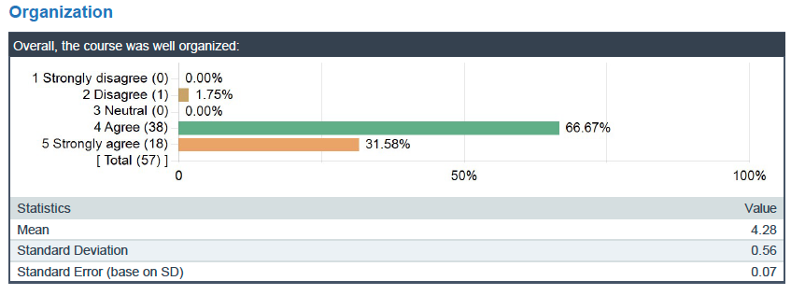
Using the SPLS to enhance the quality of teaching
Most questions use the Excellence scale or Agreement scale(1= strongly disagree to 5 = strongly agree). It is favorable for students to agree that courses and instructors are characteristic of high-quality educational experiences. In the following example, a mean score of 4.28 for the Organization question is very favorable. 56 out of 57 students Agree or Strongly agree that the course was well organized.

Slide 9
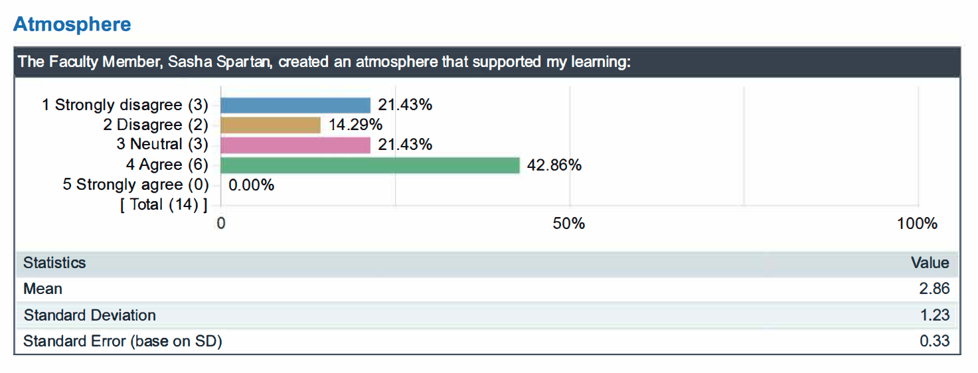
Using the SPLS to enhance the quality of teaching
In many respects, it is not necessary to compare instructor mean scores to department, college, or university mean scores. Feedback such as this suggests that the instructor could enhance the quality of the learning experience by focusing on the learning atmosphere. Some instructors might immediately look for more information in student comments, but pairing this feedback with something like a peer observation of teaching would be more reliable and help to mitigate biases.

Slide 10
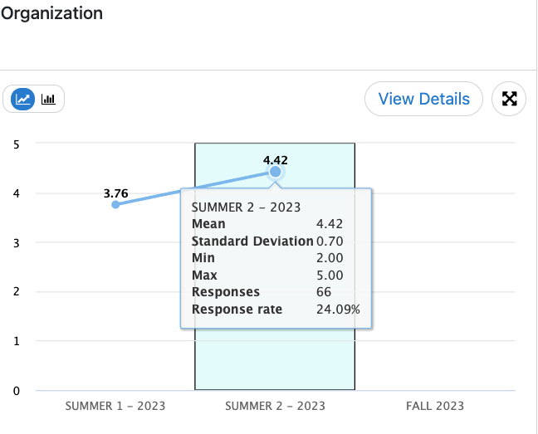
Using the SPLS to enhance the quality of teaching
There is tremendous value in seeing feedback over time.

Slide 11
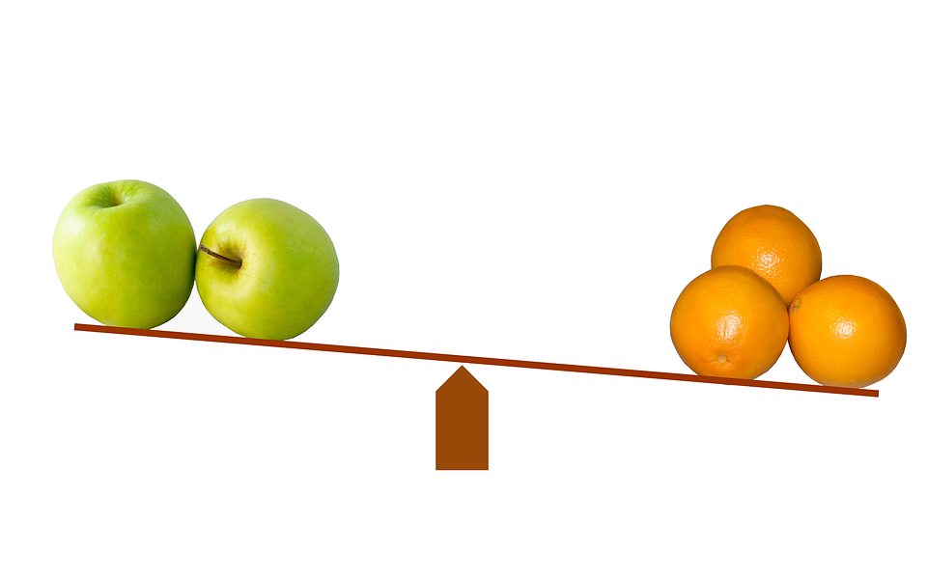
Using the SPLS as one source of evidence of quality teaching
The research on student perceptions of learning suggests that feedback is highly context-specific. Students perceive that they learn better in small classes and that is reflected in survey results. Other context-specific attributes include degree level, discipline, and type of course (e.g., lecture, lab, seminar).
Comparisons between instructors is rarely a one-to-one comparison.
Contextualize student feedback when including it in annual review and RPT processes. For example, highlight and describe the potential implications of class size, type of course, and nature of the course content.

Slide 12
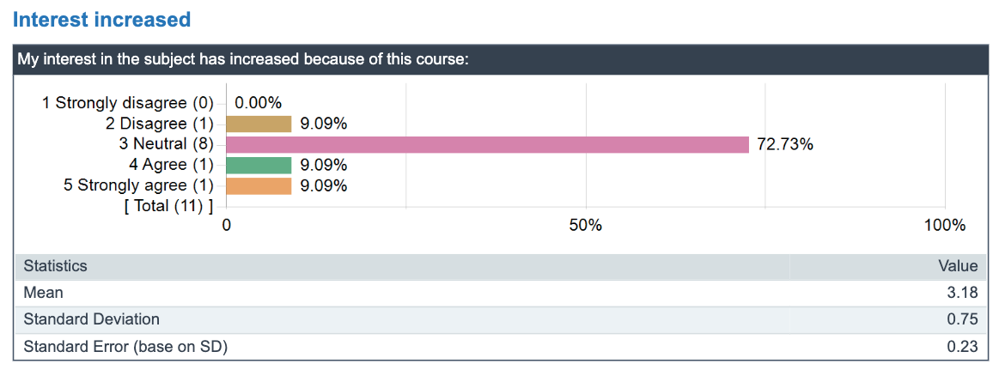
Using the SPLS as one source of evidence of quality teaching
Some feedback can be helpful to the instructor, but not useful for evaluation. For example, some required courses are not "interesting" to a large percentage of students. Thus, the institution-level question related to Interest increased is not always useful for evaluation.

Slide 13
Website
The website (spls.msu.edu) is continuing to expand, especially FAQ sections
Contact
Your first point of contact is your department chair who might refer you to the office of the dean or the SPLS Liaison for your college
Office Hours
SPLS Office Hours by Zoom are open to everyone
Access the link on the SPLS website homepage
Tuesdays at 10:00am

