Slide 1

Office of Faculty and Academic Staff Development Michigan State University

Slide 2
Office of Faculty and Academic Staff Development (OFASD)
Mission:
To support MSU colleagues as they develop productive careers reflective of their individual aspirations, and to help them connect those aspirations with institutional priorities
Vision:
To provide integrated, inclusive professional development across the full range of academic responsibilities and across the arcs of diverse academic career paths
Notes:
Recognize and support the diversity of academic appointments and career stages
Enable academics to learn from and share experiences with each other
Listen to and learn from the experiences of MSU’s academics
Offer tailored approaches to meet the needs of academic cohorts across disciplines, backgrounds, and career stages
Serve as a connector to foster collaboration across campus partners in support of academics’ professional growth

Slide 3
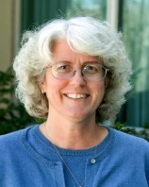
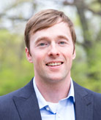
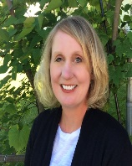
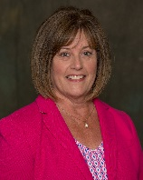
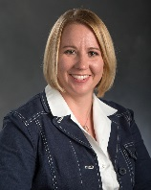
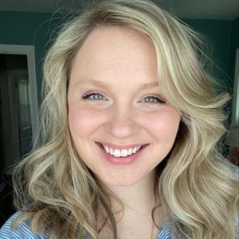
Our Team:
Marilyn Amey
Assistant Provost for Faculty
and Academic Staff Development
Nate Clason
Academic Specialist
Kelly Lambert
Project Event Coordinator
Beth Leete
Executive Staff Assistant
Cindi Leverich
Director of Academic Leadership
Development
Katie Rundblad
Faculty Honorifics Coordinator

Slide 4
Why the Office of Faculty and Academic Staff Development?
Different career phases and responsibilities need various forms of support and opportunities for faculty and academic staff to grow and feel fulfilled
Community, connections, and acknowledging contributions are hallmarks of the OFASD’s efforts
Safe space for questions, problem-solving, and finding resources

Slide 5





The FASD Approach
Recognize and support the diversity of academic appointments and career stages
Enable academics to learn from and share experiences with each other
Provide a safe space for questions, problem Solving and Finding resources
Offer tailored approaches to meet the needs of academic cohorts across disciplines, backgrounds, and career stages to allow for growth and fulfillment
Serve as a connector to foster collaboration across campus partners in support of academics’ professional growth

Slide 6
FASD Offerings
Career Conversations
National Center for Faculty Development and Diversity
Exploring Academic Leadership Conversations
Smaller cohort opportunities exploring teaching/learning and educator leadership
Learning Communities to engage on important topics of interest
Career
Development
Community
Recognition
Leadership
Internal and external awards and recognitions for leadership and excellence in teaching/learning
Thrive sessions to help situate one’s work for annual review and promotion including new course evaluation system
Programs on strategic and practical topics for leaders are often geared toward those in certain positions
Big Ten Academic Alliance leadership programs

Slide 7
Career Development and Support
Orientations
Small(er) Groups
Academic Career Conversations
Exploring Academic Leadership Conversations
Workshops
“Thrive” Sessions to navigate annual and promotion reviews
Third Stage [nearing retirement] Sessions
Student Perceptions of Learning Environments Surveys – summative course evaluations
National Center for Faculty Development & Diversity
Center for Teaching & Learning Innovation

Slide 8
Finding Community
Learning Communities – open to all with shared interest or curiosity
Cohort Programs – application process or role-based
Adams Academy Fellows
Lilly Fellows
Women Chairs
Critical Friends Peer Mentoring
Academic Leadership Fellows
BTAA Cohort Programs

Slide 9
Leadership
Leadership Institute sessions on important topics and strategies for positional leaders
Big Ten Academic Alliance Leadership Cohort Programs – ALP
Academic Leadership Fellows Program
Conversations with the President and Provost

Slide 10
Culture of Recognition
Thrive sessions to help situate and communicate work to others leading to promotion in rank including new course evaluation system
Internal awards and recognitions
For leadership
For excellence in teaching and advising
External awards and recognitions
https://provost.msu.edu/priorities-and-initiatives/honorifics

Slide 11
Office of Faculty and Academic Staff Development
For more information about these opportunities check out our website OFASD.msu.edu.
Or contact us via email ofasd@msu.edu or phone at 517-432-1185
Office location
MSU Main Library, Room W206 [after mid-Sept]

