Slide 1

Thriving in the Tenure System I: Articulating Your Scholarly Identity Through a Strong Reappointment, Promotion, and Tenure Packet February 2023
Douglas A. Gage
Vice President for Research and Innovation

Slide 2
Research and Innovation - Role in Tenure and Promotion
OR&I serves in an advisory role to the Provost’s office – we are not part of the decision-making process per say
We act as partners to promote a culture of support and success for research faculty
We do this by collaborating on research strategy and tactics with college and university leadership and by providing various support services from our office, i.e., grant consulting, workshops, core facilities, matching fund coordination, regulatory compliance and more

Slide 3
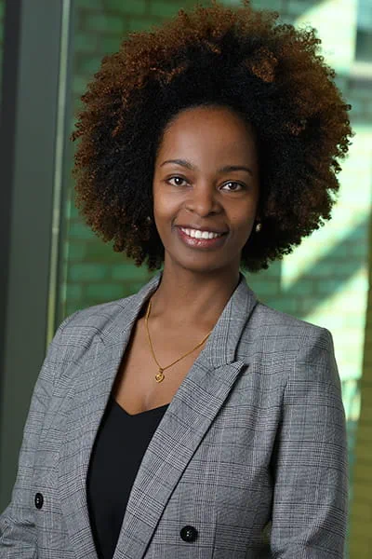
Tenure Process
Department ➔ college ➔ university administration
Make your case: the file is "you" in the promotion process
By this stage, your understanding of the expectations should be clear: Talk to your chair and departmental mentors regularly!
Maji Hailemariam Debena is an assistant professor in the Department of Obstetrics, Gynecology and Reproductive Biology in the College of Human Medicine.

Slide 4
Process Timing During COVID
Be aware of the COVID related updates that impact the review process https://hr.msu.edu/ua/promotion/faculty-academic-staff/
Any probationary faculty member who: a) was in the tenure system at MSU as of Spring 2020 scheduled for a reappointment or tenure review, or b) has an employment start date in the tenure system through August 15, 2023. The automatic extension is applied to your record by Human Resources, or you can opt out.
Once the automatic extension stops, you can still apply for an extension via this process through UCFT.
For details and questions, be sure to review the FAQ’s

Slide 5
Promotion to Associate Professor
These go without saying:
Research
Teaching (formal instruction and grad mentoring)
Service
External funding in disciplines where that is possible (as PI and as collaborator, detailing role in latter)
Authorship and co-authorship, publications, books or other scholarly works
Reputation in your discipline
But how do you differentiate yourself?

Slide 6
Promotion to Associate Professor – Cont.
Demonstrated competence and ability to sustain a career
Sustained scholarly output – no last-minute surge
Provide a textured description of your individual trajectory
Continued excellence in teaching and service
Additional evidence you are building a career and expertise, i.e., serving on editorial boards, study sections, grant review committees
But don’t do EVERYTHING. Be strategic!

Slide 7
Career Strategies
Benchmarking: Have a plan for documenting activities and progress
Develop an upward award path – early career awards, professional organization recognition
Mentoring and support groups; consider a mentor outside of your discipline as well to gain new perspectives
Scholarly presence beyond campus – invited talks, conference engagement, disciplinary society engagement & service, etc.
NOTE: don’t underestimate the value/impact of your external service! Build those connections now!

Slide 8
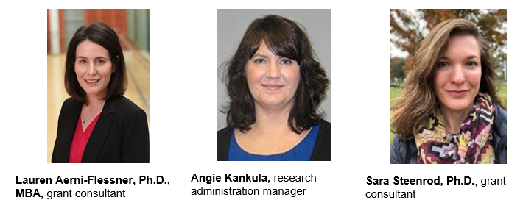
OR&I Resources to Support Your Efforts
Our office has resources available to support these efforts:
Write Winning Grants seminar coming up May 10 & 11 (half days) https://research.msu.edu/event/write-winning-grants-webinar
Workshops finding funding, early career awards and more https://research.msu.edu/events
We also have a team of grants consultants who can assist in proposal development https://research.msu.edu/proposal-services

Slide 9
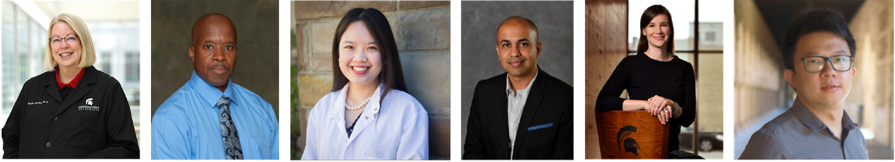
Finally: Enjoy
Less than 2% of the world’s population holds a Ph.D. It’s hard work but you’ve made it!
Don't forget what attracted you originally to academic life; creating new knowledge, working with students, etc. Focus on your passion.

