Slide 1

Thriving as a Fixed Term Faculty Member
Jennie Schaeffer
February 5, 2025

Slide 2

Faculty & Academic Staff
Carry out the academic activities of MSU's mission:
providing outstanding undergraduate, graduate, and professional education and advisement
conducting research of the highest caliber
advancing outreach, engagement, and economic development activities

Slide 3

Who are our “faculty and academic staff”?
Ranked Faculty
Instructor, Senior Instructor, Assistant Professor, Associate Professor, Professor
Academic Staff (includes but not limited to)
Academic Specialist, Senior Specialist, Assistant Instructor, Lecturer, Research Associate (postdoc), Scholar, Archivist, Intern/Resident, Engineer, Physicist, Extension

Slide 4
Thriving…
To be successful, to flourish, to grow or develop well
What does that mean for you?

Slide 5
Purpose of the Annual Review
Ensure a clear understanding of what is expected in your appointment
Assess individual performance against expectations
Provide an opportunity to provide input to unit administrators.
Inform decisions on merit pay
Provide input for decisions about future appointments

Slide 6

Principles That Should be Incorporated in Unit Bylaws
Each fixed term faculty member shall be evaluated on an annual basis and informed in writing of the results by the unit administrator
Each unit shall have clearly formulated and relevant written performance criteria and shall provide these at the time of appointment, and subsequently as necessary, to clarify expectations.
All assigned duties should be given weight in the evaluation

Slide 7
Promotion of Fixed Term Faculty
Guiding Principles:
The recognition that comes from being promoted through the academic ranks should be available to all whose performance warrants it.
A fixed term faculty member's level of accomplishment, even if within a narrow range of duties (e.g., only teaching), should reflect the same level of accomplishment for that set of duties as is required for a tenure system faculty member being promoted to the same rank.
A fixed term faculty member should only be evaluated on the work they are hired to do. Example: if they have percentages of teaching and outreach in their FTM, it should not be viewed negatively that they do no research.

Slide 8

Promotion Policies
Each department, school and college regularly employing fixed term faculty must have evaluation and review procedures for the promotion of fixed term faculty
Policies available at hr.msu.edu:
Promotion of Fixed Term Faculty
Promotion of HP Faculty
Promotion of FRIB/NSCL Faculty
Promotion of Research Faculty
Check with your unit for internal policies and deadlines

Slide 9

Coming Soon!
New promotion form specifically for fixed term faculty
Detailed guidelines for fixed term faculty and their units regarding the promotion process.
Set timeline

Slide 10
The Promotion Review Packet
Current curriculum vita
Reflective essay about accomplishments over the reporting period (5 page maximum)
A representative sample of scholarly work
Evidence of excellence in performing assigned duties, e.g. significance, impact, and innovation of research/creative activities, instructional activities and service
Unit administrators must prepare a description of the candidate's assignment, including the percentage of the appointment devoted to research/creative activities, teaching, service, etc.
External review letters are encouraged
(colleges can decide if required)

Slide 11




Th Promotion Review Process
Department level committee makes recommendation to chair or school director
Chair independently makes a recommendation to the dean
The dean is advised by a college
review committee
The dean independently makes a recommendation to the provost

Slide 12


The Promotion Review Process (continued)
Provost makes promotion decision
In Human Health Colleges (CHM, COM, CON), Provost and EVP make a joint decision

Slide 13

Closing thoughts
Assess where you are and where you’d like to be
Make sure your supervisor knows what your goals and interests are
Take advantage of development opportunities that arise
Engage in the work community
Seek mentors

Slide 14
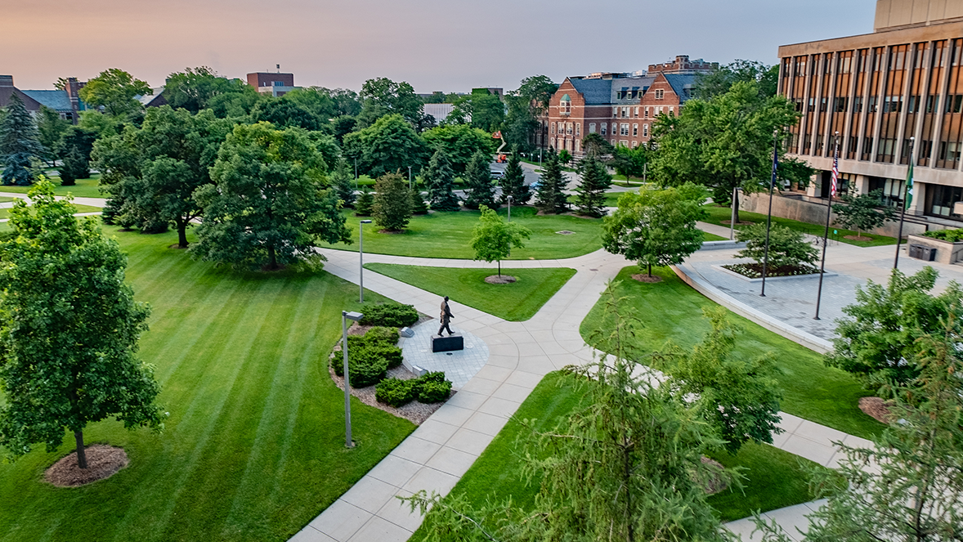
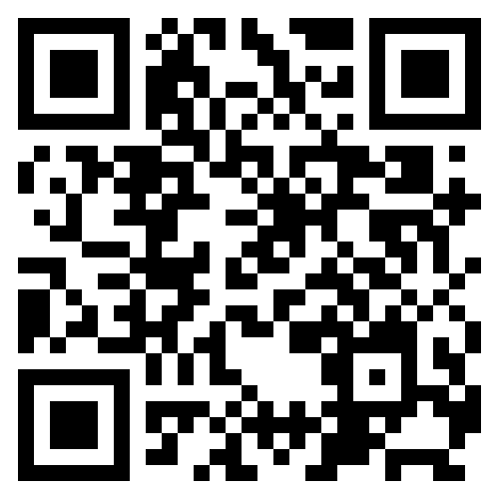



Contact FASA:
fasaffairs.msu.edu
fasaffairs@msu.edu
THANK YOU!

