Slide 1

The Path to Promotion
Session 1: The Meaning of Promotion in the Academic Specialist System
Notes:
11:30

Slide 2
Webinar Norms
You will walk away with work done.
Materials
  A place to write
  A browser
Engagement
  Participate in polls
  Use the Q&A
Follow ups
  If you are anticipating an action in 2024-2025
  If you are further out
Notes:
In each webinar in this series, we’ll provide follow-up activities that will help you make progress. There will be things to do whether you are anticipating an action next year or not.
Slides and the recording will be made available afterward. Watch the specialist listserv for details.

Slide 3
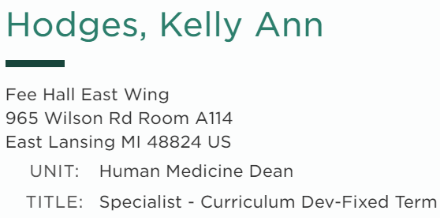
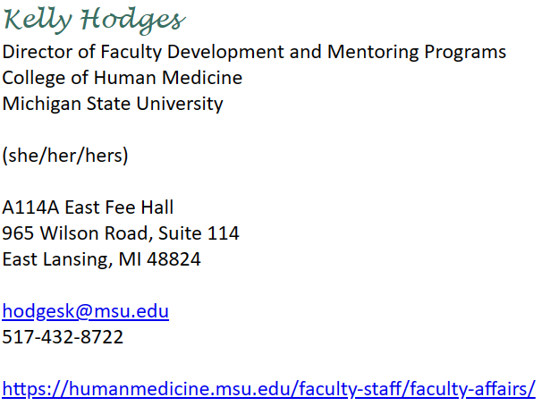
Introductions
Write down:
  Your EBS Job Title (in MSU People Search)
  How you identify yourself (e.g., in your email signature)
What are you hoping to get from this webinar? Onto your paper.
Notes:
Link to MSU People Search in the chat

Slide 4
The Landscape…
Understand how specialists’ promotion processes are related to their unique role
Know the components of a successful promotion dossier
Know the timeline and workflow of the review year
Understand the role of annual review in the promotion process
Notes:
We’ve designed this as a four-part series to ensure that you will achieve these outcomes by the end. After today, you’ll know some things and likely have a lot more questions. Put things in the Q&A and be sure to come back (or view the recording) for each of the remaining sessions to get all the answers.

Slide 5

The Role of the Academic Specialist
Goal 1: Understand how specialists’ promotion processes are related to their unique role.
Notes:
Key point: Academic Specialists are academics.

Slide 6
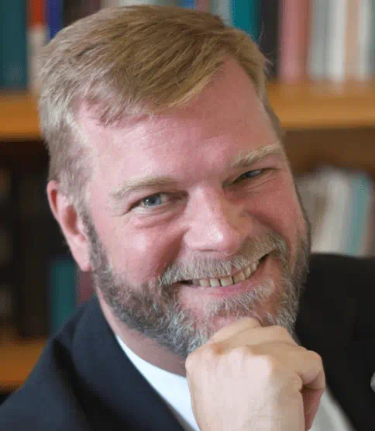
Specialists’ Role as Scholars
“Academic specialists…contribute in specialized ways to scholarly life and contribute to the intellectual fabric of our community of scholarship.”
- Interim Provost Thomas D. Jeitschko
Notes:
Each spring, the provost sends a memo to all tenure system faculty and unit/MAU leaders outlining their philosophy and approach to the promotion process. The memo is publicly available at the link on this slide.
In this memo, the provost begins by describing the faculty, and specialists are mentioned in that description. Like other categories of faculty mentioned in this description, specialists have specialized roles, but they exist to contribute to the scholarly community, and the tripartite mission of instruction, research and service.

Slide 7
The Community of Scholarship
Creating new knowledge and the role of academic freedom
The special relationship between creating new knowledge and teaching
Service, outreach and engagement as a land grant institution
Notes:
Text is again from the memo. To be a member of the community of scholarship means to participate in these things, the tripartite mission of MSU.
Some academic appointment types have the expectation that a “basic level of excellence” is expected in all three broad mission areas of instruction, research, and service. Other types, including specialists, do not.

Slide 8

Tell Your Story
Write 1-2 sentences about who you are as an academic, a member of the community of scholarship.
Write 1-2 sentences about your unique contribution to the community.
Notes:
On your paper. This is really important, don’t lose it!

Slide 9

What is Promotion?
Goal 1: Understand how specialists’ promotion processes are related to their unique role.
Notes:
Key Point: Promotion is about encouraging, and then recognizing, academic excellence.

Slide 10

What is Academic Promotion?
Promotion is the mechanism by which an academic institution continuously renegotiates and refines its vision of what an academic should be, to fulfill the mission of the institution and its role in society.
Notes:
As explained in the provostial memo, there is an irony in the promotion process. Conceptually, we strive to advance new knowledge in new ways, for the benefit of society. But procedurally, we tend to define success in academia using measures defined by those that have gone before.
Therefore, we need to create systems that resist the potentially regressive impulses in this system. The institution bears this responsibility to view scholarship through the widest possible lens. The individual academic bears the responsibility to exercise their academic freedom through their work in whatever mission areas apply to their role, to advance new kinds of knowledge.
The academic specialist system is one structural tool available for viewing scholarship through a wide lens while holding individuals accountable for contributing to the community of scholarship.

Slide 11

Philosophy of Promotion
“several years of sustained, outstanding achievements in scholarship, teaching, and service…consistent with performance levels at peer universities…”
… and relative to the expectation of the appointment system and the specific appointment.
Notes:
So what kind of academic excellence is good enough for promotion?
Positions across the university, within the specialist system and across other systems, are so diverse that there could not possibly be checklists or specific targets that would encompass them all. In addition, principles of academic freedom and the mission of the university to advance new forms of scholarship could be impinged by additional specific guidance. So, this philosophy guides the decision-making at the university level.

Slide 12





The University expects…
…that you will succeed.
…that you will know what is required of you to do so.
…that you can connect your work to the goals and values of your unit and the university.
…that you will have leadership support to accomplish the aspects of your position.
…that you can tell your story effectively.
Notes:
There would be no reason to say these things if they were self-evident or simple.
Two of these are about what the faculty member will do: #3 and #5. These are things we’ve begun to address today and will continue to address in this series.
Three of these are about what the institution – meaning the university, the college/MAU, and the department/unit will do. In this series, we’ll talk about these things too, so that you know what the U expects for you and know that you can rely on university-level support for having those things within your MAU and unit.

Slide 13
Why Promotion?
Financial benefit
To be recognized for your achievements
To share your academic achievements
To argue for time and resources
To challenge yourself
Notes:
Getting promoted is a lot of work, on your part and on the part of many others. But you might find it worth it, for some of these reasons.
For non-union specialists, promotion to senior specialist and/or award of continuing status comes with a centrally-funded salary increase (a raise, not a bonus). In 2023, the amount was $4000.

Slide 14

Features of a Specialist Appointment
Goal 1: Understand how specialists’ promotion processes are related to their unique role.
Notes:
Understanding what an academic specialist appointment is is challenging. The system is unique to MSU and arose in a specific historical context. Other institutions have the kinds of roles that we have (e.g., academic advisors), but the features of the appointment system are different from place to place.
In this section, we will make sure you can speak clearly and accurately about the details of your appointment and the kinds of actions you may be interested in pursuing.

Slide 15
Employee Type
Faculty? Academic Staff? Staff?
MSU Bylaws
Academic Hiring Manual - University Approved Academic Positions/Ranks
Faculty, Academic Staff and Executive Management Position Creation and Equal Employment Opportunity (EEO) Reporting Guidance
Notes:
It depends on the purpose. In some contexts, specialists are described as faculty and in others academic staff. Specialists are never “Staff” or “Support Staff.”
MSU People Search lists me like this…
MSU Bylaws also classify specialists as (voting) faculty. You should check what your college (MAU) and department (unit) bylaws say about you, but the U expected colleges and departments to review bylaws in the last few years and to think actively about alignment to the U’s bylaws.
The University Approved Academic Positions/Ranks policy subdivides the academic side of the house into those we report as faculty, and those we report as academic staff. You can’t see this in EBS yourself, but your HR person can see a field (Employee Subgroup) that identifies you as Academic Staff. Employee Subgroup Details (msu.edu) at https://hr.msu.edu/ebshelp/hrpayrollformscostredistribute/EmployeeSubgroupDetails.html
Why? The final link is the best publicly available MSU-based source I’ve found so far that hints at why we do this. It’s for federal employment reporting purposes, and for a host of other reporting tasks that rely on that structure (e.g., accreditors, the AAU, etc.)

Slide 16
Other Ambiguous People…
Tom Izzo (MSU Search = Faculty, HR = Academic Staff, Bylaws = not faculty)
Post-docs (MSU Search = Faculty, HR = Academic Staff, Bylaws = not faculty)
Librarians (MSU Search = Faculty, HR = Academic Staff, Bylaws = faculty)
Academic Specialists (MSU Search = Faculty, HR = Academic Staff, Bylaws = faculty)
Instructors (MSU Search = Faculty, HR = Faculty, Bylaws = faculty)

Slide 17
Other Ambiguous People…
 | MSU Search? | HR? | Bylaws?
Tom Izzo | Faculty | Academic Staff | Not faculty
Post-docs | Faculty | Academic Staff | Not faculty
Librarians | Faculty | Academic Staff | Faculty
Academic Specialists | Faculty | Academic Staff | Faculty
Instructors | Faculty | Faculty | Faculty
Notes:
Write down your guesses…

Slide 18
Are Academic Specialists Faculty?
For internal purposes, academic specialists are faculty.
For some external reporting purposes, academic specialists are not categorized as faculty. For this reason, HR systems have an “academic staff” category into which we and Tom Izzo fall.
Academic specialists are never staff.
Notes:
There is a step in the process of creating a specialist position in which the requesting unit must explicitly demonstrate the position is not appropriate for any staff classification.

Slide 19
Appointment System
Faculty Type
Academic Specialist
Appointment System
Continuing system
Fixed Term system
Notes:
The continuing system was designed to be tenure-like, and it operates much like the tenure system. New specialists are appointed in a “probationary period” of fixed duration, with a specified end date. They undergo a formal, multi-level review for reappointment to a second probationary period. If that’s successful, they are awarded continuing status: an appointment with no specified end date.
Fixed term appointments always have a specified end date, but they can be up to three years in length at the discretion of the unit/MAU. With special approval from the provost’s office, a fixed term appointment can be up to five years in length. Reappointment is at the discretion of the unit; there is no multi-level process and no peer review is required.
Appointment system is a feature of the position, not the person. It’s determined at the time of position request, not at the time of hire. It’s not about you – it was decided long before they knew you. It was determined by the unit and is typically related to financial decisions.
In EBS these data are captured in the Contract Name (Fixed Term, Tenure/Continuing) and Status Name (With Continuing) fields.

Slide 20

Appointment System
On your paper, write down your appointment system.
If you are in the continuing system, write down whether you are in a probationary appointment or have been awarded continuing status.
Notes:
Launch Poll 1: Appointment System
In EBS these data are captured in the Contract Name (Fixed Term, Tenure/Continuing) and Status Name (With Continuing) fields.

Slide 21
Rank
Most Faculty
Academic Specialists
Professor
Senior Specialist
Associate Professor
Specialist
Assistant Professor
Notes:
There are two ranks for academic specialists, no matter which appointment system you are in.
The term “promotion” refers specifically to changing rank. It does not refer to changing appointment systems or to the award of continuing status within the continuing system.
Compare the specialist system to most other faculty, where there are three ranks, no matter which appointment system you are in.

Slide 22
Rank
Rank is (mostly) independent of continuing status.
On your paper, write down your rank.
Notes:
Launch Poll 2: Rank
In the fixed term system, promotion to senior specialist does not confer continuing status. A memo distributed to colleges annually in November describes the steps necessary if a unit would like to move a fixed term senior specialist to the continuing system. See November 20, 2023 memo “Review of Academic Specialists” II. E. (p. 4)
In the continuing system, the award of continuing status does not automatically include promotion to senior specialist, although the review may include both actions if requested. If a continuing system specialist in a probationary appointment is promoted to senior specialist, continuing status is granted. See the Specialist Handbook, 4.2.8.

Slide 23
Functional areas
Tenure system faculty do all the things.
Specialists specialize.
Specialists have a primary functional area and may or may not have effort assigned in other areas (but “characteristically,” do).
Notes:
Specialist Handbook 2.3 provides a general description of the specialist as a specialized faculty member.
Specialist Handbook 2.4.1 provides brief guidance meant for units who are trying to understand what kind of work specialists with various primary functional areas would do. It is not an exhaustive list, nor is it a list of requirements.

Slide 24





Functional areas
Advising
Teaching
Curriculum Development
Research
Outreach
Write down your primary functional area.
Notes:
Launch Poll 3: Primary Functional Area

Slide 25

Effort allocation
Primary Functional Area
Specialist Position Description (SPD)
Possibly, Fixed Term Reappointment Memo(s)
Notes:
Having an accurate accounting of your effort allocation is important for preparing a case.
Your primary functional area is typically the area in which you spend the most effort.
Your SPD, your full job description if you have one, and if applicable your fixed term appt/reappt memo specify the amount of load you have in various categories and the specific expectations for the effort in those categories.

Slide 26
Academic activity
All the functional areas
Plus:
  Institutional service in administrative/leadership roles
  Scholarly presentations (regardless of peer review status or audience)
  Publications (regardless of peer review status or format)
  Getting grants (or other kinds of financial contracts)
  Committee service at any level (internal or external)
  Anything else…
    Record your professional development and learning.
    Also include any awards or honors, or anything else related to your identity as an academic.
Notes:
These are the categories of academic activity you will need to report on in your reappointment, continuing status and promotion application materials.
You are not expected to have activity in ALL of these categories, necessarily. The specific criteria for promotion in your position will delineate the meaning of “excellence” in those areas of work that are part of your position. Demonstrating several years of sustained excellence in these areas is the basis of your case for the action you are seeking. Specialists in the continuing system will have additional timeline expectations, with graduated expectations for excellence that correspond to the required actions (reappointment and award of continuing status, in addition to promotion).

Slide 27

Tools you need
A place to keep track of the list of your activities
A place to keep track of artifacts that illustrate the quality of those activities
A record of your job description and effort allocation over time
Notes:
Minimally, a CV that is organized around the categories and follows conventions in your field. If your MAU is onboarding to Academic Profile, you have access to that tool.
Minimally, a set of folders that you can put stuff into. Some of this can go in AP, but you still need folders.
Minimally, your SPD and FT memos, but ideally a more complete job description document.

Slide 28
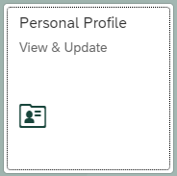



Other things to know about your appointment
AY vs AN
Employment percent and salary
Initial Appointment Date
Probationary End Date (for probationary continuing system)
Accumulated FTE Service Months (for promotion)
UNTF Eligible (for fixed term)
Notes:
Poll 4: AY or AN
Check your offer letter if you are not sure. Your EBS profile holds some of these details.
If you are fixed term and your position is UNTF eligible, you may also be eligible for a provision in the UNTF contract called Designation B, which provides a form of employment security. Designation B requires a promotion-like review. See the contract for more details.
Homework – read Specialist Handbook section 4.1 and 4.2, see if you understand it all. Additional homework in next slides.

Slide 29
Key documents at offer
Offer letter
Specialist Position Description
“Specific criteria for promotion”
Copy of the unit evaluation procedures for specialists
Copy of the Faculty Grievance Procedure
Summary of benefits and other attachments
If applicable and requested: Copy of the Fixed term Faculty/Academic Staff Appointment Reappointment Memorandum
Notes:
These items are required to be provided at hire. See Handbook, 4.2

Slide 30
Key documents at offer
Offer letter
Specialist Position Description
“Specific criteria for promotion”
Copy of the unit evaluation procedures for specialists
Copy of the Faculty Grievance Procedure
Summary of benefits
If applicable and requested: Copy of the Fixed term Faculty/Academic Staff Appointment Reappointment Memorandum
Notes:
The highlighted items are sent to the university. The rest are only kept in unit (or possibly MAU) files.
If you find some of these weren’t provided, you wouldn’t be alone. To start your path toward promotion, the first thing to work on is getting items 2, 3, and 4.

Slide 31
Additional reading
Specialist Handbook 2.4 The Specialist System
Specialist Handbook 4.1 Establishment of Positions and 4.2 Appointment Policies
MSU Bylaws Section 1.1: Definitions, The Faculty
Your college/MAU and department/unit bylaws
Your offer letter and its attachments
FASA Contact for Individual Questions:
Kathy Charles (lewlessk@msu.edu)

Slide 32

Questions
Notes:
12:15
At this point we will turn off the slides and go to a gallery view of all panelists, cameras on.
Committee members will be promoted to panelists. Rename self as Name, Job Title (MAU) (pronouns if desired)
Quick introductions of all panelists who helped with the production today, and are ready for your Q&A. Karen to facilitate Q&A.

