Slide 1
Composing & Sharing Your Teaching Dossier
Center for teaching and learning innovation (Draft)

Slide 2
Objectives
By the end of this session, you will:
Be able to describe the purpose of composing a teaching dossier.
Be able to identify the core components of a well constructed teaching dossier.
Construct an outline of your teaching dossier.
Decide what resources and artifacts you will include in your dossier.
Decide what tools you will use to build and share your dossier.
Reflect on how you wish to maintain and build your dossier for future use.

Slide 3
Outline of Module
Components of a Teaching Dossier
Core elements and optional additions
Building a Teaching Dossier
Sharing and maintaining
Purpose
Rationale and use

Slide 4
Purpose
Highlights personal values and perspectives on teaching.
Provides a context to personal philosophy of instruction.
Provides evidence of experience and effectiveness.
Highlights ongoing professional development and commitment to improvement.
Displays contributions to scholarly work.
Offers personal reflections.

Slide 5
Elements of a Teaching Dossier
Biographical Statement
Brief History of how you ended up in your current position.
Your current responsibilities
Describe the courses you have taught most recently
Describe the courses you’d like to teach or develop To get started, you may want to begin with addressing the following:
When did your teaching begin?
What brought / drew you to teaching?
What are your goals for teaching?

Slide 6
Elements of a Teaching Dossier
Approach to Teaching / Teaching Philosophy
Personal beliefs about teaching and learning.
Evidence to support your claims about teaching and learning:
Anecdotal evidence and personal experiences
Discipline-specific strategies you employ
Summarize your plans and goals as an educator
Write this in the 1st person.
Statements should be somewhat ‘brief’ (i.e. within 2 pages)
“A teaching philosophy statement is a systematic and critical rationale that focuses on the important components defining effective teaching and learning in a particular discipline and/or institutional context” Schönwetter et al, 2002
Schonwetter, D.J., Sokal, L., Friesen, M., and K.L. Taylor (2002) Teaching philosophies reconsidered: a conceptual model for the development and evaluation of teaching philosophy statements. The International Journal for Academic Development. 7:83-97.

Slide 7
Elements of a Teaching Dossier
Teaching Methods & Examples
A description of the teaching methods you employ. Don’t simply state that you use a particular method (i.e. lecture). You should provide a rationale: [Example]: “My instructional method of choice is the didactic lecture. I believe that for my discipline direct instruction is the most effective approach, and lecture is the most efficient method to achieve the learning outcomes for my course”.
You may include descriptions of activities and assignments you use in your class.

Slide 8
Elements of a Teaching Dossier
Teaching Responsibilities & Activities
Courses taught:
Brief description of the course: Modality, level, class size, credit hours, etc.
Role in course development and delivery
Materials developed (i.e. online modules, videos, study guides, lab manuals, etc.)
Any additional teaching (non-credit)
Seminars & workshops
Sessions for community interest groups
You may attach the syllabi for courses that you have developed or taught

Slide 9
Elements of a Teaching Dossier
Professional Development & SoTL Activities
Professional Development Sessions & Training
These are activities where you were a participant, not the facilitator or author of the opportunity.
In-house opportunities (i.e. CTLI, IT, Department, College sessions)
Discipline or society opportunities (i.e. FASEB, AAA, AERA, etc.)
Scholarship of Teaching and Learning (SoTL) These are activities related to the practice of teaching and learning you have researched. These would include, but are not limited to innovations in technology, strategies, assessments, and design:
Faculty Development Presentations & workshops
Conference Posters & Presentations
Papers & Publications
Participation & Collaboration

Slide 10
Elements of a Teaching Dossier
Reviews & Feedback
Consider sharing (anonymized) feedback from students in the form of emails, posts in discussion forums
or general feedback.
Course evaluation data if it is public and anonymized.
Peer feedback and comments from peer dialogue activities (with permission)
Awards and recognition (i.e. iteach.msu.edu “Thank an Educator”)

Slide 11
Elements of a Teaching Dossier
Summary & Reflections
Keeping notes on your teaching is a good professional practice. It allows you to reflect and review your efforts and experiences for future opportunities. Consider the practice of reflecting on your instruction as your chance to present your perspective on a course. Students have this opportunity in the course evaluation process, similarly you should also look at that experience and comment on things that worked well, and things that would be done differently the next time.
Your summary should be a brief reflection on your experiences. You may also outline goals that you hope to accomplish in your teaching practice.

Slide 12
Elements of a Teaching Dossier
Appendices / Evidence
One of the most profound differences between a dossier / portfolio and a Curriculum Vitae (CV) is that you can showcase and provide artifacts to demonstrate your work. In this portion of your dossier you may consider adding:
- Examples of learning activities
Module examples
Learning materials that you have developed
Assessments

Slide 13
Sharing your dossier
Creating a resource to share
Making the right decision
Options and examples
Things to consider

Slide 14
Creating your dossier
Using your MSU NetID you have access to various tools and resources that you may consider using in the development of your dossier. Two options you may consider:
D2L
Google Sites

Slide 15
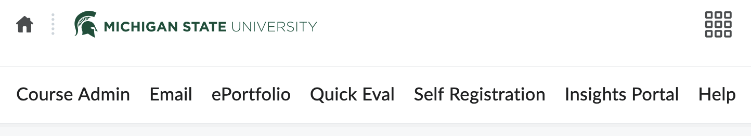
D2L - ePortfolio
You may be familiar with the ePortfolio option within D2L, or you may have seen the tab and wondered what it was for (see below).
Note: The D2L ePortfolio is available to anyone with a NetID who can log into D2L. This doesn’t mean it is the best or most ‘user-friendly’ option. It is being presented here because it is a tool everyone at MSU should have access to.

Slide 16
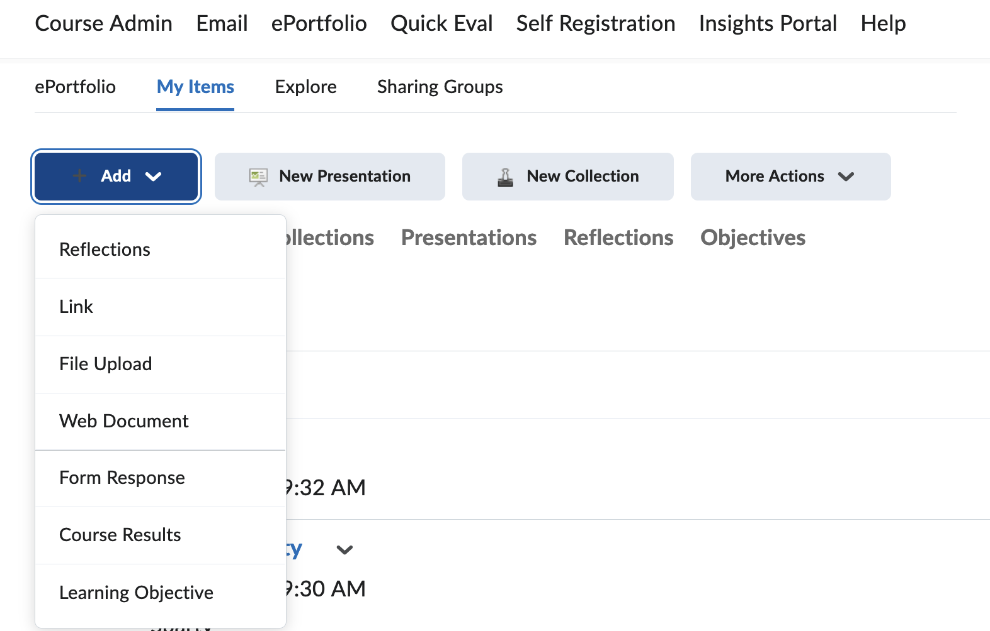
D2L - ePortfolio
Building an ePorfolio in D2L is counter intuitive to other tools, like Google Sites.
To construct an ePortfolio in D2L, you must first add the artifacts (i.e. examples, documents, reflections) to D2L (See image below)
To add artifacts and items to your ePortfolio:
Go to ‘My Items’
Select ‘Add’
Select the type of item you wish to add

Slide 17
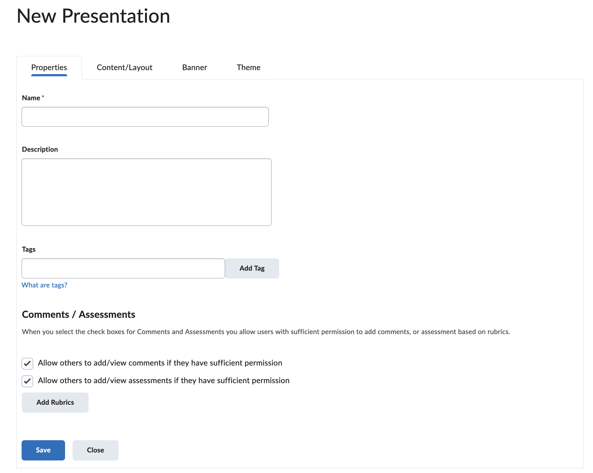
D2L - ePortfolio
Once you have your items added to D2L, you can compose your ePortfolio.
The ePortfolio in D2L is shared by creating a ‘Presentation’.
Select the ‘New Presentation’ tab and fill in the information for your presentation (see image to left).
You can add pages and select different layouts for your ePortfolio.

Slide 18
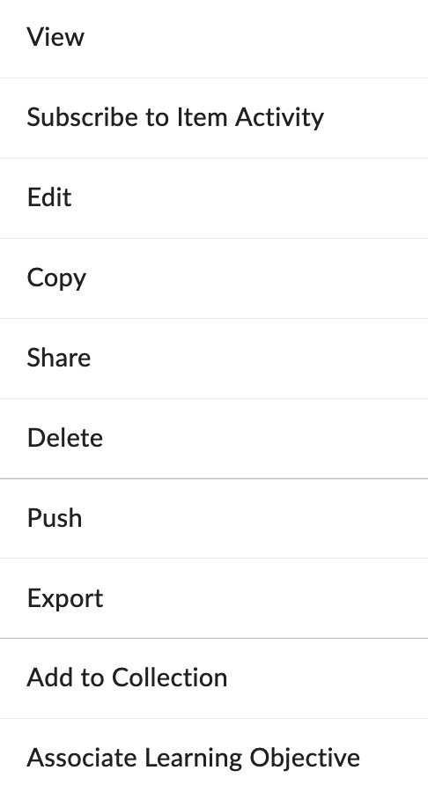
D2L - ePortfolio
When you have composed your ePortfolio, you can share it with people for review and feedback.
Look for the title of your presentation within the ePortfolio section of D2L.
Select the down arrow and click on the ‘Share’ tab.
You can set the window of access for people to review your ePortfolio.
There is a URL that you can share with people to access your presentation

Slide 19

Google Sites
Log into your Google account (MSU email address will work)
Go to Google Drive (or go to https://sites.google.com)
Select the ‘New’ button
Search for Google Sites
The interface for Google Sites is more intuitive than ePortfolio. You can:
Select more themes for your resource.
Add elements as you build
Link to resources within your Google Drive
Use Google analytics to monitor visits to your page
Note – Google sites is a public facing website. People with the URL can access this site. The benefit of using D2L is that you have more control over who can view and access your portfolio and the content contained within.

Slide 20
Considerations
- There are some factors to consider before you start building or composing your dossier (online):
- Privacy & access – Who and when?
- Portability – Can I take this with me?
- Ease of developing a resource
- Monitoring visitors (Use of Google Analytics)
- Linking to content and materials – You can link to Google resources within the D2L ePortfolio. You may have a
hard time linking to D2L from Google Sites

Slide 21
Consideration checklist
Feature | D2L | Google
Cost (Free) | ✓ | ✓
Portability (Take with you) | ✗ | ✓
Privacy (Control) | ✓ | ✗
Ease of Use (Build) | ✗ | ✓
Analytics | ✓ | ✓*
Design Elements | ✗ | ✓
* With Google Analytics

Slide 22
Examples & Resources
Here are some sample portfolios by MSU graduate students. You can refer to these as an example of what is possible technically:
Samples:
https://grad.msu.edu/sample-portfolios
How to:
https://youtu.be/0woNTtlcxgM
Shameless self-promotion example: https://sites.google.com/view/jayloftus-portfolio/home?authuser=0

