Slide 1
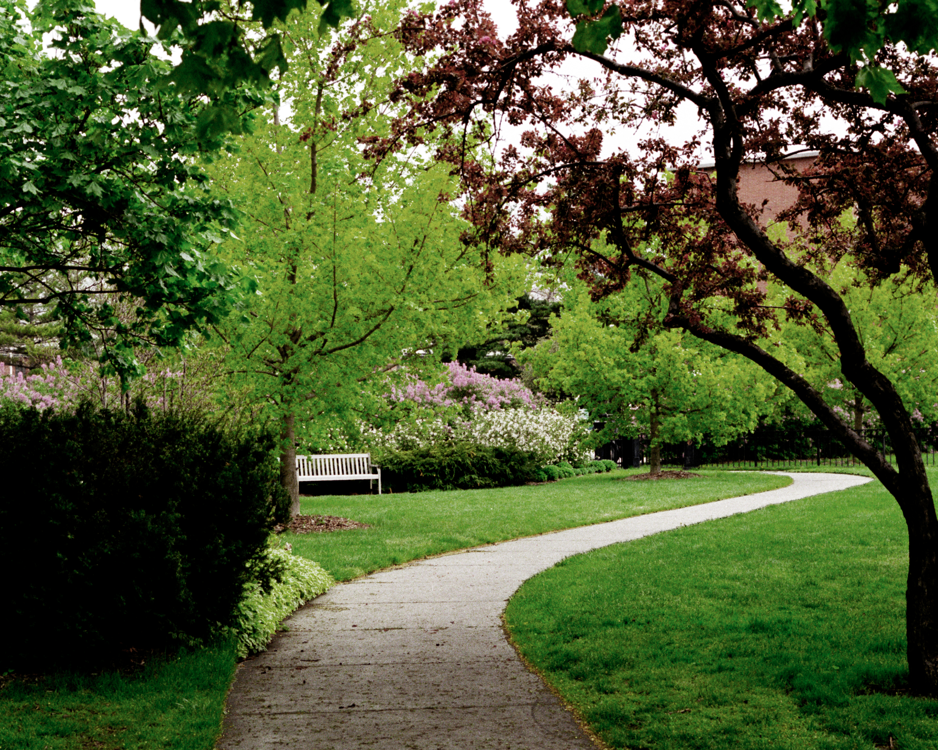
The Formal Process: Reappointment, Promotion, and Tenure
Ann E. Austin
INTERIM Vice Provost and Associate Vice President for Faculty and Academic Staff Affairs
October 18, 2023

Slide 2

Discussion Today
The University Philosophy concerning tenure
The Typical Tenure Clock Timeline for Faculty
Extensions to the Tenure Clock
RPT Process Overview
University Standards
Annual Review
Diversity, Equity, and Inclusion

Slide 3
The University Philosophy about Tenure
(see Annual Provost Memorandum, “Spring 2022 Memo”)
The University philosophy of tenure is set forth in the annual Provost memorandum.
Annually, the Provost sends the university RPT policy to academic leaders to assist them with reappointment, promotion, and tenure decisions.
Bookmark this link! I believe there is a new Spring 2023 Memo
Spring 2022 Memo: https://hr.msu.edu/policies-procedures/faculty-academic-staff/faculty-handbook/recommendations.html

Slide 4
Spring 2022 Memo
The University Philosophy on Tenure
MSU as an institution is committed to the highest standards of research, teaching, service and outreach.
The MSU philosophy of tenure is a frame for our aspirations to achieve the highest standards of research and teaching, and of service and outreach.
Units responsible for tenure and promotion recommendations are invited to engage in a new kind of thinking that establishes and values a new level of creation, invention, production, discovery, expression, and revelation about ourselves, our world, and our place in that world.
Tenure provides academics the freedom to explore and express work that could be antithetical to present knowledge.

Slide 5
Spring 2022 Memo
(pg. 2 of 2)
Philosophy (continued)
Academic freedom & responsibility are intertwined.
Recommendations for reappointment, promotion and tenure are among the most important decisions made by the University.
The success of an individual faculty member is an indication of a department’s success. We want to support all faculty members as they grow and contribute. We want each faculty member to succeed.
Faculty Rights and Responsibilities Policy: https://hr.msu.edu/policies-procedures/faculty-academic-staff/faculty-handbook/faculty_rights.html
Notes:
Joint appointments have more than one unit to which they need to attend. Units should come together with candidates to discussion expectations and procedures

Slide 6

A Helpful Resource
Did you know?
The Faculty Guide for Reappointment, Promotion, and Tenure (RPT) Review is a roundup of all policies and procedures related to the RPT process.
Share with your faculty and bookmark it!
Faculty Guide for RPT: https://hr.msu.edu/ua/promotion/faculty-academic-staff/guide.html

Slide 7
The Typical Timeline for Assistant Professors
Appointed as assistant professor to a 4-year probationary appointment
  During the third year a reappointment review occurs
  If unsuccessful, the appointment ends as originally scheduled
If successfully reappointed, the faculty member begins a second 3-year probationary appointment
  During the second year, the tenure review occurs
  If successful, one is promoted to associate professor and awarded tenure
  If unsuccessful, the appointment ends as originally scheduled
Notes:
The tenure review begins late in the second year, right. This was confusing to the group last time.

Slide 8
The Typical Probationary
Associate Professor Progression
A small number of faculty have initial appointments as associate professors without tenure, with probationary appointments typically of 2 - 4 years
  The reappointment review and decision are done in the year prior to the expiration of the appointment.
  If successful, reappointment to associate professor with tenure
  If unsuccessful, the original appointment ends as scheduled.
Notes:
This was a little confusing to the group last time too.

Slide 9
Extensions to the Tenure Clock
There are six automatic extension reasons:
  Leaves of absence that are one semester to twelve months.
  Changes in appointment to 50% time or less for one year.
  Immigration/visa status that does not permit the award of tenure for candidates who have been recommended for tenure.
  Birth/adoption of a child
  An extension recommended as an outcome of a hearing and/or appeal conducted pursuant to the Faculty Grievance Policy.
  The impact of COVID-19 for any probationary faculty member who: a) was in the tenure system at MSU as of Spring 2020 scheduled for a reappointment or tenure review, or b) has an employment start date in the tenure system from Summer 2020 through August 15, 2023.
Notes:
Automatic but still have to be documented, there just isn’t a real petition necessary. See if there’s a way to combine the extension slides and/or add some of the information at the end in the “handout”

Slide 10
Extensions to the Tenure Clock (continued)
In addition to automatic extensions, additional extensions of the probationary appointment may be requested from the University Committee on Faculty Tenure (UCFT) for a variety of reasons such as:
childbirth adoption the care of an ill and/or disabled child, spouse, or parent personal illness | to receive prestigious awards, fellowships, and/or special assignment opportunities; or other such serious constraints

Slide 11
Extension to the Tenure Clock (continued)
University policy – criteria are the same as for those who have not received an extension.
Note: Receipt of an automatic extension for any of the reasons above does not preclude consideration for reappointment or promotion with tenure at the normal time.
However, if the extension for the first probationary appointment is waived by the faculty member, the extension does not carry over to the second probationary appointment, with exception to a COVID extension.
In addition, a faculty member is bound to the outcome of the reappointment review if unsuccessful.
Extending the Tenure Clock: https://hr.msu.edu/policies-procedures/faculty-academic-staff/faculty-handbook/tenure_timeline_extension.html

Slide 12
Components and Processes
Components for review
  Evaluation of teaching, research/creative activities, and service
  External letters of review
  Reflective Essay – analytical, reflective looking back and forward
Process
  Department-level review
  College-level committee
  Dean’s review
  Provost’s Office Review
Notes:
Please note that we have another part of the session that talks about the essay part.

Slide 13
Overview of The Reappointment, Promotion, and Tenure Review Process
Department/ School Peer Review Committee Recommendation to Unit Administrator
Chairperson/ School Director Recommendation to Dean
College Peer Review Committee Recommendation to Dean
Dean Recommendation to Provost (February 28th)
Dean meets with Provost representatives (Associate Provost for FASA, distinguished faculty representative)
Provost makes final recommendations to President and Board of Trustees
Notes:
Something about Health College process/direction as it relates to this

Slide 14
University Standards – Reappointment
Based on clear evidence that a record is being established of progress toward
  Becoming an expert of national/international stature
  A solid teacher
  A contributing member of the unit, college, University, and/or discipline

Slide 15
University Standards – Promotion with the award of tenure
Based on several years of sustained, outstanding achievements in scholarship, teaching, and service across the mission, consistent with performance levels expected for promotion to associate professor at peer universities.
A reasonably long period in rank before promotion is usually necessary to provide a basis in actual performance for predicting capacity to become an expert of national and/or international stature and long-term, high-quality professional achievement and University service.

Slide 16
Annual Review
Reflective of one’s experience over a given reporting period
Should include reflection of contributions to DEI goals
All annual review letters from the chairperson/unit administrator are Included in the tenure review packet for review at all levels (e.g., peer review committees, Dean, Office of the Provost)

Slide 17
Evaluation & Impact of COVID
COVID Impact statement - The purpose is to acknowledge that faculty may have or continue to encounter varied challenges due to the pandemic.
The COVID-19 impact statement may be submitted to their unit administrator as part of their RPT dossier, activity report for annual review, and to internal and external reviewers upon promotion assessments.
Each impact statement is equally valued and accepted as valid.
Guidelines for Creating a COVID Impact Statement: https://hr.msu.edu/ua/promotion/faculty-academic-staff/covid19-impact-statement-guidelines.html
Notes:
How much emphasis is put on the covid statement?

Slide 18
Diversity, Equity, and Inclusion
DEI are core values of MSU.
Faculty should include evidence of their activities and accomplishments in DEI, as appropriate, when detailing information on relevant research/creative activities, teaching, and service.
High-quality, impactful academic work presents itself differently in varying fields of study; thus, a centralized, narrowly defined approach will not be taken.
Faculty members may weave their discussion and documentation of their DEI contributions throughout the essay, or they may choose to devote specific sections to such discussion.
Determining specific instructions about how to address DEI in RPT materials resides at the college level.
Where appropriate, faculty commitment to learning and engaging in DEI efforts will be recognized and considered in the RPT process.

Slide 19
Additional Information
Additional relevant policies:
Non-Tenured Faculty in the Tenure System
Faculty Review
Faculty Mentoring Policy
Historical Summary Numbers
Approximately 2/3 of original entering cohort attain tenure.
At the final stage of tenure consideration, approximately 90% attain tenure.
MSU wants its faculty to succeed!

Slide 20
THANK YOU

