Slide 1
Conflict – really, what is it?
Francisco A. Villarruel, Ph.D.
Faculty Grievance Official
fgo@msu.edu

Slide 2
Conflict – what is it?
When you think of conflict, what synonymous can be used to describe encountered situations?

Slide 3
Sharing
Right to left, share a word (non redundant) for the synonym of conflict.

Slide 4
Why do we fear/avoid conflict?
Impacts respect (mutual)
Impacts reputation
Creates tension
Reinforces power dynamics
Contributes to (dis)satisfaction
Changes ‘norms’ and expectations
Creates ‘more effort’
Increased avoidance
Other….

Slide 5
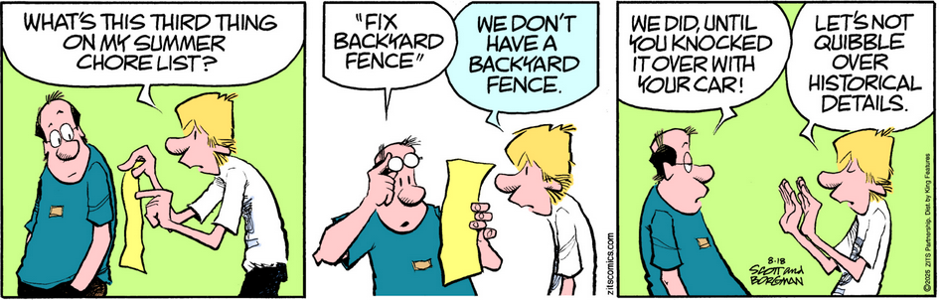
Defining conflict

Slide 6
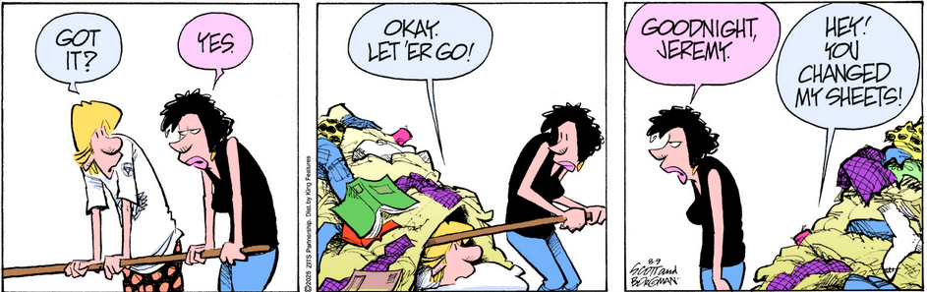
Defining Conflict

Slide 7
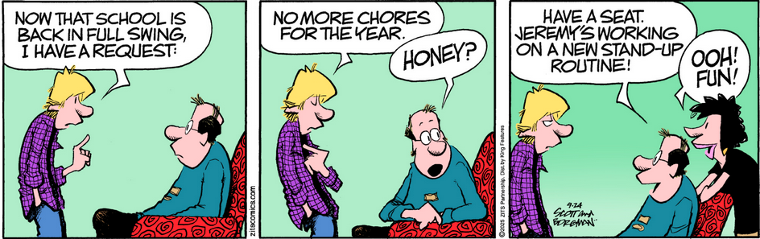
Defining Conflict

Slide 8
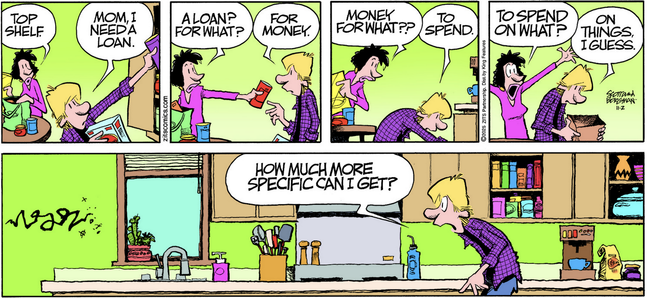
Defining Conflict

Slide 9
Barriers to conflict engagement?
What can we do to control and overcome our fears?

Slide 10
Summary of issues
Space
Energy
Time
Material
Control
Affect
Meaning
Content

Slide 11
“Engaging” in conflict
What are the risks of conflict engagement?
What are the benefits of conflict?
How can conflict be used to build climate?

Slide 12
An approach to ‘conflict’ engagement
Listening and hearing
Reflective questioning and discussion

