Slide 1

Seed of Dignity

Slide 2
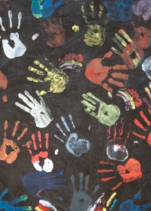
Human Dignity
Hicks has defined dignity as “the glue that holds all of our relationships together” and “the mutual recognition of the desire to be seen, heard, listened to, and treated fairly; to be recognized, understood, and to feel safe in the world.”

Slide 3
Dignity Model – Donna Hicks (2013)
Human desire to be treated with dignity is “primal”
When violated, it can feel like a threat to our survival
Treating people with dignity leads to more fruitful interaction

Slide 4
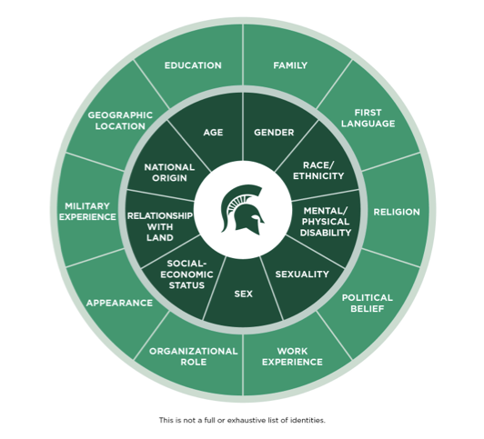
Identity

Slide 5

THE ROOTS OF CONFLICT
EXPECTATIONS
ACKNOWLEDGEMENT

Slide 6

Boundaries

Slide 7
One Way to Think About It
Think of love, respect, or dignity like the water we need to live…
Boundaries are like the
bucket that holds each of these necessities in our lives.

Slide 8
Practicing Dignity
Approach every topic, statement and response with respect
Respond instead of reacting
Avoid attacking someone else’s experience, but rather focus on your own feelings and experiences
Respect the equally valid experiences of others
Offer grace to others and take ownership of mistakes
Commit to being fully present with people, honoring the dignity of privacy - Take the lesson, leave the story
Avoid freezing people in time

Slide 9


Slide 10

Leadership

Slide 11


“Decisions are a lot like boats… they don’t come in halves. Make a whole decision or don’t embark on the journey.”
DECISIONS

Slide 12

How do I use this?

Slide 13

The Complexity of Our Brain

Slide 14

Bias
Explicit Bias
Attitude and beliefs that we have about a person or group on a conscious level. We are fully aware of these, so they can be self-reported.
LINE OF CONSCIOUSNESS
Unconscious Bias
Unconscious attitude that lie below the surface, but may influence our behaviors.

Slide 15


Slide 16


Slide 17
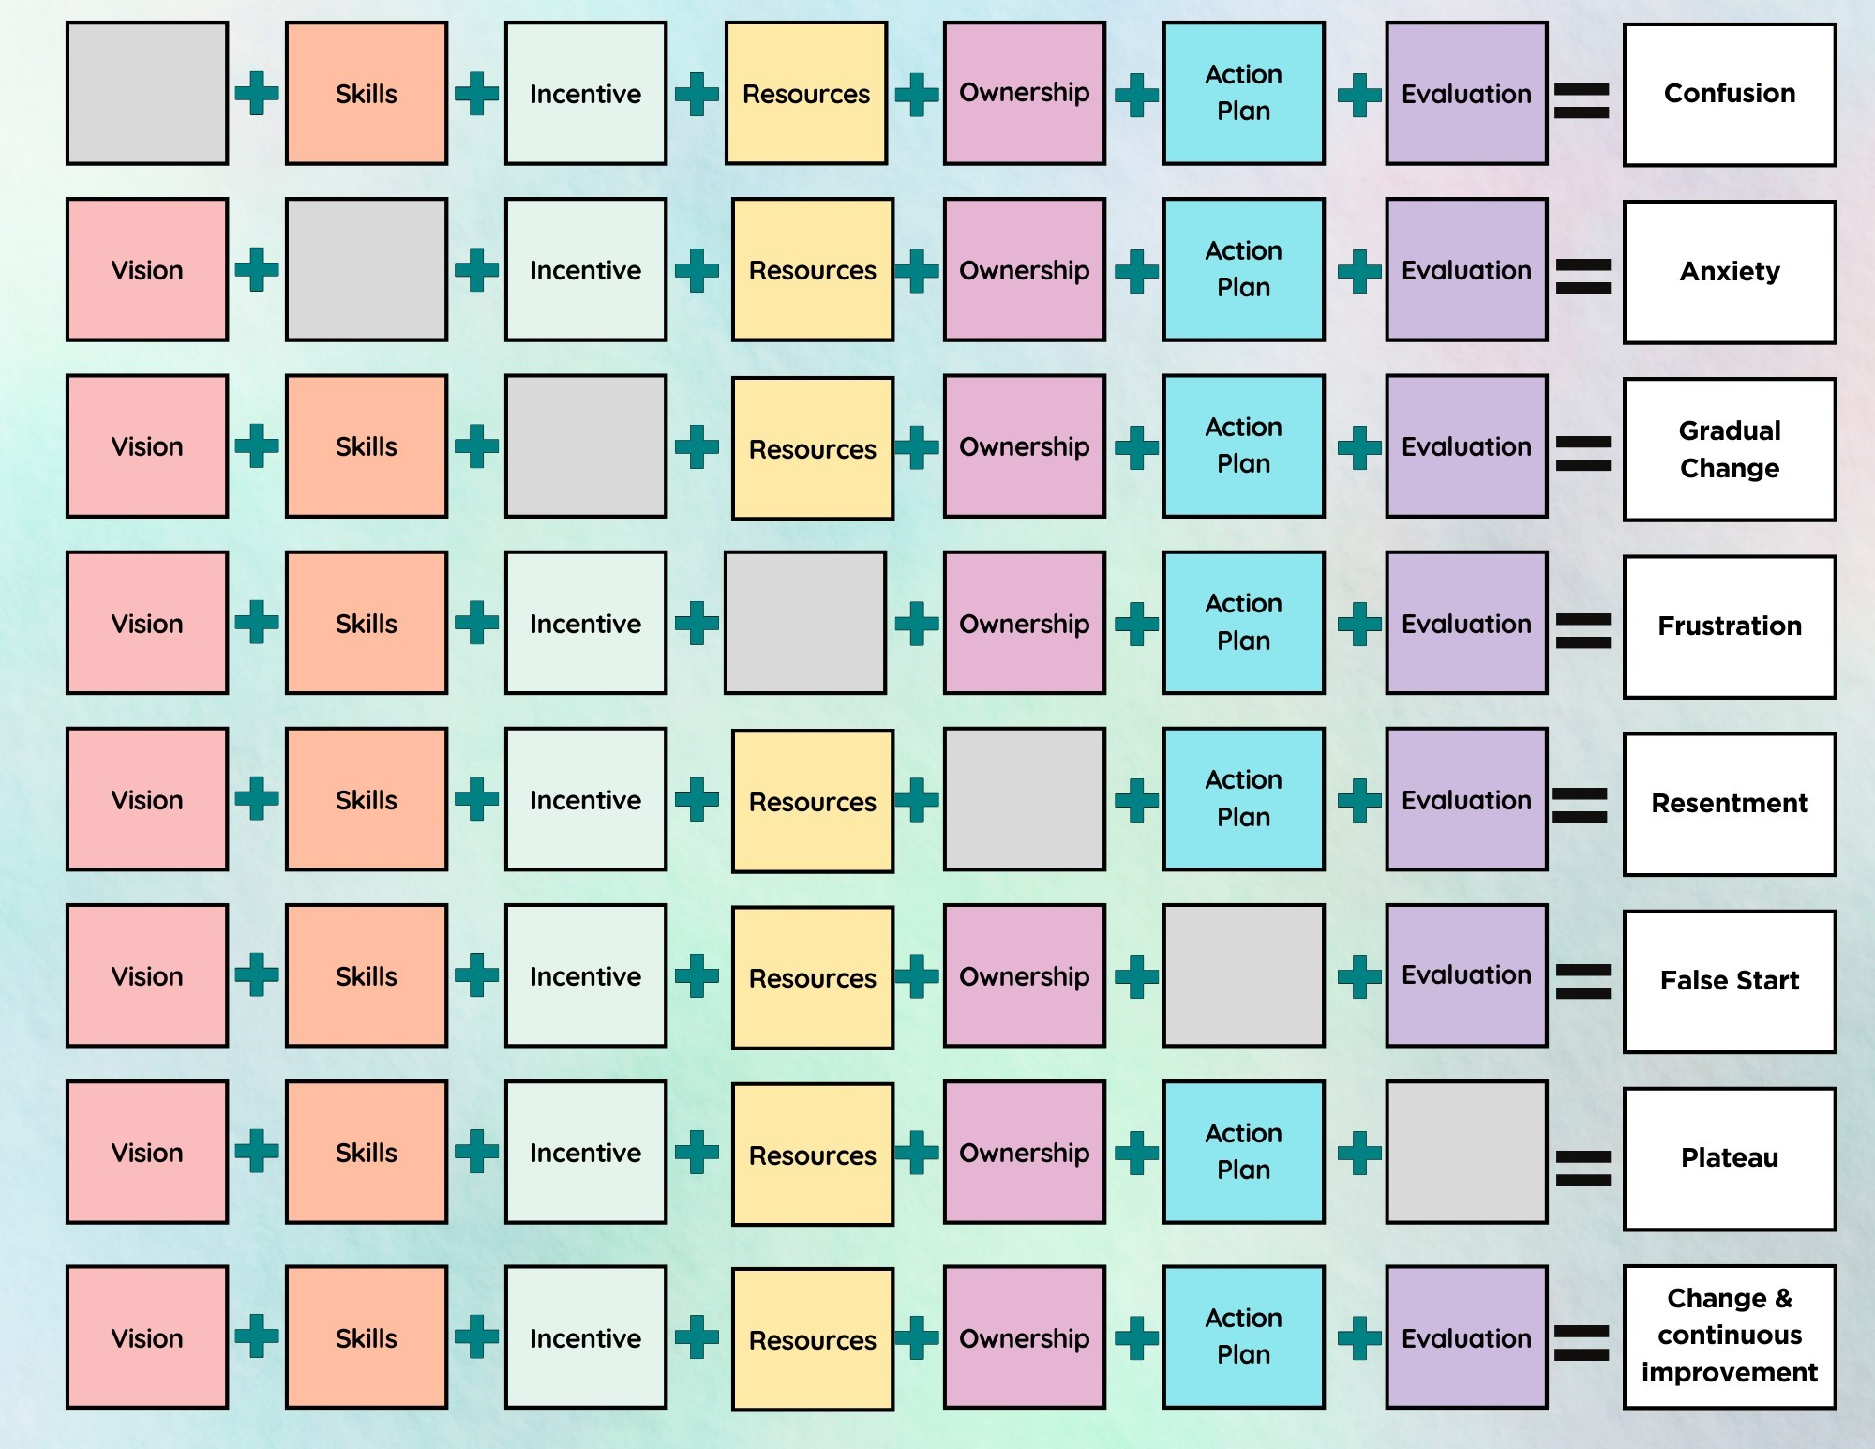
Source: Center for Youth and Communities Heller School for social Policy and Management, Brandeis University
Prepared by the Center for Youth and Communities, Brandeis University, 2004;
Based on experience in 50 Communities and early work on change management by Mary Lippitt, author of The Leadership Spectrum

