Slide 1
Administrator's Guide to Management of cases Reported TO the Office for Civil Rights & Title IX
Process & Responsibilities
Notes:
Cindi

Slide 2
Strategic Partners
Nicole Schmidtke, Faculty and Academic Staff Affairs, messin41@msu.edu
Amanda Moses, Employee and Labor Relations, mosesa@hr.msu.edu​
Rob Kent, Assistant Vice President and Senior Deputy Title IX Coordinator, isr.robkent@msu.edu
​
​
​
Notes:
Cindi

Slide 3
WARNING
This presentation refers to an example of sexual harassment.
If you believe that you will find the discussion to be traumatizing, you may choose to not participate in the meeting or step away from the discussion.
Resources and assistance are available through the Center for
Survivors and the Employee Assistance Program.
Notes:
Nikki

Slide 4
ACRONYMS
ADP (Anti-Discrimination Policy)
FASA (Office for Faculty and Academic Staff Affairs)
OCR (Office for Civil Rights and Title IX Education and Compliance)
ISR (Investigation, Support and Resolution – the division in OCR that used to be referred to as OIE)
ELR (Employee and Labor Relations)
OGC (Office of General Counsel)
OHS (Office of Health Sciences)
RVSM (Relationship Violence and Sexual Misconduct and Title IX Policy)
RO (Resolution Office – hearing office within ISR)
SIT (Support and Intake Team – intake and support within ISR)
Notes:
Nikki

Slide 5
Objectives
Introduction to the offices that support administrators through this process- OCR, FASA, ELR
Briefly Discuss OCR investigation and resolution process to increase general understanding
Focus on the milestones of the OCR process that are crucial for Administrators
How to address behavior early
Notes:
Nikki

Slide 6
Human resources STRUCTURE @ MSU
FASA Bucket
ELR Bucket
Provost
Vice Provost and Associate Vice President for Faculty and Academic Staff Affairs
5,600 faculty, academic staff and executive managers***
Vice Provosts, Deans and MAU Leaders
EVP Administration
Associate Vice President of HR
7,000+ support staff
***OHS and FASA partner on OHS faculty/academic staff cases
Notes:
Amanda
HCI- fall into either bucket depending on employee type

Slide 7
What is misconduct?
Wrongful conduct, by the University or a University community member that is illegal under applicable federal, state, or local laws, is fraudulent, or is in violation of any of the University’s policies or procedures. Misconduct includes, but is not limited to, violations of University policy and the law including academic misconduct, fraud, unauthorized use of the University’s property or resources, fraudulent or dishonest financial reporting, bribery, or kickbacks.
Notes:
Amanda
Poll Question – Do you know what Misconduct is?

Slide 8
Policy Overview
Faculty & Academic Staff
Faculty Rights and Responsibilities** (Recently Updated)
Code of Teaching Responsibility
Consensual Amorous or Sexual
Relationships with Students
Research Misconduct
Dual Appointments
University-Wide
Relationship Violence and Sexual Misconduct & Title IX Policy
Anti-Discrimination Policy
Mandatory reporting of RVSM
Acceptable Use Policy for MSU Information Technology
Occupational Health and Safety Rules & Regulations
Interim Protection from Retaliation* (New)
Support Staff
Support Staff Rules Governing Personal
Conduct of Employees
Notes:
Amanda
Note that these are not all of the policies that address behavior

Slide 9
Early Intervention Strategies
Address inappropriate behavior early and consistently
Schedule in person meetings (if possible) with the employee of concern to address the behavior, reset expectations and document the discussion in writing (preferably back to the employee)
Departmental/Unit Codes of Professionalism or Statement of Values- always helpful to lean on when setting the expectations about behavior
Conflict resolution and management – when conflict is bubbling up with employees in your unit, consult with your FASA, ELR, OHS reps on how best to address (e.g., restorative practices, shuttled mediation, etc.)
If you do not document it, it did not happen.
Notes:
Amanda

Slide 10
Office for Civil Rights, & title IX education & Compliance
Prevention, Outreach, and Education Department (POE)
Investigation, Support and Resolution
Support and Intake Team (SIT)
Director, RVSM Response & Investigations
Director, ADP Response & Investigations
Resolution Office (RO)
Office of the ADA Coordinator
Office of the Vice President
PACE (Projects, Analytics, Compliance and Envisioning)
Equity Review Officer
Advisors
Notes:
Rob

Slide 11
Overview of OCR Process
Intake and Support
Investigation
Appeal
Hearing and Resolution
Notes:
Rob

Slide 12
Protocol for Coordinated Response
In 2018, OCR, FASA, ELR and OHS created shared protocol for coordinated response and information sharing between these units before, during and after an investigation and resolution
The Protocol addresses each unit's role in the response and info sharing process from initial notification, interim and supportive measures, status updates, and sanctioning or other follow up
https://civilrights.msu.edu/policies/Protocol-for-Coordinated-Response-11.1.24_.pdf
Notes:
Amanda

Slide 13
Roles and Responsibilities During OCR Investigations
OCR- intakes reports, facilitates supportive measures for parties, investigate conduct under the ADP/RVSM, and issue decision and findings
FASA/ELR/OHS-Advises unit leadership on the HR-related policies and procedures and contracts, tracks notifications and schedules meetings
Unit Administrators-Oversee the employment decisions of the employees in the unit, document unit decisions and processes
OGC-Provide legal guidance and advice throughout the process
Notes:
Nikki

Slide 14

OCR's Initial Response and Notification Process
Notes:
Rob

Slide 15

Report Submitted to OCR: Initial Assessment by OCR
Notifications to Other Units
Referrals
Outreach
Closure Considerations
Notes:
Rob

Slide 16
SAMPLE NOTIFICATION
Hello,
​​​​​​​
My name is [[SENDER_FULL_NAME]] with the Office for Civil Rights and Title IX Education and Compliance (OCR) at MSU. OCR is responsible for responding to possible violations of the Relationship Violence & Sexual Misconduct and Title IX Policy (RVSM) and the Anti-Discrimination Policy (ADP). You are receiving this notification based on your current listed role on campus.
OCR received a report about concerns involving Respondent Employee X.
Claimant impacted by the conduct is Claimant Y.
At the present time, OCR is aware of the following information:
[Bulleted summary of relevant information from report]
OCR is also aware of the following reports or complaints previously made about Respondent:
[OCR will include prior reports involving the Respondent to help units/HR in making interim employment decisions]
Notes:
Rob

Slide 17
[If OCR is closing at the initial notification stage] OCR has the reviewed the submitted report and based on the information available at this time, OCR will be closing this matter for the following reason:
The information available does not demonstrate coverage under OCR polices.
The information provided is insufficient for an investigation into this matter without claimant participation.
The information provided is insufficient for an investigation into the matter because the respondent has not been identified.
The facts provided, taken as true would not demonstrate an OCR policy violation.
We are referring the matter to you for review to take potential action as deemed necessary to address conduct that may implicate policies, protocols, or standards of conduct other than the ADP/RVSM policy. Please consult with Human Resources for further guidance on the available options and implementation of employment actions and notify OCR if action is taken. In the event you have additional information that may change OCR's review, please do not hesitate to contact us immediately.
Prohibition on Retaliation...
Privacy notice...
Notes:
Rob

Slide 18

Unit's Initial Response Upon Receiving Notification
Consult with FASA, ELR, OHS to review
Consider whether interim action may be needed
Do not investigate
Do not retaliate
OCR Notification to Senior Admins, FASA or ELR*
*FASA: If the respondent is FAS or EM
ELR: If the respondent is Support Staff
Notes:
Rob

Slide 19
The "Do Not Investigate" Myth
Do not investigate- refers to investigation of OCR allegations, not other conduct/behavior
There is a misconception on campus that when OCR is assessing or investigating conduct, that the unit cannot do anything to address the employee's behavior and/or performance
Interim Employment Actions related to the reported misconduct are always an option (will discuss in the next section)
Important to remember that there are many other employment related policies that apply in any given situation and the unit may be able to move forward with HR-led investigations for other policy violations in the interim while OCR investigates
Poor performance that is parallel and not related to the reported behavior issues can and should always continue to be addressed
Always consult with FASA, ELR, OHS, and OGC before continuing
Notes:
Nikki

Slide 20

Questions?
Notes:
Nikki

Slide 21

Interim Actions- FASA/ELR and the Unit Leaders Response
Notes:
Amanda

Slide 22
INTERIM Actions
Interim Measures = Non-disciplinary, safety measures or measures to deter reported conduct during an investigation under RVSM Policy or ADP.
Examples include: verbal coaching, change of work location, modified duties, restriction of access, remote work, no contact directives, delaying performance reviews, paid administrative leave, etc.
Must talk to FASA, ELR, OHS and OCR prior to any action.
Exception: Imminent Safety Concerns
No determination of any wrongdoing
Typically stay in place during the length of the investigation, but can be modified
Interim measures should be in writing
Notes:
Amanda
Supportive vs interim

Slide 23
Situational considerations
Health and safety concerns
How often the parties interact and how they interact
Power dynamics
Life experiences
Awareness of multiple people within the unit potentially being involved in a case, witnesses resulting in divisions and residual conflict
Reducing the ability for any retaliation
Pattern of behavior
Notes:
Nikki

Slide 24
Reporting
If interim actions or actions after a finding are taken, other oversight organizations may need to be notified
Clery Act – if the incident involved a Clery crime, the Clery Act Compliance Coordinator will be notified by FASA/ELR
Federal Agencies (NSF/NASA/NIH/DOD/DOE/USDA)
CGA website with requirements: https://www.cga.msu.edu/PL/Portal/2190/HarassmentReportingRequirementsbyAgencyEntityinBrief
Notes:
Nikki

Slide 25

No interim actions
If no interim actions taken, you will wait for the findings concerning the ISR investigation and/or RO finding.
Remain observant of the situation and reach out to FASA, ELR, OHS if you have concerns.
You will get regular status updates from ISR and/or RO. If you have questions, reach out to ISR or RO.
You may address other workplace issues such as performance or policy violations. You should consult with ELR/FASA/OHS and OGC as appropriate.
Notes:
Nikki

Slide 26
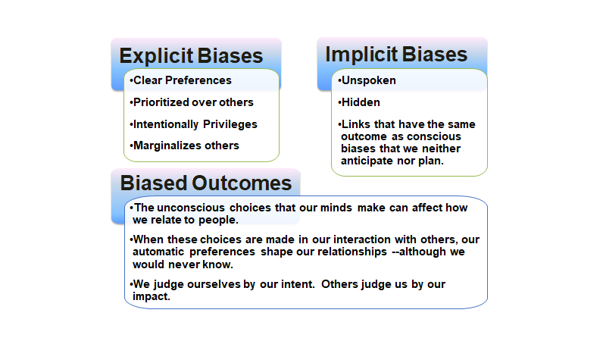
Individual Leadership Considerations
Notes:
Nikki
Resources to link people to- conflict management, implicit bias, etc. Does IDI have a slide on it??

Slide 27

Case Scenario – Part 1-- Notification from OCR and Interim Measures
You receive a notification from OCR that one of your employees has reportedly engaged in multiple conversations with a student that have, at times, crossed professional boundaries and are being perceived by the student as persistent unwanted, romantic advances in violation of the RVSMTIX Policy. This respondent is relatively new and has no prior history. ISR is still trying to assess if the claimant student wants to meet with an investigator.
A meeting is scheduled with unit leadership, FASA/ELR/OHS, OCR and OGC to discuss potential interim measures.
What are some considerations you think should be discussed at this meeting?
What are some questions you might have for FASA/ELR/OHS?
What are some questions you might have for OCR?
What potential interim measures might you be considering at this point?
Discuss in small groups and then we will return and share out.
Notes:
Nikki Reads
Carl Answers
Notes- Your FASA liaison promptly schedule an interim measures meeting with OCR- What questions do you have for FASA and/or OCR and (2) what potential interim measures are you considering?

Slide 28
Claimant DOes not Participate- What happens now?
OCR will still evaluate the information and determine whether the Title IX Coordinator will sign a complaint
The TIX Co can sign a formal complaint in lieu of the Claimant
If no TIX signed complaint, then the matter will close and will be referred to the Unit/HR
OCR closure DOES NOT mean that the Unit/HR's work is done
The information should still be evaluated for potential follow up under other policies and/or re-setting expectations on appropriate behavior (i.e., coaching)
Notes:
Amanda,

Slide 29

OCR – Investigation and Resolution Process
Notes:
Rob

Slide 30
Investigation Process
The investigation process = 90 days, but can be extended for good cause
During the investigation process, you should receive regular status updates from the investigator
The investigator may reach out to you as the unit representative to ask for information/documents that are typically held by units (e.g., bylaws, meeting notes, etc.)
Notes:
Rob

Slide 31
Privacy of Information
There are overarching privacy concerns related to allegations of employee behavior/discipline and/or reported OCR allegations (e.g., state law; University policies, including ADP/RVSM; employment contracts, etc.)
Thus, the information should only be shared on a need-to-know basis
OCR notifications involving reported employee behavior are initially sent to the Dean/MAU leader and a second administrator designated by the Dean/MAU leader
However, in some cases, units may need to include other supervisors/administrators in the discussion (e.g., Associate Deans, Chairs, Chiefs of Staff, etc.)
Sometimes leaders feel compelled to send a communication to groups of individuals regarding an ongoing investigation
Units should proceed with absolute caution and always speak to FASA, ELR, OHS, OCR and OGC (and potentially UCAMS) before proceeding as these communications are fraught with legal and compliance issues
Notes:
Rob

Slide 32
Communication Review process for employee misconduct
Communications should reflect the University’s commitment to ensure a safe and respectful working and learning environment while adhering to employee privacy rights required by law.
The University endeavors to increase transparency, promote accountability, and build trust and awareness within the University community.
Balance of transparency and confidentiality
Stakeholder communication strategy
Working with ELR/FASA, OCR, OGC, and University Communications
Considering communication in the context stage of the process and impact on stakeholders
https://hr.msu.edu/ebshelp/councilofdeans/Misconduct%20Communication%20Review%20Process%202021.11.1.docx
Notes:
Nikki

Slide 33
Administrators: What you can and cannot do during Investigation?
CAN place respondent on interim employment measures pending the investigation
CANNOT discipline employee respondents for violations of ADP/RVSM absent a finding
CAN continue to address performance issues (i.e., not completing reasonably assigned duties) with all parties
CANNOT engage in retaliation
CAN share information on a need-to-know basis
CANNOT widely communicate details of an investigation
Notes:
Nikki

Slide 34
Hearing and Written Decision
In general, cases involving RVSM and other ADP gender discrimination issues are entitled to a hearing
Units/HR will continue to receive regular status updates during this process
Written decision- all formal investigations will end with a written decision either from the Investigator (no hearing) or the Resolution Officer (hearing)
The written decision will have findings of fact and conclusions regarding whether the policy was violated
Even in cases with a no finding of responsibility under the ADP/RVSM, units should still be reviewing the written decision, including the author's findings of fact
These findings of fact can be utilized in subsequent HR processes
However, no decision is final until the appeal deadline lapses and/or the appeal process has concluded
Notes:
Rob

Slide 35
What is considered in an appeal
Procedural Irregularity
New Evidence
Conflict of Interest or Bias
Arbitrary and Capricious
Notes:
Rob

Slide 36
Questions?
Notes:
Amanda

Slide 37

FASA/ELR and the Unit- Post-Decision Response
Notes:
Amanda

Slide 38
FINDING: Violation of RVSM or ADP Policy
Schedule
FASA/ELR rep will schedule a meeting with College/Department leadership, OGC, and OCR
Consider
Consider if other policies were violated and if further investigation of the issues is needed
Assess
Assess appropriate discipline or other interventions
Create
Create a plan to implement discipline and any necessary communications
Notes:
Amanda

Slide 39
No finding
What does "No Finding" Really Mean?
Next Steps/Considerations:
Leadership meets with FASA, ELR or OHS to assess situation
Are there other behaviors or actions that are concerning?
Is further investigation needed (under other policies)?
Action steps to consider: professional development, re-entry, clarification of rules/policy, discipline, etc.
How do you rebuild the team?
Notes:
Nikki

Slide 40
Discipline Overview for Support STaff
Consult with ELR to ensure compliance with collective bargaining agreements and human resource policy.
Approval from the Director of Employee Relations is required for certain actions.
ELR can assist with required notifications/reporting
Notes:
Amanda

Slide 41
Discipline overview for faculty & academic staff
Academic Specialist Handbook
Faculty Handbook
Fixed-Term
Tenure Stream Faculty
FRIB NCSL Handbook
Health Professional (HP) Handbook
Librarian Handbook
UNTF Contract
Notes:
Nikki - Discipline training on 2/27/25- FASD site

Slide 42
Additional Learning Opportunity COming Up...
What you Need to Know – The Discipline Process for Academic Administrators and Managers
March 12, 2026, 9-11am, MSU Green Room
Creating and Sustaining a Respectful Work Environment Series - Faculty and Academic Staff Development
Notes:
Nikki

Slide 43
Case Scenario - Part II- Post Decision Response
After an investigation and hearing, the Resolution Officer issues its final decision and the outcome is that the respondent employee did not violate the RVSMTIX Policy. However, the RO's decision found that:
The respondent employee made an unwelcome comment on the claimant student's physical appearance
The respondent employee gave claimant student a hug without asking permission
The respondent employee asked the claimant student if they had a significant other
Although there was no finding of responsibility under the ADP/RVSM, what are your next steps as an administrator to address this behavior?
What considerations are you taking into account when determining the appropriate follow up?
Discuss in small groups and then we will return and share out.
Notes:
Amanda

Slide 44
Safe Environment ACTION Plan protocol
In 2022, a taskforce was empaneled by the Provost to review best practices around reintegrating employee respondents into the workforce post-OCR investigation
The taskforce's recommendations were published- Safe Environment Action Plans
The purpose of the Plan is to provide guidance to the unit on how to provide a safe and inclusive working environment post-OCR investigation, particularly in situations where respondents are re-integrated into the workplace
The Plan is then reviewed with the Review Team for consultation and feedback
After consultation with Review team, the Plan is finalized and implemented. FASA and the unit will review the Plan periodically and make adjustment as needed.
Review teams will be trained on the confidential nature of the process
Notes:
Nikki

Slide 45

Questions?

Slide 46
Additional Resources
Faculty and Academic Staff Affairs
Office for Civil Rights and Title IX

Slide 47
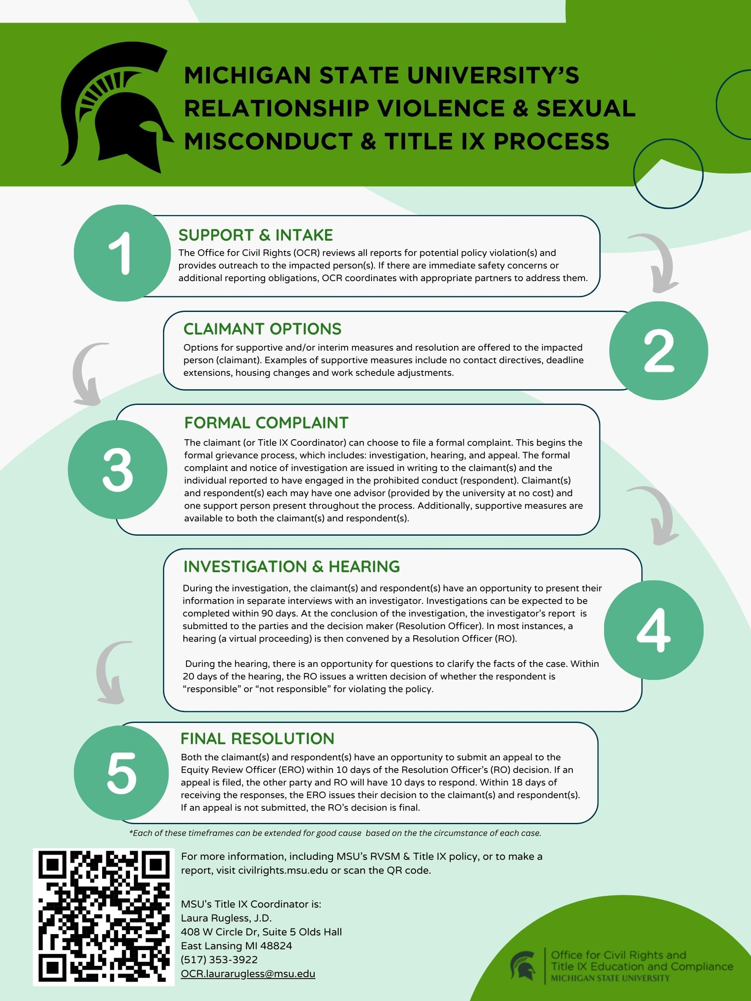
Notes:
Rob

Slide 48
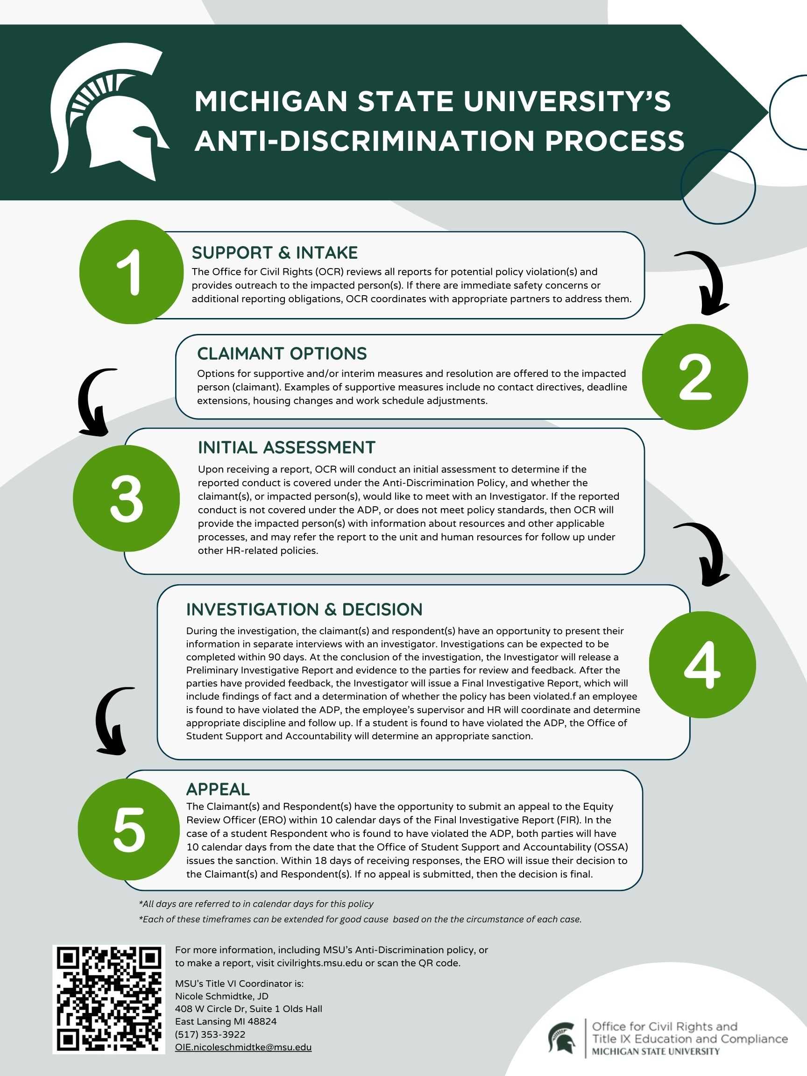
Notes:
Rob

