Slide 1
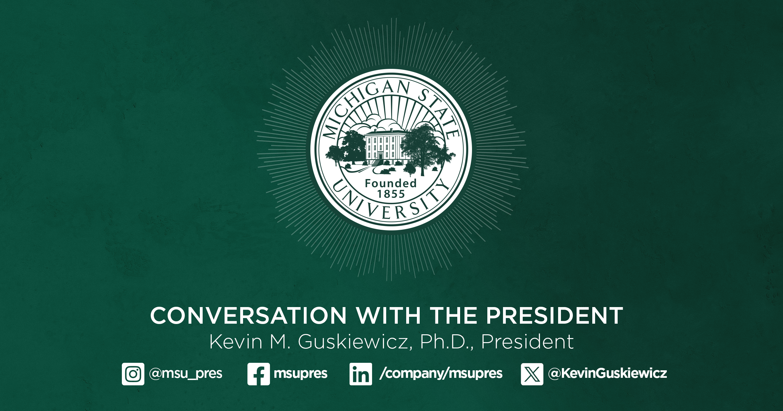

Slide 2
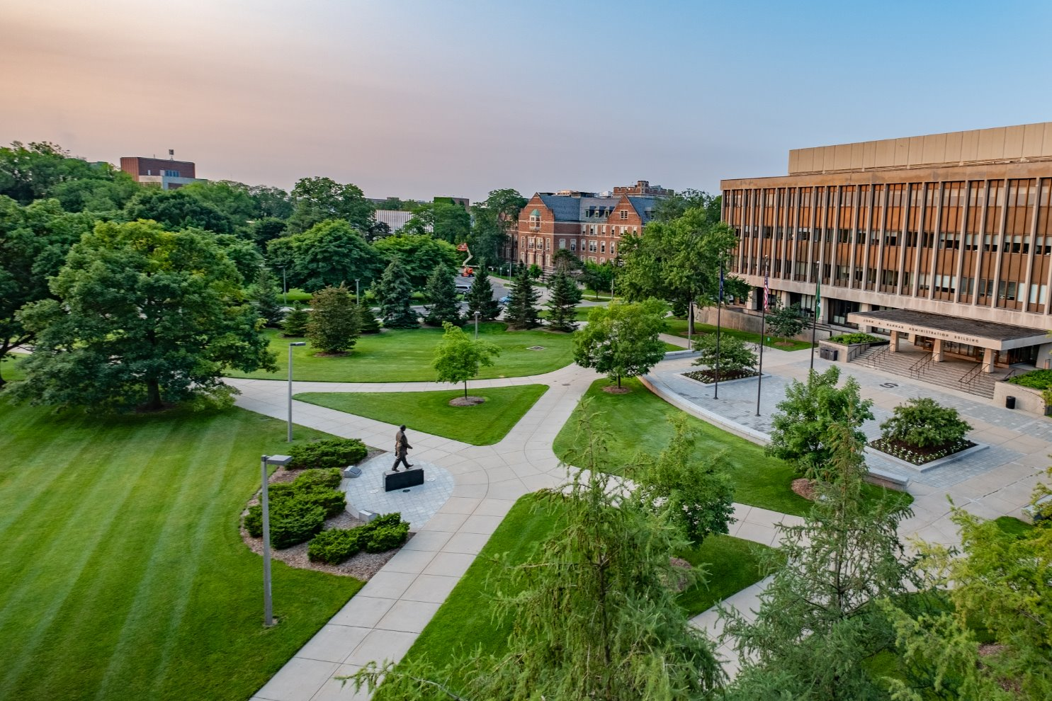
MSU's Legacy of Bold Innovation
Feb 2025, Detroit Innovation Conference

Slide 3
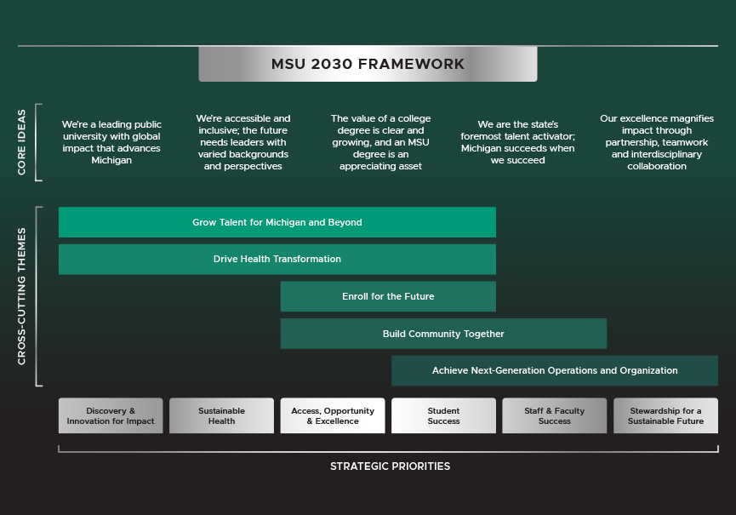
MSU 2030: Strategic Plan Update
Feb 2025, Detroit Innovation Conference

Slide 4
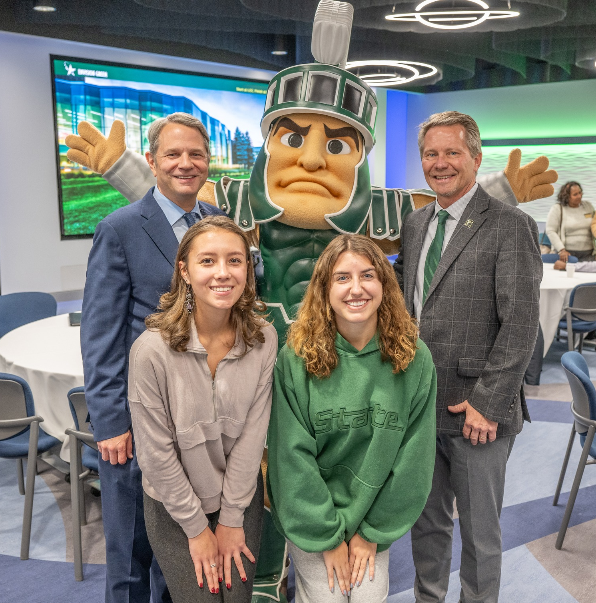
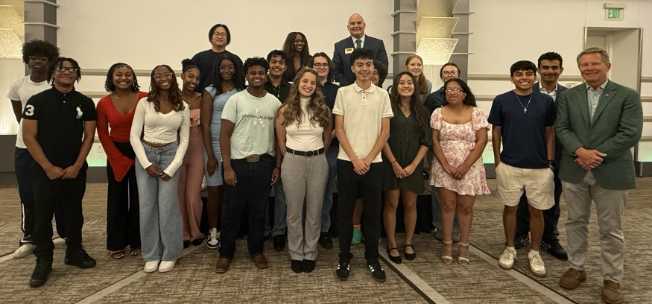
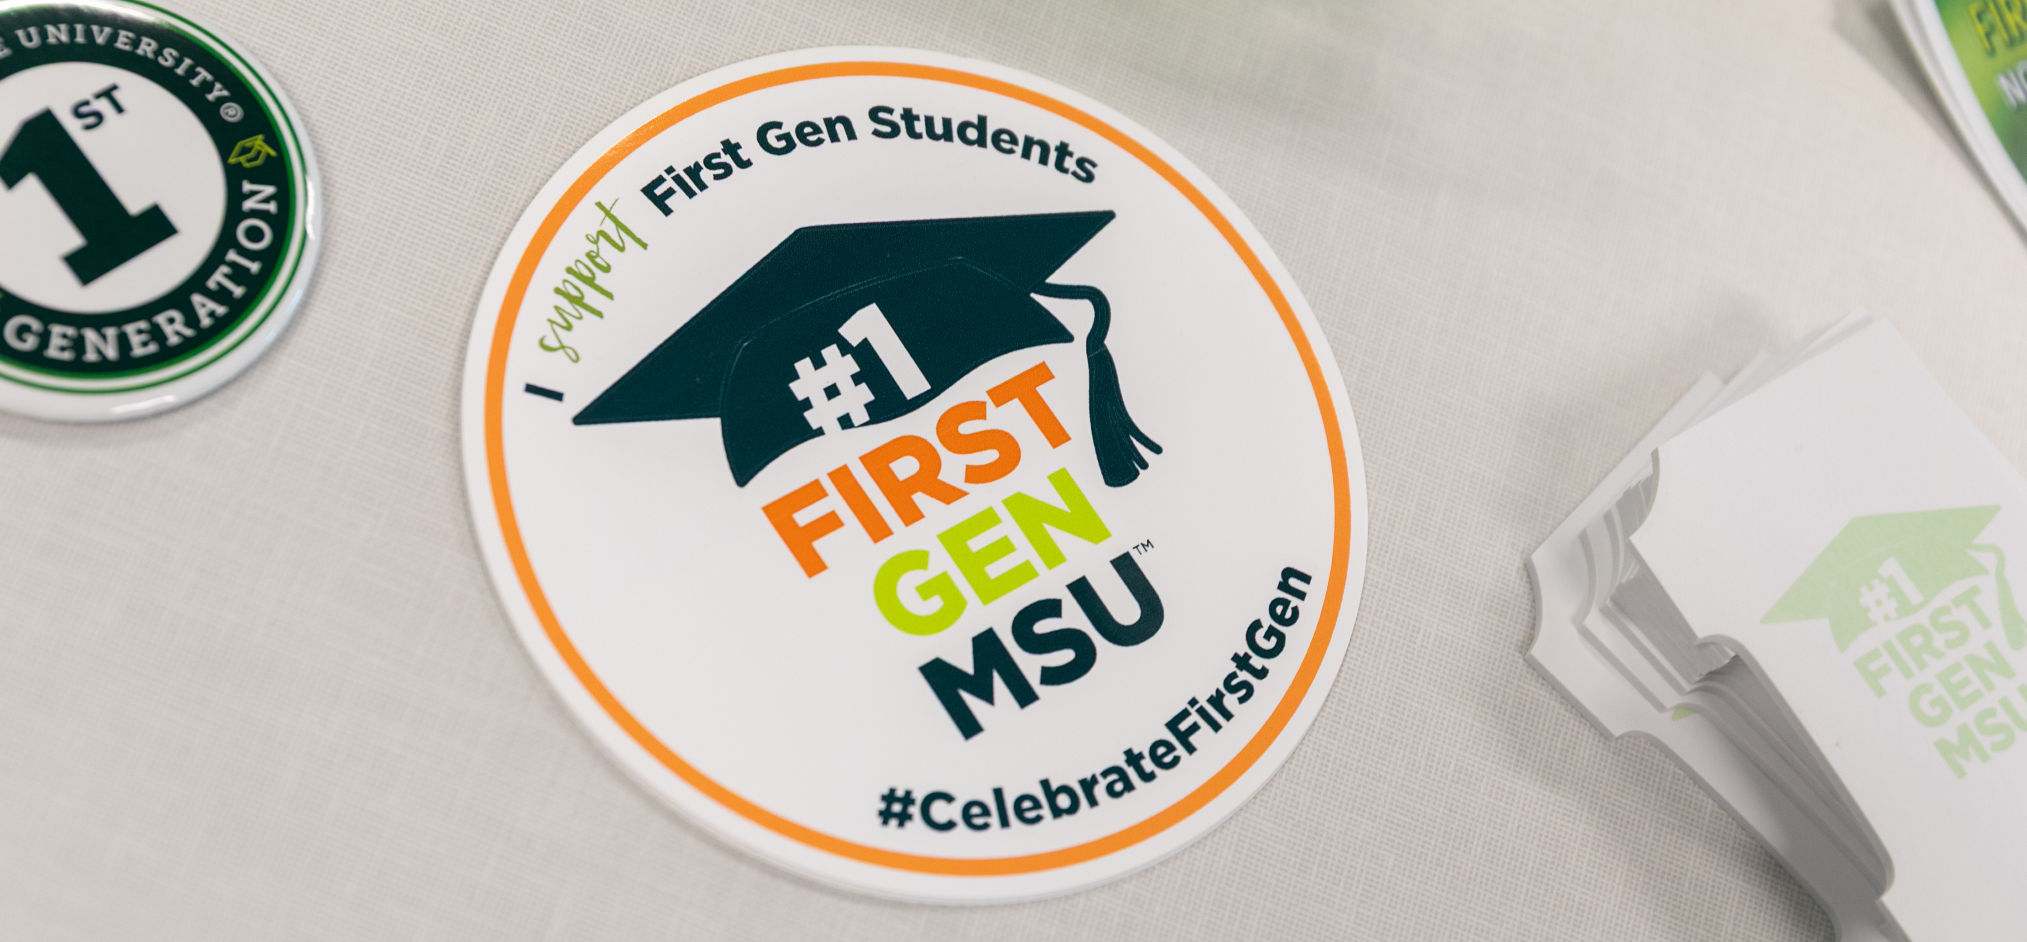
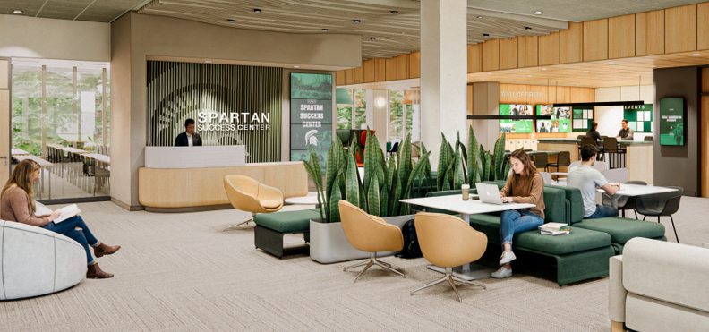
Enroll for the Future
Feb 2025, Detroit Innovation Conference

Slide 5
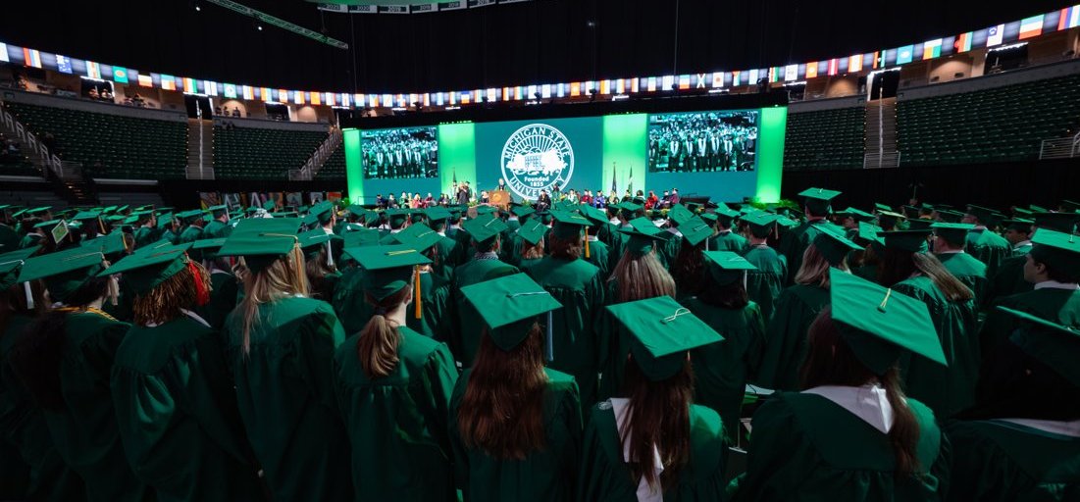
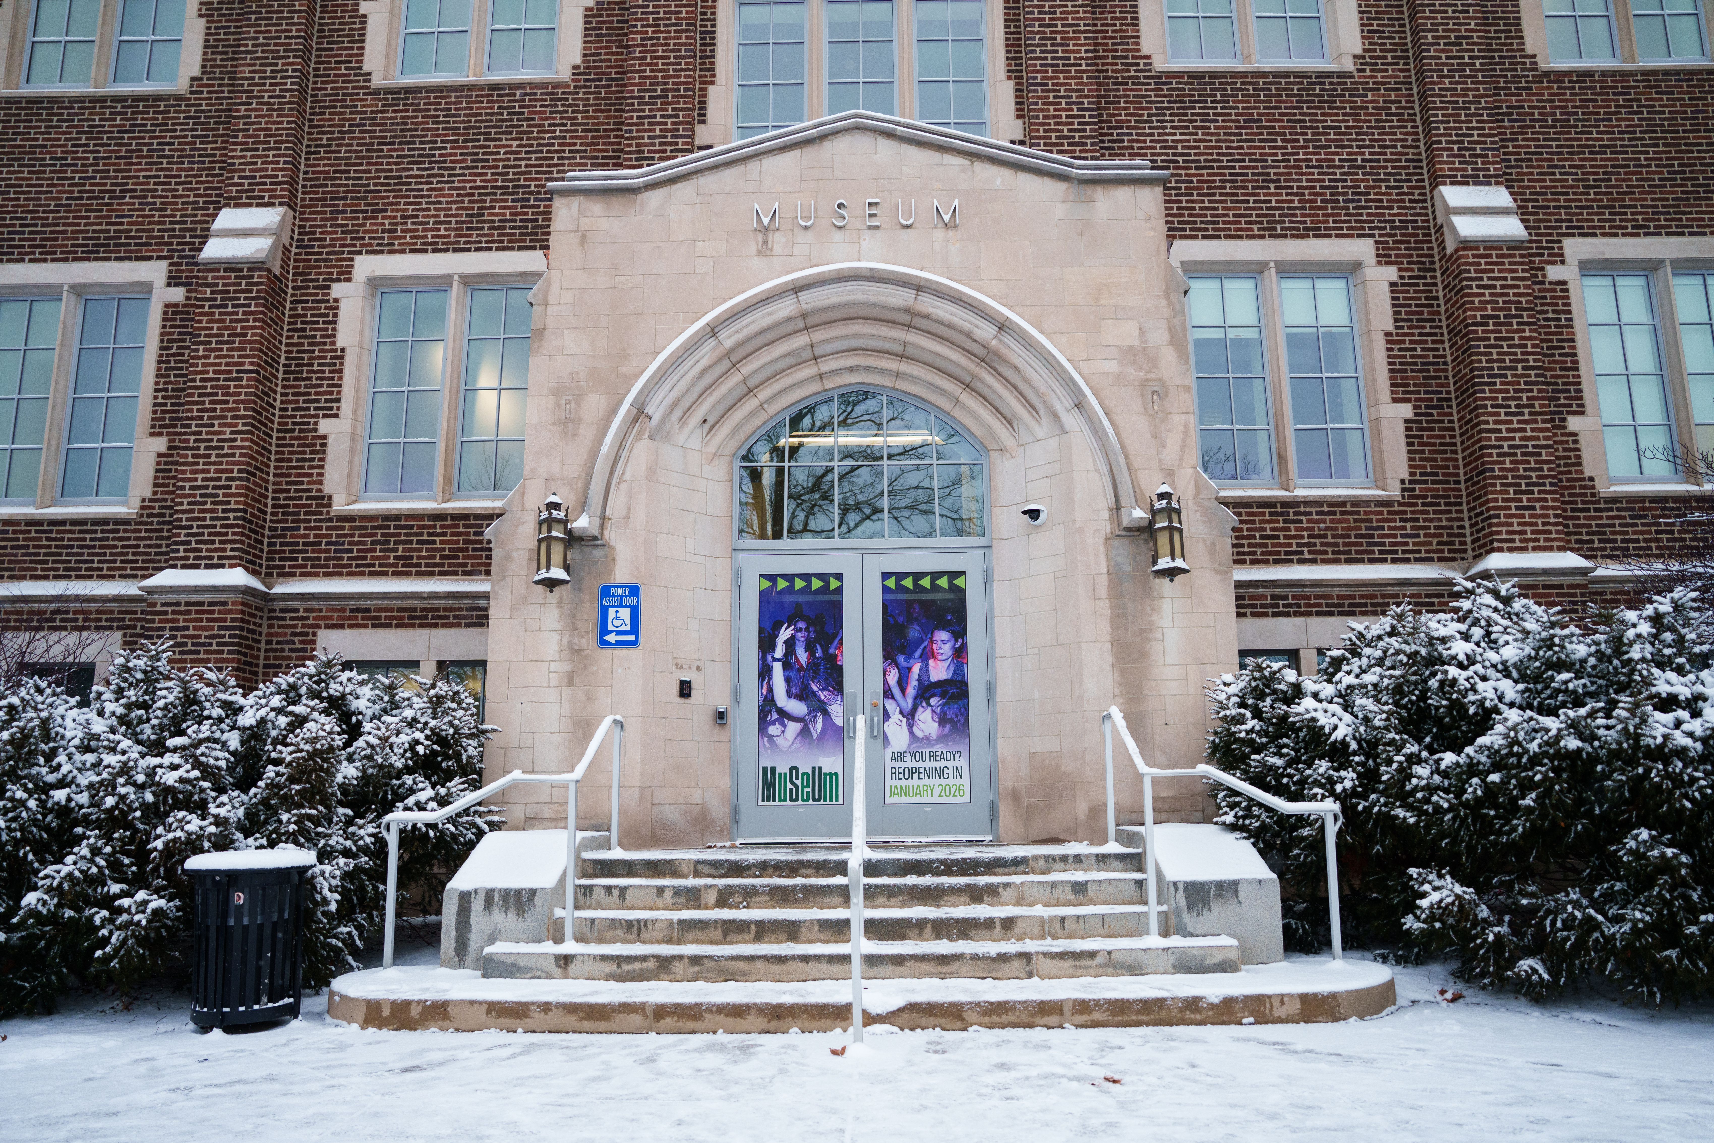
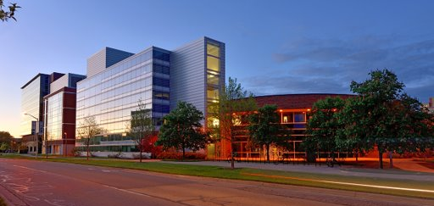
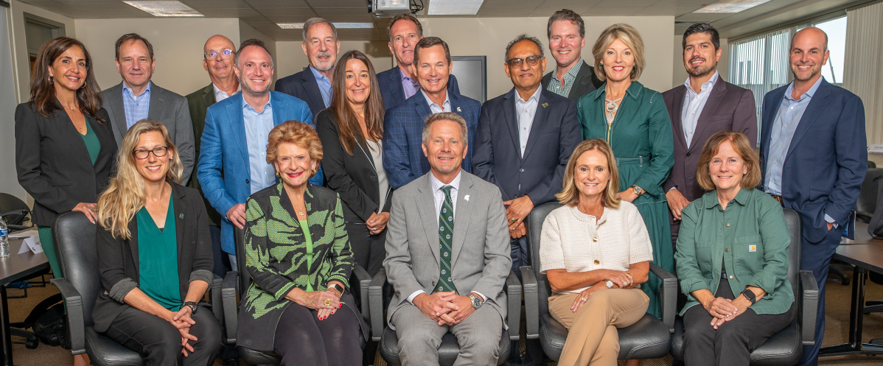
Growing Talent for the Future
Feb 2025, Detroit Innovation Conference

Slide 6

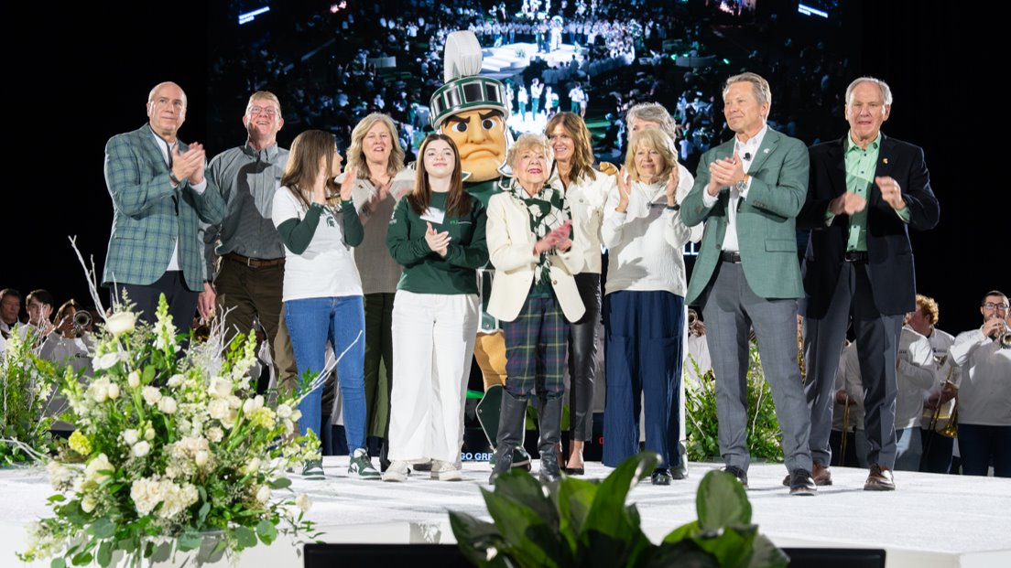
Next Gen Operations and Organization
Feb 2025, Detroit Innovation Conference

Slide 7
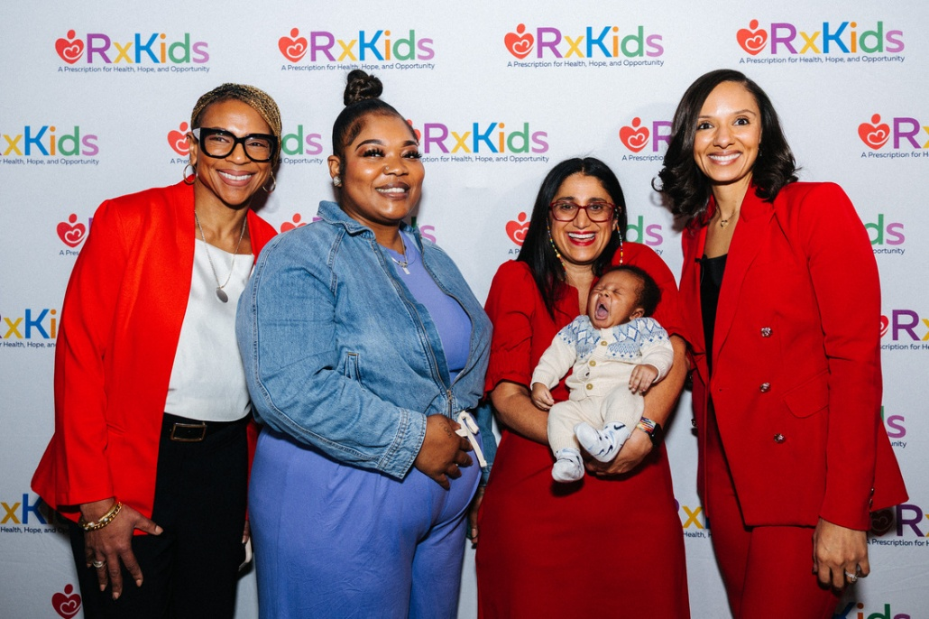
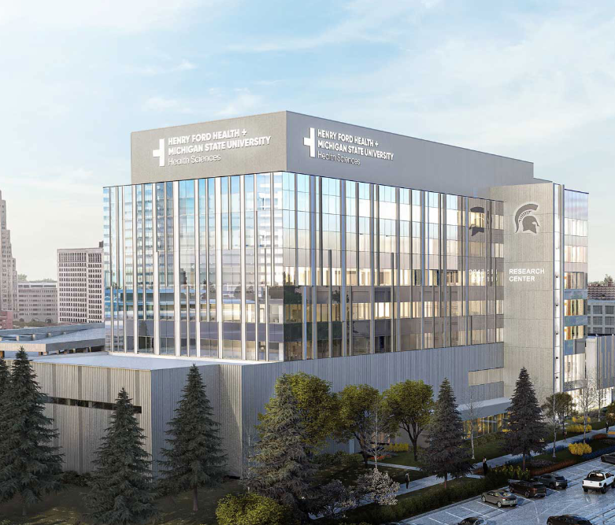
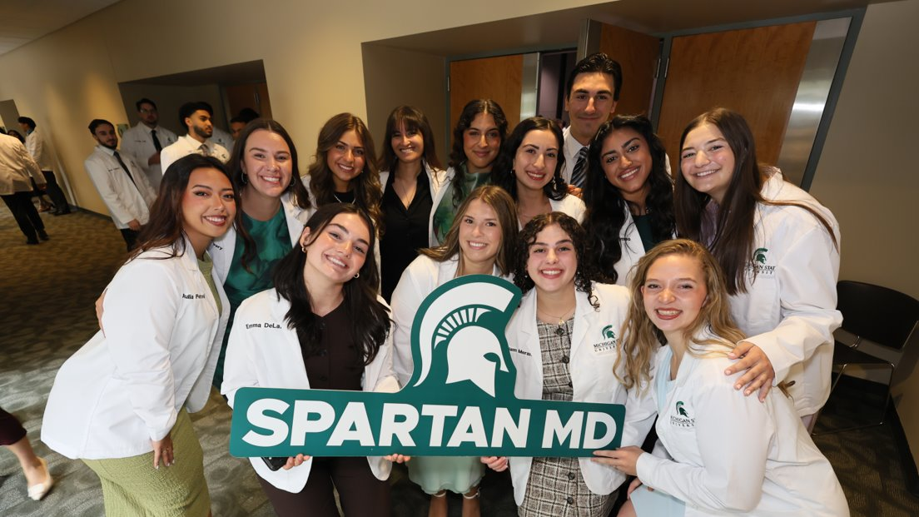
Driving Health Transformation
Feb 2025, Detroit Innovation Conference

Slide 8
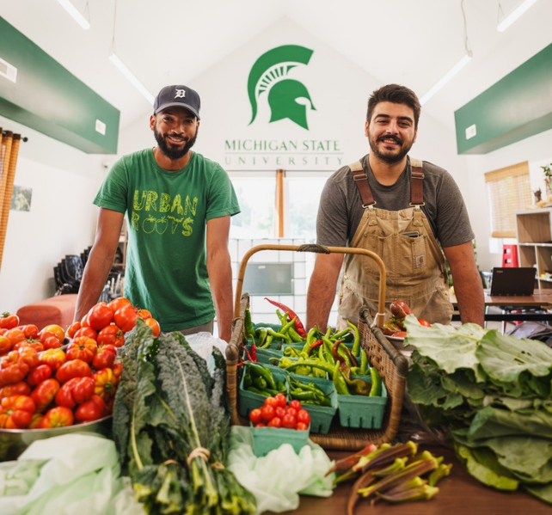
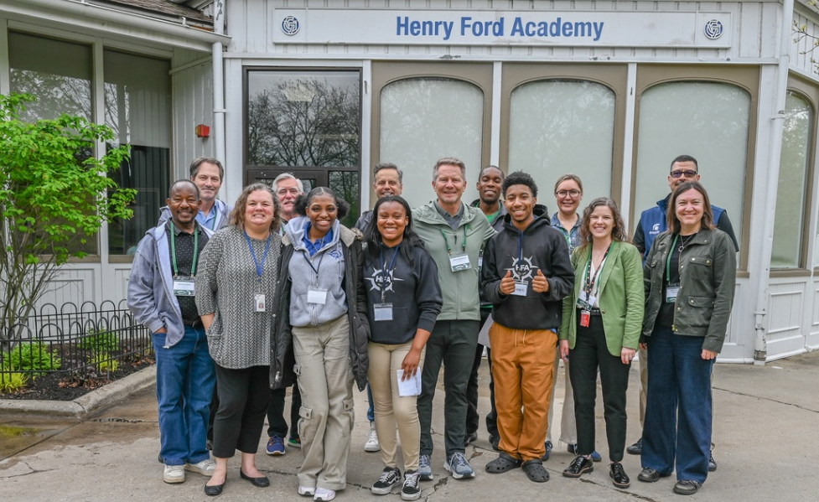
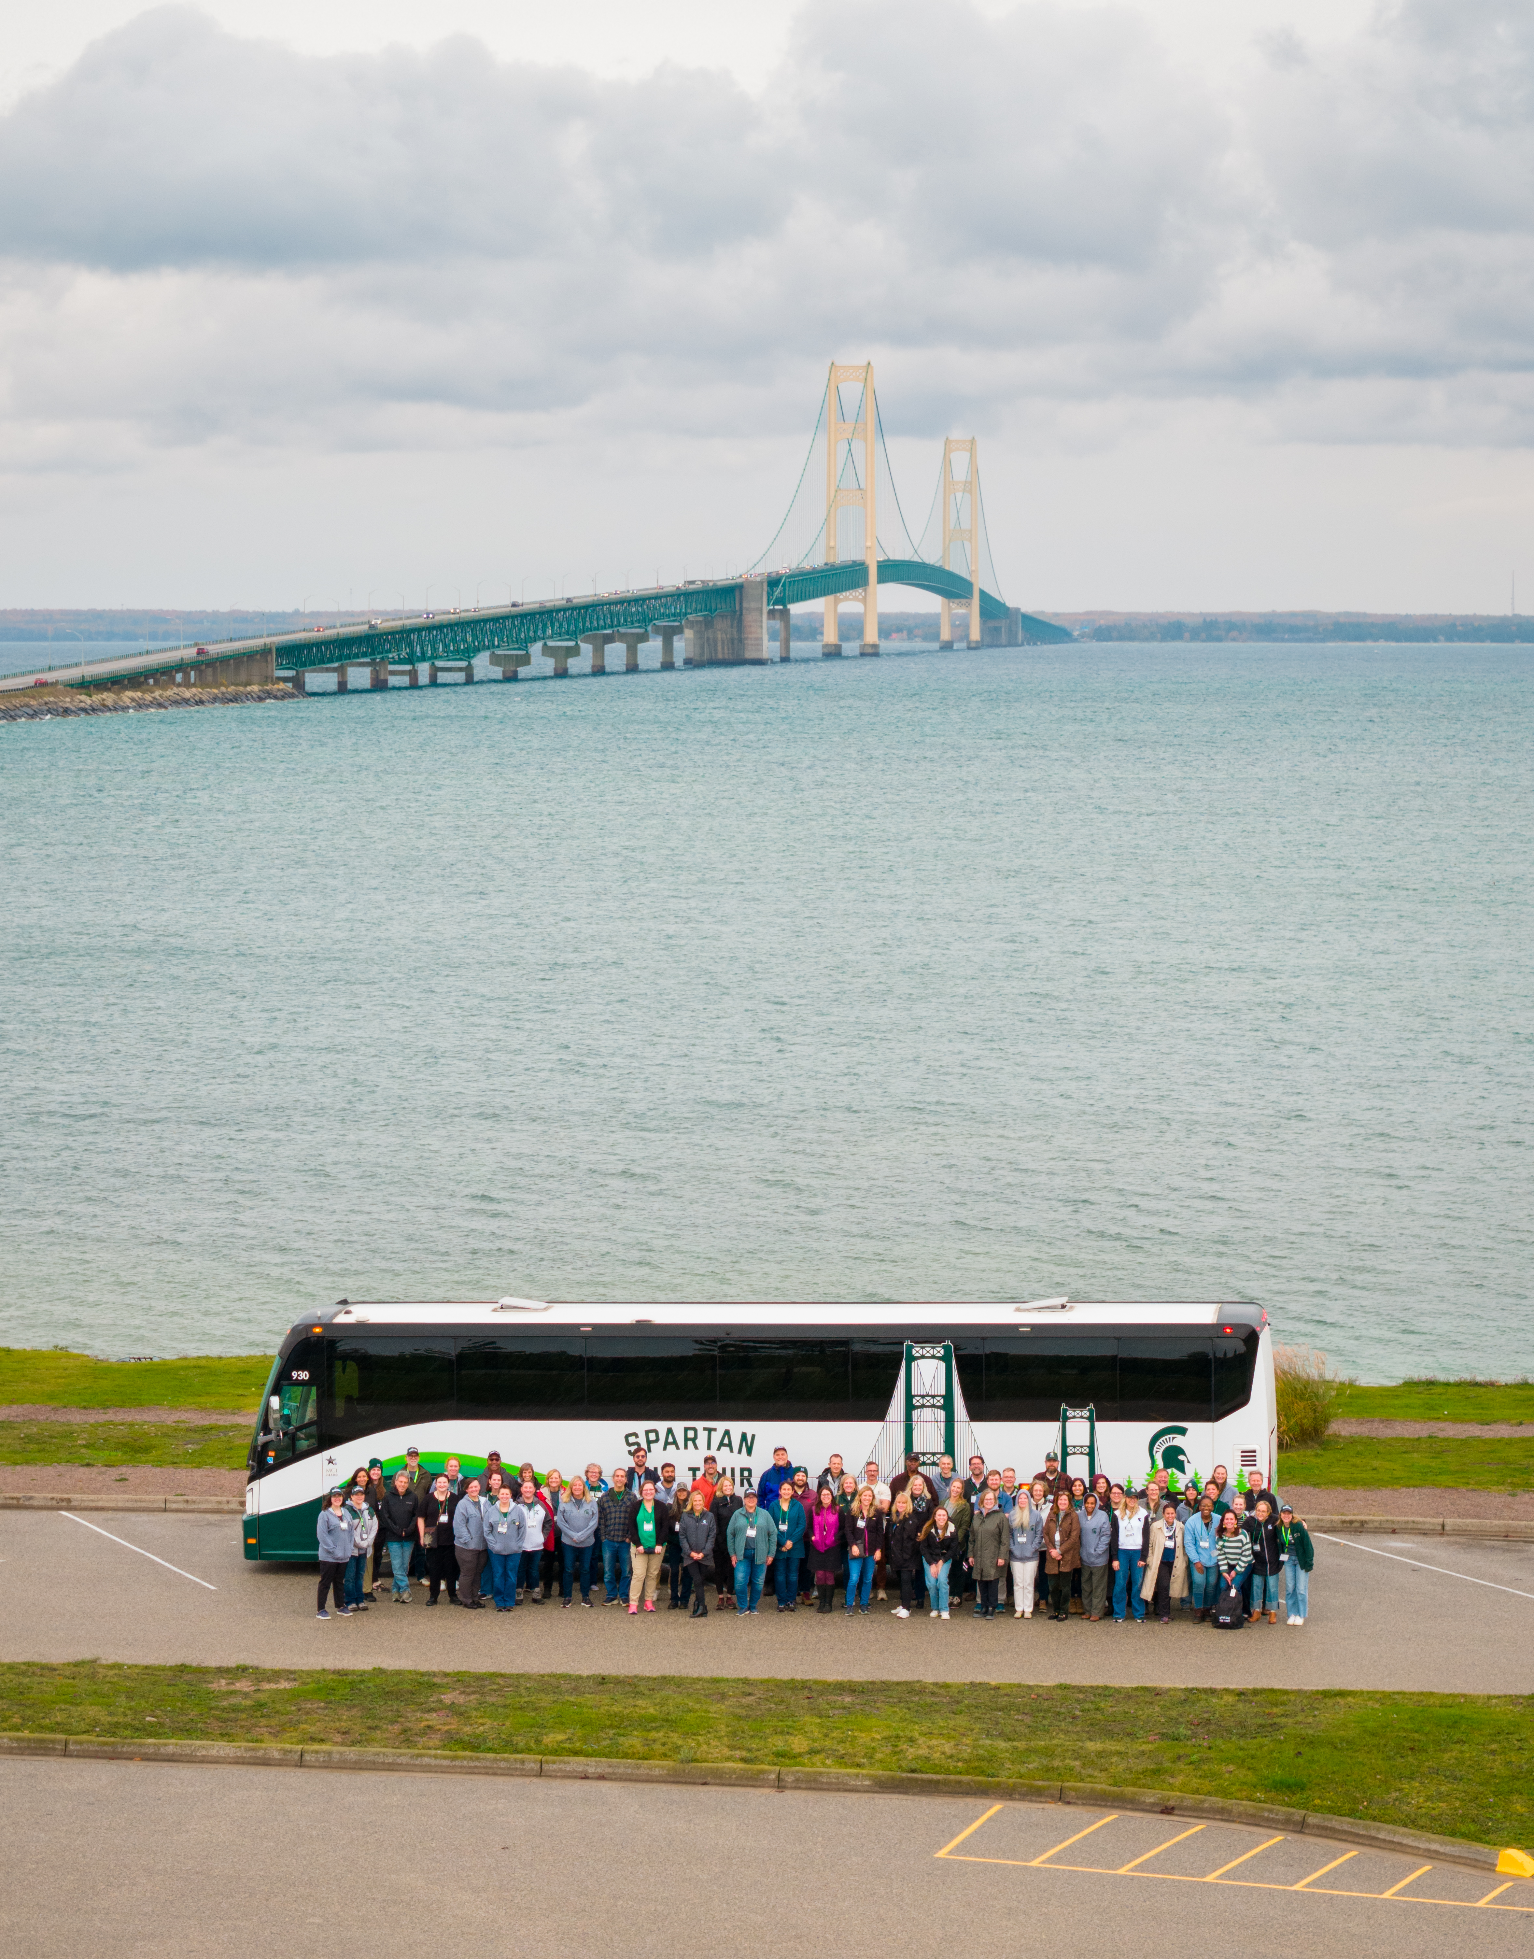
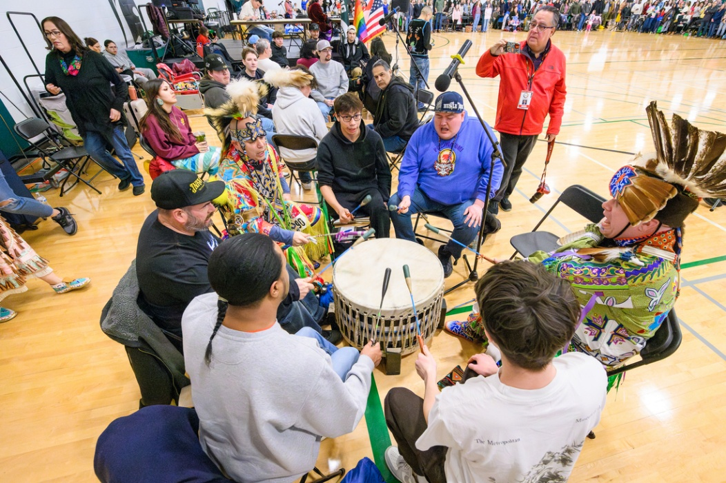

Building Communities
Feb 2025, Detroit Innovation Conference

Slide 9


Growing Trust Among Alumni and Residents
Alumni trust of MSU increased 16 points from 2024 – a new high
Favorability at highest level since 2022
Academic programs, research, athletics, and leadership drove increases in reputation
MSU REPUTATION AMONG
MICHIGAN RESIDENTS
MSU FAVORABILITY AMONG
MSU ALUMNI
-9pts
△ SINCE 2024
=
△ SINCE
2024
+4pts
“Good Reputation” +9pts
Feb 2025, Detroit Innovation Conference
-2pts
+9pts
-2pts

Slide 10
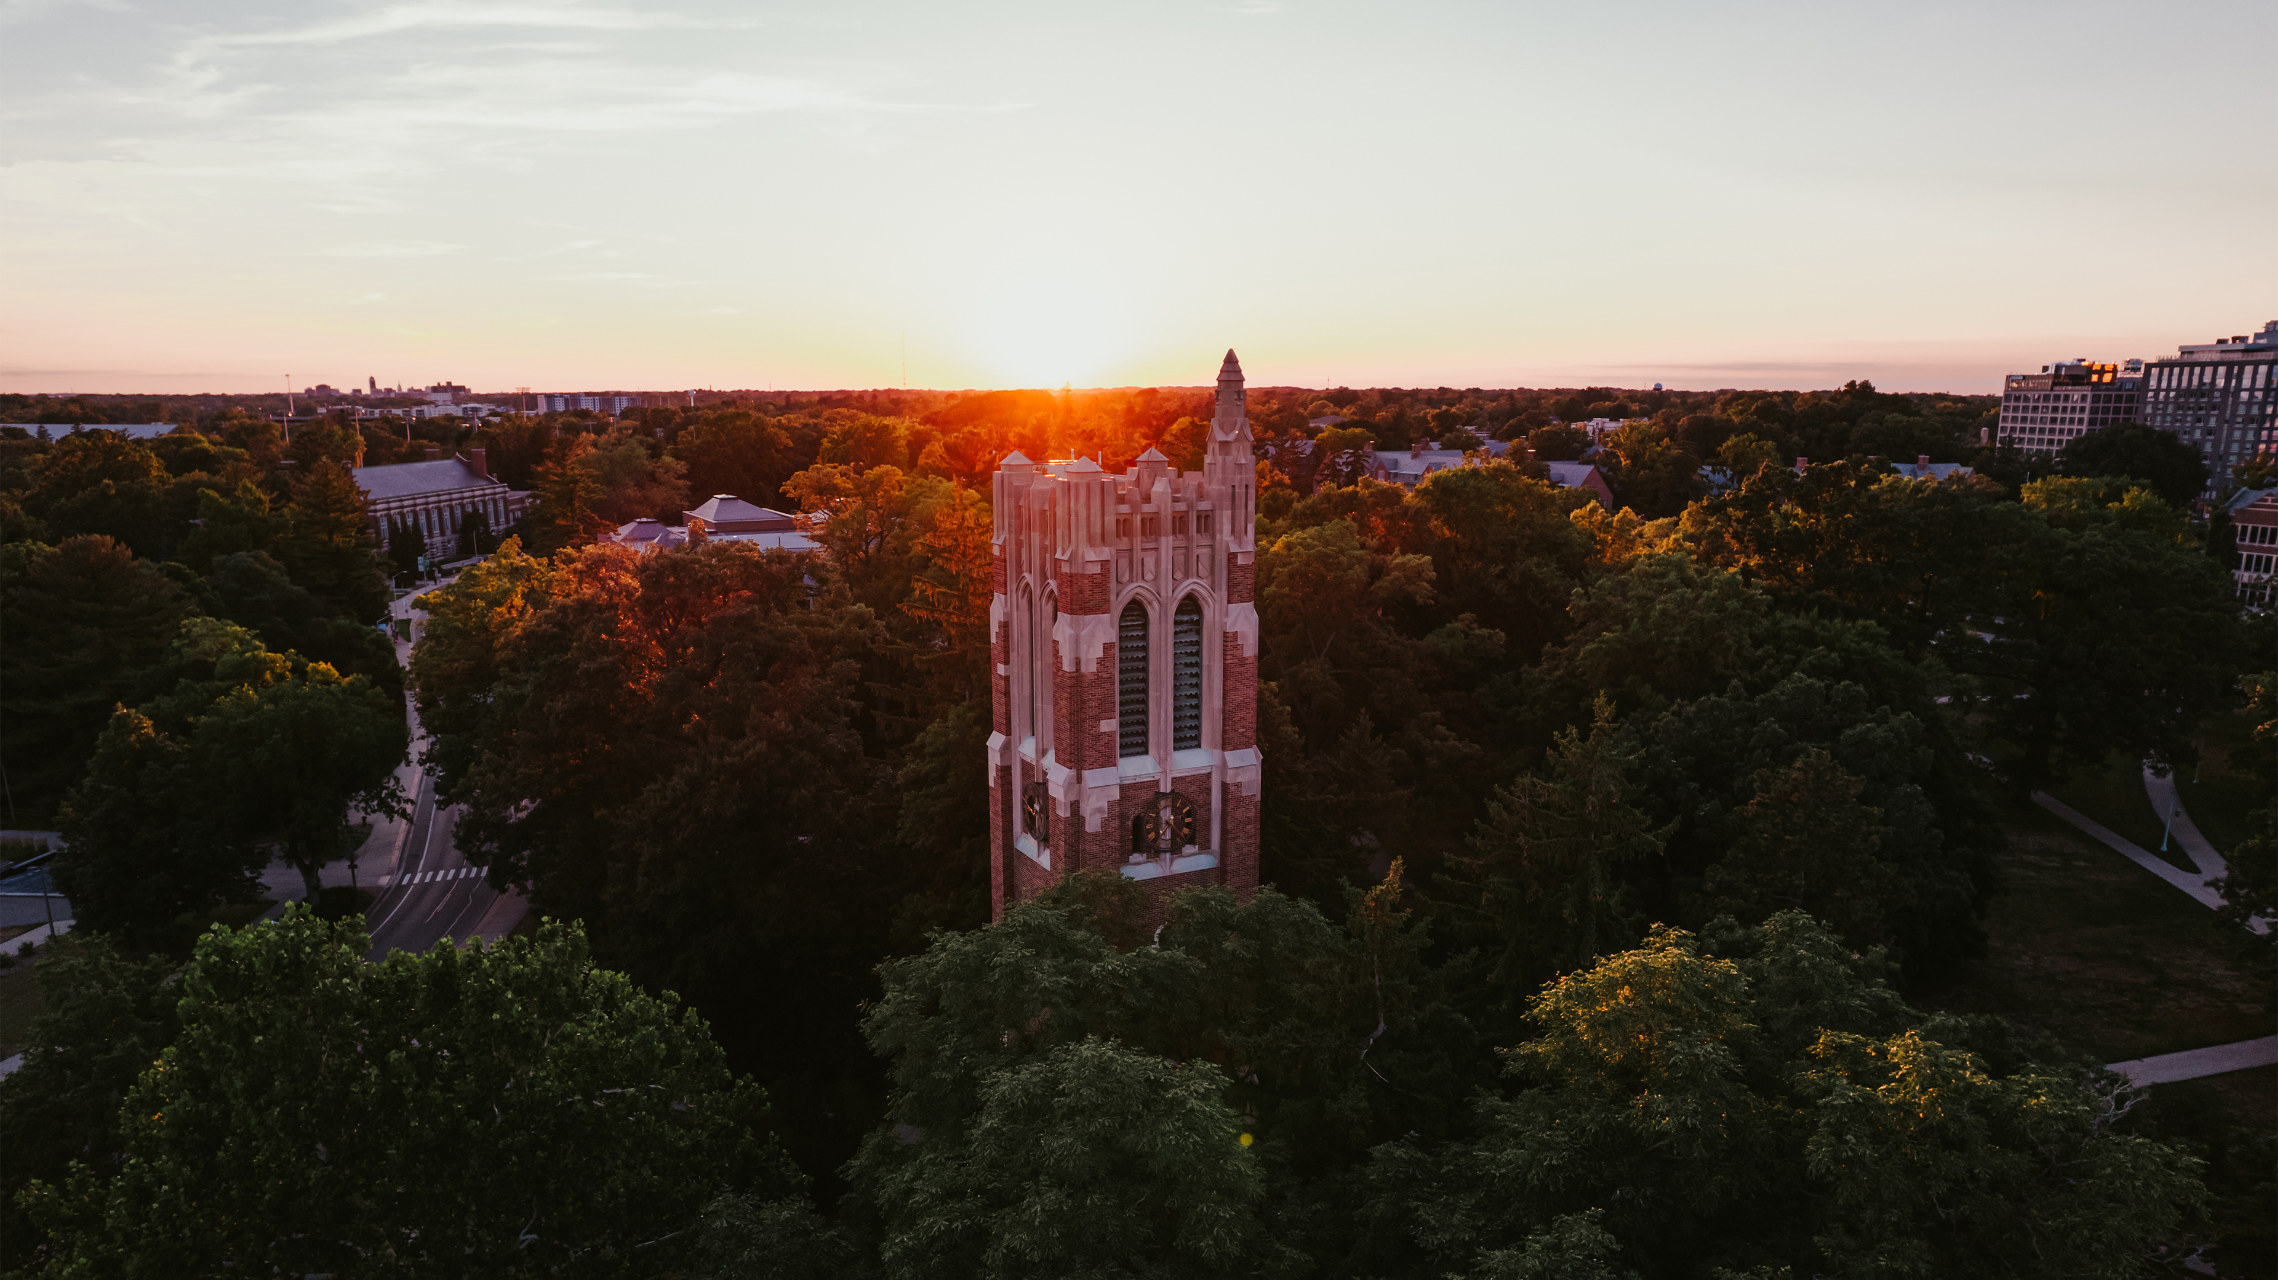
One Team — Thank You!
Feb 2025, Detroit Innovation Conference

Slide 11


