Slide 1
The Joy Project!
Sarah Prior, PhD
Tori Bush, Sociology
April 7, 2026

Slide 2

Sarah Prior, PhD
2
The Joy Project
About Sarah!
Associate Professor, Sociology
Director, Bailey Scholars Program
Joy Seeker
Notes:
Great pleasure and joy to work with amazing students like Tori who heard about the work I was doing on joy and wanted to join the project. Tori has been working with me on this research since January and has brought so much thoughtful insight!

Slide 3

Tori Bush
3
The Joy Project
About Tori!
Major: Sociology
Minors: Leadership of Organizations; Leadership in Integrated Learning
Pursuing Human Resources/Talent
Joy Seeker!

Slide 4
Thank You!!
The Joy Project
Thank You!
Dedicated in loving memory of:
Marilyn Amey
Special thanks to: Cindi Leverich, Kelly Lambert, & Beth Leete
Shout-out for joyful inspiration to: Sonja Fritzsche

Slide 5
On your index card…
Activity
On the other side…
The Joy Project
Activity
Where do you find the most joy at work?
What things hinder your ability to find or create joy at work?
Notes:
If you are on zoom, feel free to post in the chat

Slide 6
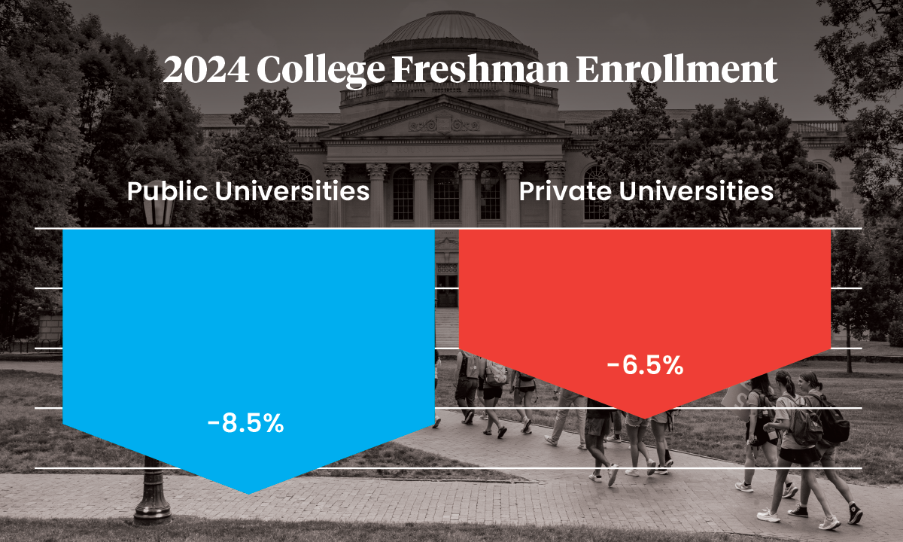




“Unprecedented Times”
The Joy Project
Context
Yikes!

Slide 7
Project
Why Joy?
Why?
The Joy Project
Why Joy?
I set out to see if, and how, academic leaders make space for joy.
Because, as my interviewees claimed, “Joy is the key to our survival and longevity.”
“Without joy, people will wash out - our work will be unsustainable."
Notes:
While some disregard joy as a suitable academic pursuit, the literature is clear that joy is an important aspect of each of our lives and all the parts of our lives. For many of us, we spend a considerable amount of our lives in our workplaces – wouldn’t it be great if we found them places that create joy

Slide 8
AND
Because the world is on fire and we need more JOY!
Notes:
Period. Full stop. We all need more joy.

Slide 9
How can we infuse joy?
What the literature says about joy
The Joy Project
Literature
Intentionally seeking joy can be an act of defiance
Most of our work environments are not created to intentionally spark joy
We have an inherent inclination to seek joy, but we have been taught to ignore it (much like our imagination
The competitive individualistic nature of academia shapes how we experience joy
Create environments that have buoyancy
Create workplace environments (physical environments) that foster joy
Be intentional
Notes:
For example – my interviewees often talked about one thing that brought them joy was the view from their office window. My view is of the Ag Hall Dumpsters.

Slide 10
n=27 completed
…more to come!
Purpose
Methods
The Joy Project
Methods
Sample
To uncover if, and how, university academic leaders think about creating joy in the spaces they lead.
Executive Management
Deans and Assoc./Assist. Deans
Department Chairs
Program Directors
Notes:
Conducted zoom interviews that last 30-45 minutes
Asked questions about their academic leadership journey, how they define joy in leadership, what makes for opportunities for joy, are their hurdles, etc.

Slide 11
FINDINGS!
9
The Joy Project
Findings

Slide 12
How did participants define joy?
Joy is…
Joy is…
Joy is…
Joy is…
Joy is…
Joy is…
The Joy Project
What is Joy?
Community
Connection
Belonging
Connectivity
Intentional
Being Curious
Enjoying the Work
FUN!
Freedom to be in the Moment
Freedom to be Vulnerable
Personal passion infusing into professional practice
Aligning with Values
One of the things that is fundamentally human about us
Boundaries
Celebration
Recognition
Appreciation
Colorful

Slide 13
How is joy experienced?
Joyful Experiences
Joyful Experiences
Joyful Experiences
Joyful Experiences
Joyful Experiences
Joyful Experiences
The Joy Project
Joyful Experiences
Helping + Serving Others
Making a Difference
Seeing Work Succeed
Teamwork
Problem-Solving
Collaboration
Collective Achievements
Student Success, Developments, and Achievements
Recognition
Intentionality
Celebrating Others’ Milestones
Work Environment/Culture/Climate
Positivity/Optimism in Challenges
Everyday Micro-Moments of Joy
Real Human Connection
Feeling Supported/Valued

Slide 14
What hinders creating space for Joy?
What Hinders Joy?
What Hinders Joy?
What Hinders Joy?
What Hinders Joy?
What Hinders Joy?
What Hinders Joy?
The Joy Project
Hinders
Cynicism
Hierarchy
Disconnection
Bureaucracy
Conflicting Values
(especially when things require us to move away from our values)
Decentralization
Living through horrifying and enraging times
Hard to be joyful when they are defunding what you do!
Voice is Undervalued
Some people are jerks
Joy does not register on central’s radar
Excessive Workload/Burnout
Lack of Human Connection
Unaligned Expectations
Recognition without Compensation
Demoralization…which is the antithesis of joy

Slide 15
Joy. Matters.
We. Need. Joy.
So What?
The Joy Project
So What??
Most believed the structure of the university was not designed for joy.
Centering joy, especially in times of crisis, is an act of rebellion.
Joy is defiance.

Slide 16
Academic Leadership
Other Takeaways
Focus on Individualism
The Joy Project
Takeaways
The majority of respondents thus far have described their journey to academic administration and leadership as “unplanned.”
Higher education promotes a focus on the individual - this damages the culture because it negates the community.

Slide 17

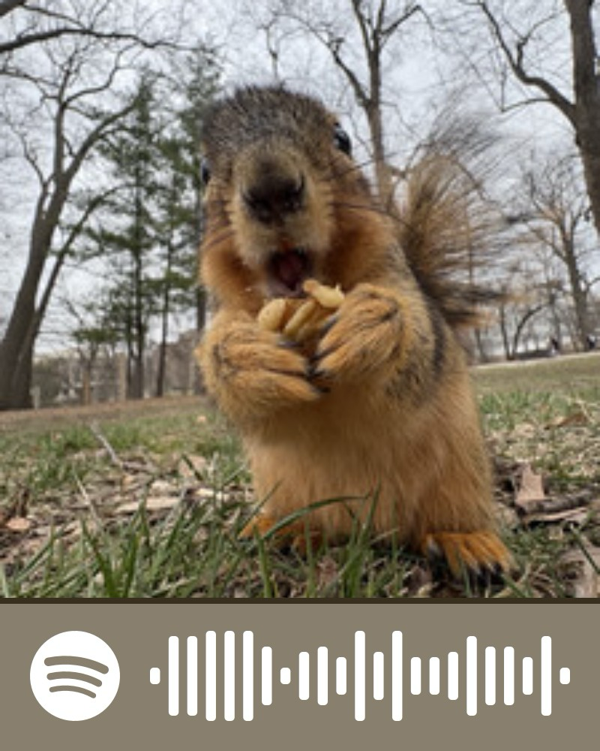
The Joy Project
Superstition – Stevie Wonder
Love & Hate – Michael Kinwanuka
The Girl from Ipanema – Astrud Gilberto
Dies Irae – Karl Jenkins
Anything by Earth, Wind & Fire
Walk like an Egyptian – The Bangles
They Not Like Us – Kendrick Lamar
Anything by Dolly Parton
Truth Hurts – Lizzo
Happy – Pharrell Williams
Waltz – Joann Strauss
Uptown Funk Remix – Mark Ronson & Bruno Mars
The 59th Bridge Street Song – Simon & Garfunkel
Carmina Burana – Carl Orff
Beethoven 9th and 7th
Anything by Prince
River Deep Mountain High – Tina Turner
Sir Duke – Stevie Wonder
Nothing Matters when We’re Dancing – The Magnetic Fields
Midnight Radio – Hedwig and the Angry Inch
Everyone Knows this is Nowhere – Neil Young & The Crazy Horse Band
My Third House – Kings of Leon
I Could Never Take the Place of Your Man – Prince
How I Feel – SOLHOT We Levitate
Terrapin Station – The Grateful Dead
Lost – Bailey Zimmerman (Ft. The Kid LAROI)
I Just Might – Bruno Mars
Playlist
Scan with Spotify App
Access Using Link

Slide 18
Reading List
The Book of Delights – Ross Gay
Joyful – Ingrid Fetell Lee
Unearthing Joy – Gholdy Muhammad
Rooted in Joy – deonna smith
Inciting Joy – Ross Gay
Playful Leadership – Rina Zitser
Generous Thinking – Kathleen Fitzpatrick
Leading with Joy – Akaya Windwood & Rajasvini Bhansali
Radical Inclusion – David Sengeh
Critical Hope – Kari Grain
Radical Happiness – Lynne Segal
Suggested items

Slide 19
Aesthetics of Joy
Energy – vibrant color and light
Abundance – lushness, multiplicity, and variety
Freedom – nature, wildness, and open space
Harmony – balance, symmetry, and flow
Play – circles, spheres, and bubbly forms
Surprise – contrast and whimsy
Transcendence – elevation and lightness
Magic – invisible forces and illusions
Celebration – synchrony, sparkle, and bursting shapes
Renewal – blossoming, expansion, and curves
The Joy Project
Aesthetics

Slide 20
What’s Next??
MORE JOY!
And suggestions for creating joy in your own spaces.
Notes:
What can you do?
Create space where people feel safe to be vulnerable
Create opportunities for connection
Recognize your people – nominate them for awards, iTeachMSU, etc
Examples: CIS International Happiness day table

Slide 21
What questions do you have??

Slide 22
